Slide 1

Sustainability: the investor view
Jennifer Coulson| bcIMC| June 15, 2017
Notes:
This slide uses the Layout: “Title Slide (option 2)”
This title slide works well for presentations relating to vision, future, planning, infrastructure, long-term planning, business plan

Slide 2
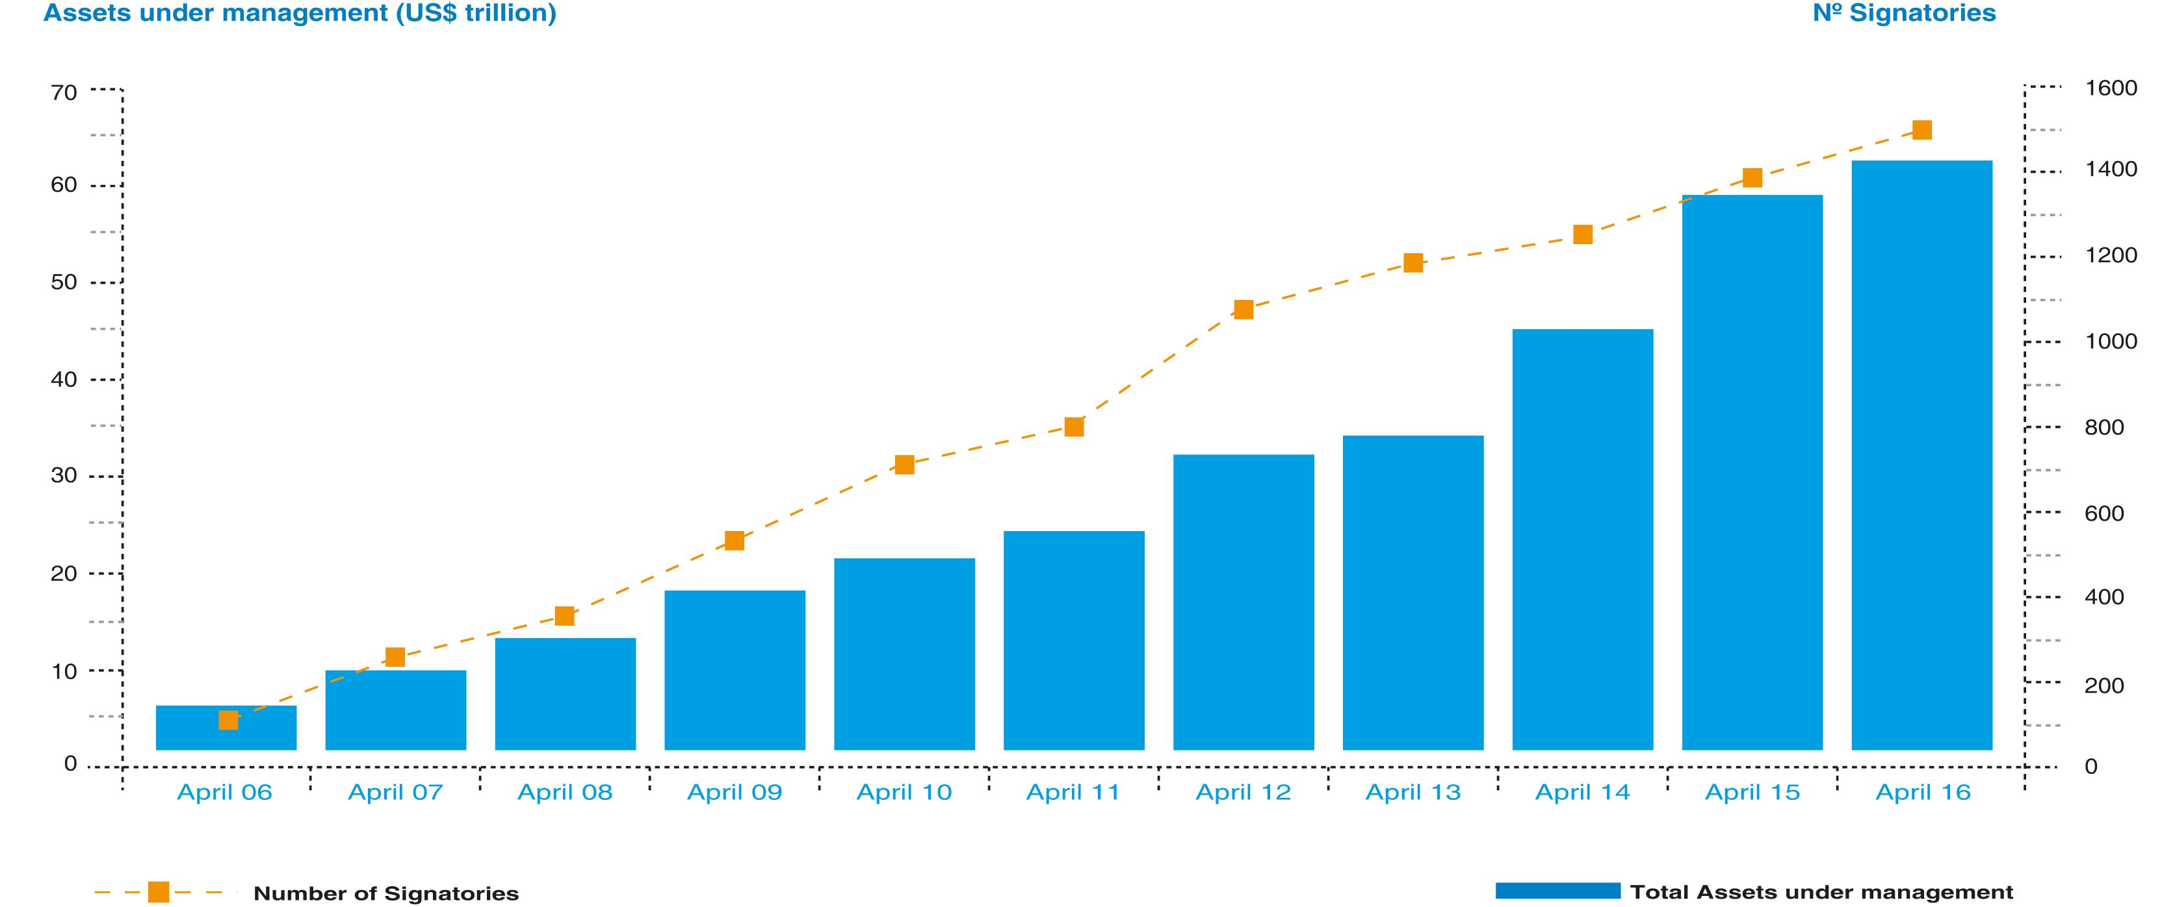
Investors are Committing to ESG
Notes:
This slide uses the Layout: “Title and Content”
POWERPOINT TIP: Need to organize your information but find you are overusing bullets? Review the next set of slides to see different approaches that use icons and photos for an interesting and professional look.
Think of your bullets as newspaper headlines. Keep them succinct as possible.

Slide 3
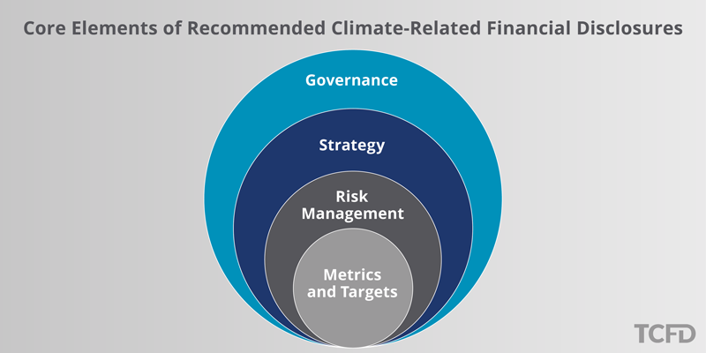
Advancing Climate Risk Disclosure
Notes:
This slide uses the Layout: “Title and Content”
POWERPOINT TIP: Need to organize your information but find you are overusing bullets? Review the next set of slides to see different approaches that use icons and photos for an interesting and professional look.
Think of your bullets as newspaper headlines. Keep them succinct as possible.

