Slide 1
Hot topics in tax
Financial Executives International Canada Halifax, NS – June 12, 2018

Slide 2
Hot topics in tax Disclaimers
This material has been prepared for general informational and educational purposes only and is not intended, and should not be relied upon, as accounting, tax or other professional advice. Please refer to your advisors for specific advice.
This presentation is © 2018 Ernst & Young LLP. All Rights Reserved.

Slide 3
Hot topics in tax Discussion points
From BEPS* (2013) to US Tax Reform (2018): The last five years in tax
Changing the rules: The new fiscal paradigm in North America
At a glance: The US Tax Cuts & Jobs Act
Effects on Canadian businesses and the Canadian economy
Strategic considerations and the future of tax planning
Canadian policy response: What’s next?
* OECD Base Erosion and Profit Shifting Action Plan (2012-2015, ongoing)

Slide 4
Hot topics in tax Panelists
Dr. Jack Mintz National Policy Advisor at EY
Waël Tfaily EY, Partner Transfer Pricing Services
Adam Mendes
OMERS

Slide 5
The new fiscal paradigm: What happened?
From BEPS (2013) to US Tax Reform (2018): A brief history of the last five years in tax.

Slide 6
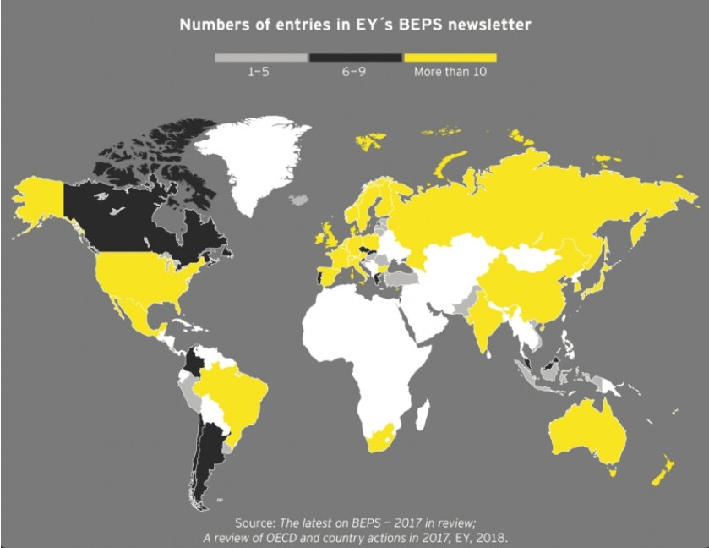
Macro perspective BEPS-reform adoption tracker

Slide 7
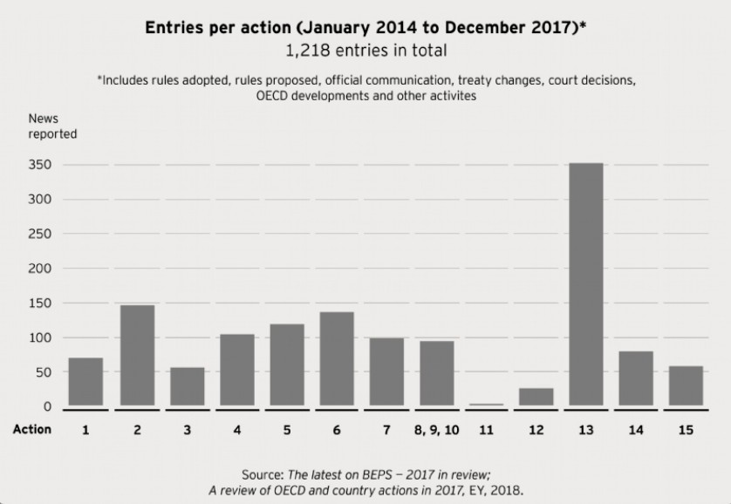
Macro perspective BEPS-reform adoption tracker
BEPS action items:
Digital Economy
Hybrids mismatches
Effective CFC rules
Interest deductions
Harmful tax practices (transparency/substance)
Treaty abuse
Permanent Establishment status
Transfer pricing
Transfer pricing
Transfer pricing
BEPS data analysis
Disclosure of aggressive tax planning
Transfer pricing documentation
Dispute resolution
Multilateral agreement

Slide 8
Macro perspective Tax Reform and the US agenda
‘Make America Great Again’ by..
Impact on interest rates → Increase
Notwithstanding monetary policy tightening signals from the Fed, federal budget deficits and public debt are expected to increase, push-up interest rate premiums (further pushing up USD).
Cutting corporate taxes
Using taxation to improve US competitiveness relative to its trading partners
Increase after-tax rates of returns
As an incentive to invest in America
Renegotiate trade agreements
By leveraging US dominance in global trade to ‘win on trade’
Impact on USD → Uncertain
The US protectionist agenda is expected to increase US capital stock and cash repatriation into the US pushing up the USD (and potentially, depressing US exports). However, worries of increased budget deficits and federal debt puts downward pressure on the USD countering the upward effect.
Strengthen US position through bilateral trade ‘deals’
Increase investment activity
Impose special tariffs
Impact on tax controversy → Increase
The increased risk of budget deficits and public debt will add pressure on the IRS to collect revenues from US based-multinationals and to monitor cross-border transactions. A corresponding increase of attention from the CRA is also expected, raising the probability of tax audit and controversy on cross-border transactions.
Increase US capital stock
Increase US jobs
Increase real wages
Increase productivity

Slide 9
Macro perspective At a glance: US Tax Cuts & Jobs Act
GILTI Tax
Imposes a minimum tax on excess income of foreign subsidiaries (aka Global Intangible Low-Taxed Income (GILTI)), over a certain routine return (10%) on tangible business assets.
Repatriation tax
One-time “Transition Tax” on non-repatriated earnings and impose a 15.5% tax on liquid assets and/or 8% otherwise.
The ‘BEAT’ tax
Base Erosion Anti-Abuse Tax (“BEAT”), a minimum tax on certain payments made to a foreign affiliate (otherwise deductible) such as management fees, royalties, etc.
Encourages US repatriation of cash
AMT repeal + CAPEX expensing
Repeals the Alternative Minimum Tax (“AMT”) and allows 100% expensing of capital asset expenditures, old and new, for 5 years.
Discourages intangible return in low tax jurisdictions…
Discourages cross-border payments outside the US
FDII Tax
Imposes a 13.125% tax (increases in 2026) on excess returns earned directly by a US company from foreign revenues from intangible (aka Foreign-Derived Intangible Income (“FDII”)).
Encourages immediate investments in US
… and encourages R&D activity in the US
Discourages cost push-down, and encourages income shifting to the US
Corporate federal rates at 21%
Cutting corporate federal tax rates from 35% to a flat rate of 21%.
Increases the competitiveness of, and discourages the movement of workforce out of the US
Reduce taxes on personal income
Reducing tax brackets and overall taxes on lower and middle income taxpayers
Anti-hybrid rules
Denial of deductions for certain hybrid payments in respect of interest and royalties.
Limitations on interest deductions
To 30% of EBITDA (up to Jan 1, 2022), and of EBIT thereafter.

Slide 10
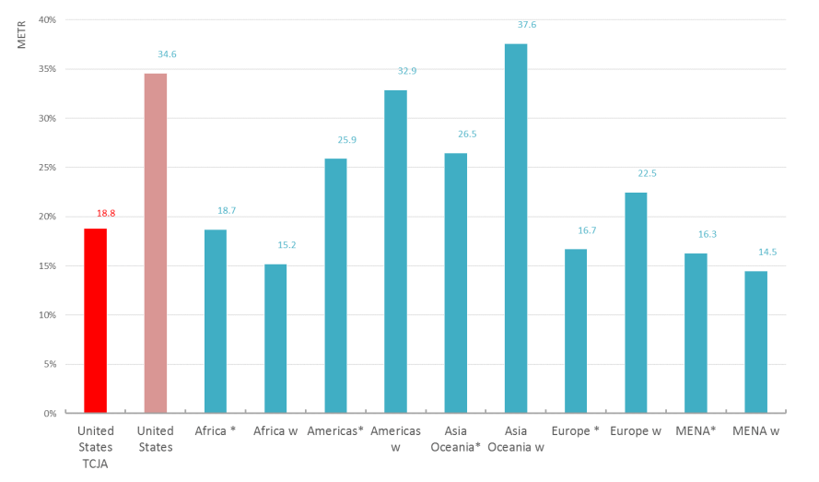
Macro perspective Tipping the fiscal scale
2017 METR by Region in comparison to U.S. METR (pre-and post-reform)
Note: * denotes a simple average / w denoted a weighted average

Slide 11
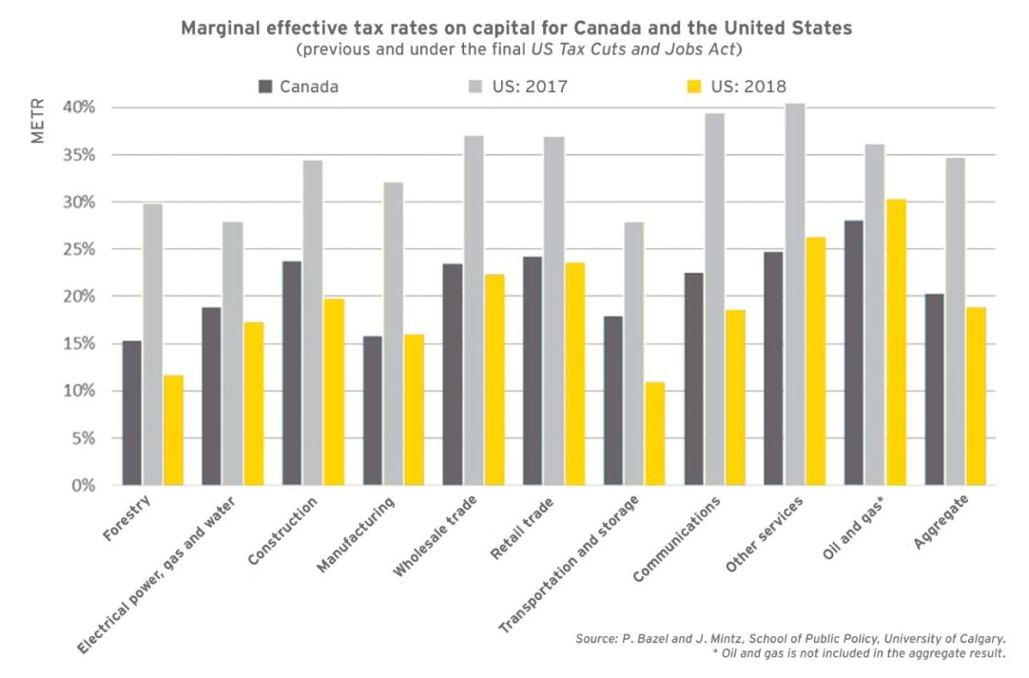
Macro perspective Tipping the fiscal scale

Slide 12
How is Canada reacting to it?
Views from top executives: Capital Allocation and Canadian Competitiveness Survey (June 2018)

Slide 13
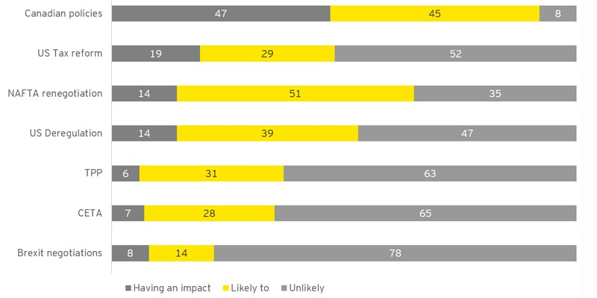
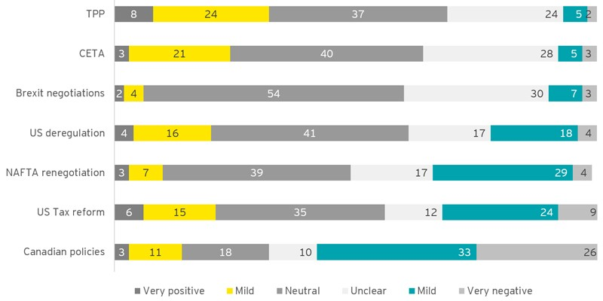
The new fiscal paradigm in North America Impact on Canadian business plans
Q
Impact on you business plans?
Q
Likely impact on your company?

Slide 14
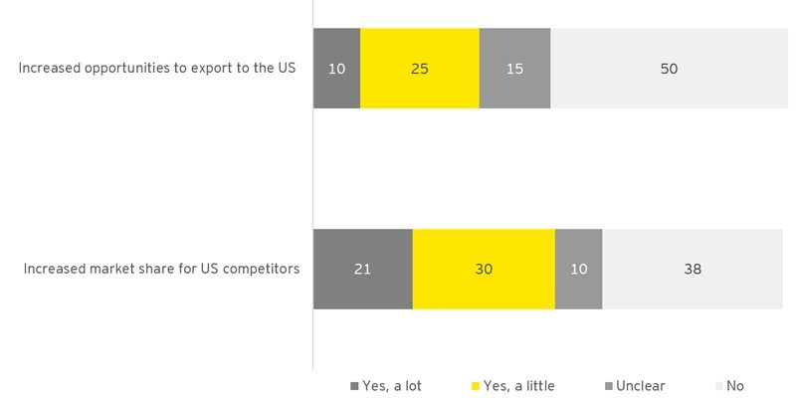
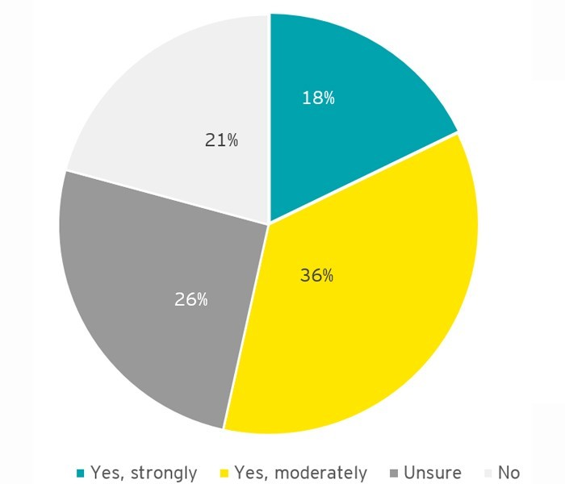
The new fiscal paradigm in North America Impact on Canadian business plans
Q
Likely impact of US tax reform?
Q
Shift of risks, functions or revenues to the US from Canada?

Slide 15
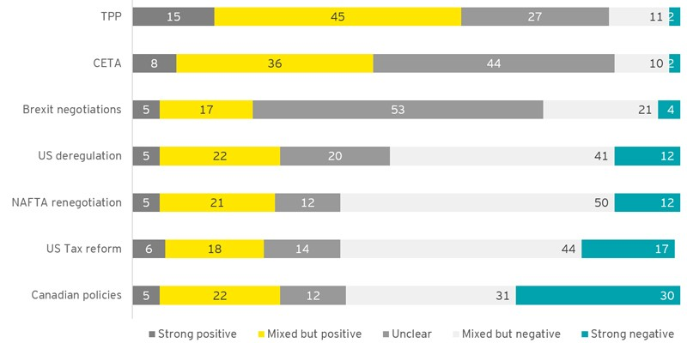
The new fiscal paradigm in North America Negative impact on the Canadian economy
Q
Impact on the Canadian economy?

Slide 16
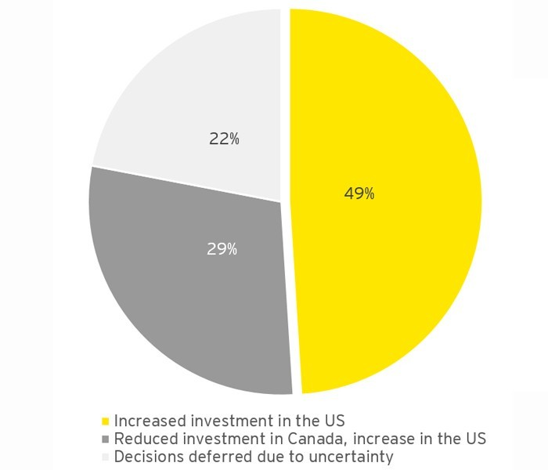
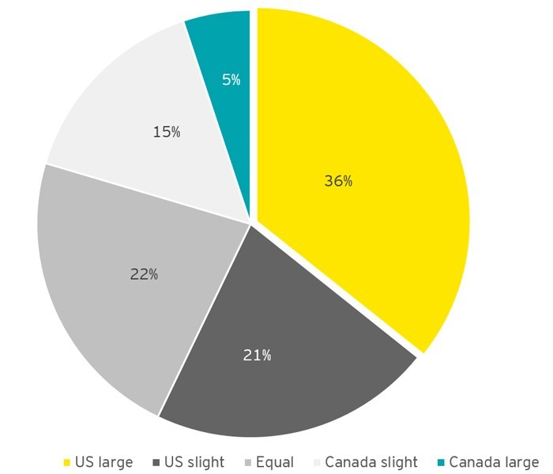
The new fiscal paradigm in North America Negative impact on the Canadian economy
Q
US Tax Reform: Most likely impact on your plans?
Q
Which country will have an advantage for the talent you need?

Slide 17
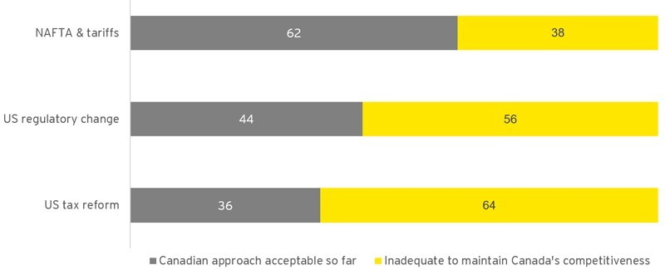
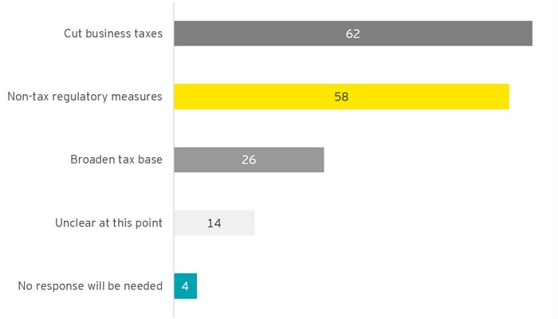
The new fiscal paradigm in North America Policy response from the Canadian Gov.
Q
How do you feel about the approach Canadian authorities are taking?
Q
What type of response will be needed by Canada?

Slide 18
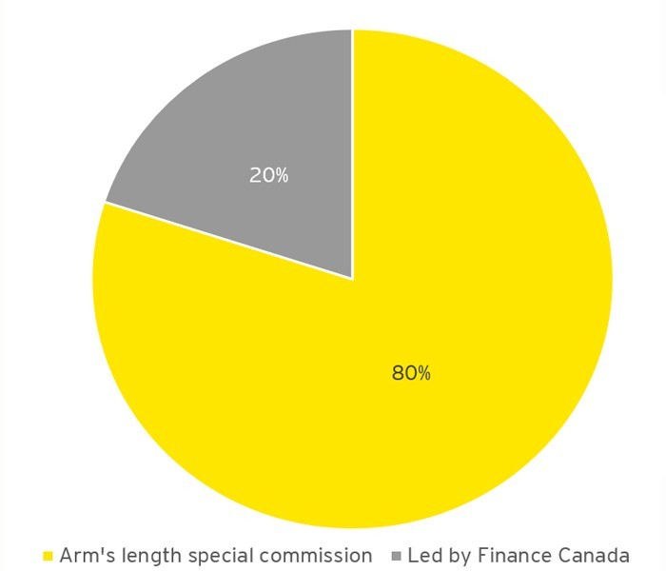
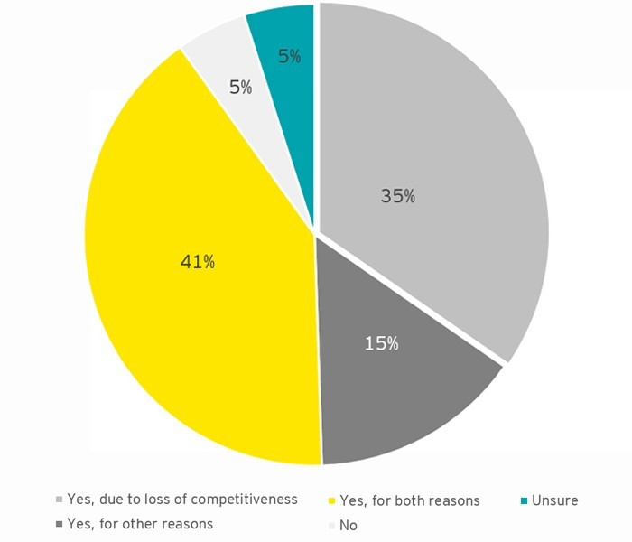
The new fiscal paradigm in North America Support for comprehensive tax policy review
Q
Is a comprehensive tax review needed in Canada?
Q
Should a comprehensive tax review be done by Finance Canada or an outside expert commission?

Slide 19
The US perspective by contrast
How are US companies planning to deploy capital in light of tax savings: The Dollar Deployment survey (February 2018)

Slide 20
Dollar Deployment survey (US) Impact of US TCJA on US companies
Q
As a result of tax savings from the Tax Cuts and Jobs Act (TCJA), the Dollar Deployment survey showed:
73% of companies plan to accelerate M&A
*48% are willing to pay more to acquire a business
Top 3 ways companies plan to use savings:
89% plan to enhance employee compensation
66% are likely to pass savings to consumers
47%
46%
42%
75% plan to increase manufacturing in the US
69% are likely to repatriate overseas funds
Pursuing mergers and acquisitions
Returning capital to shareholders
Increasing research and development
* Percentage of respondents who plan to use tax savings for M&A

Slide 21
Dollar Deployment survey (US) Plans for US tax savings
Q
How will your company use the savings that are expected to result from the recent US tax reform legislation in 2018 as part of your capital allocation strategy?
Increasing research and development (R&D) efforts
Returning capital to shareholders (ROC)
Pursuing mergers and acquisitions (M&A)
Increasing capital expenditure (CapEx), such as by updating technology or expanding facilities
Creating more jobs
Paying down debt
Increasing salaries
Paying bonuses
None of these
My company will not be impacted by the recent tax reform legislation

