Slide 2
“From Wall Street to Bay Street”
2:15 – 3:15 p.m., Thursday, June 6th, 2019
Blue Mountain, Ontario

Slide 3
Trailer –”Wall Street to Bay Street”
https://vimeo.com/279475717

Slide 4


Slide 5


Slide 6


Slide 7
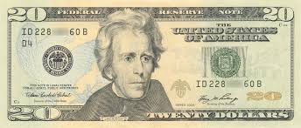
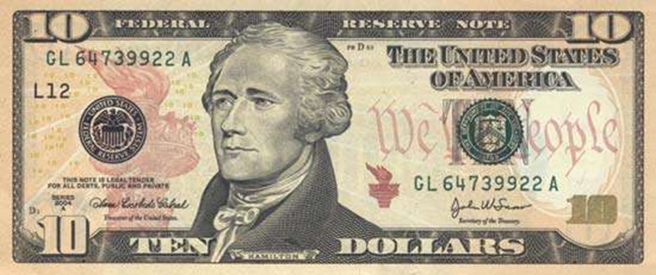

Slide 8
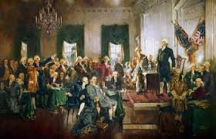

Slide 9
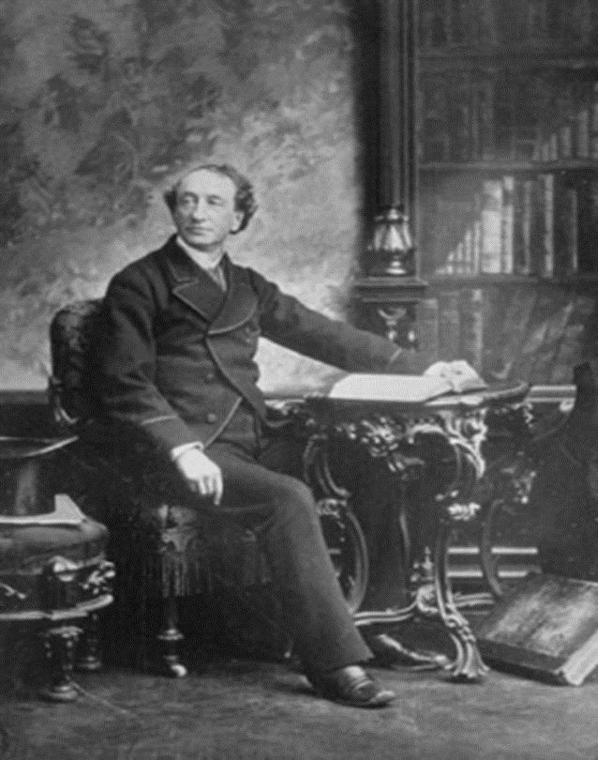

Slide 10
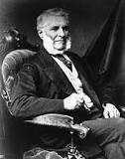
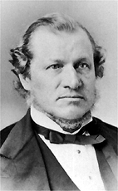
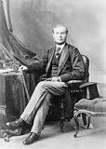

Slide 11
Canada. USA Comparison GDP per capita, 1871-1981
Year | Can | USA
1871 | 100 | 100
1926 | 255 | 286
1981 | 655 | 559

Slide 12
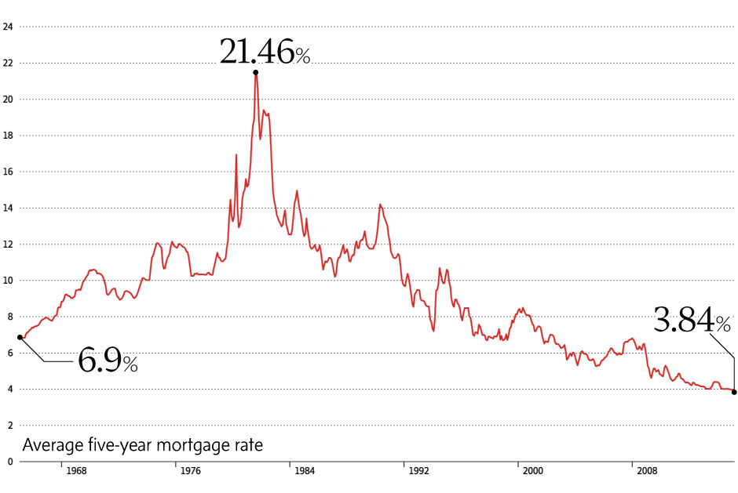

Slide 13
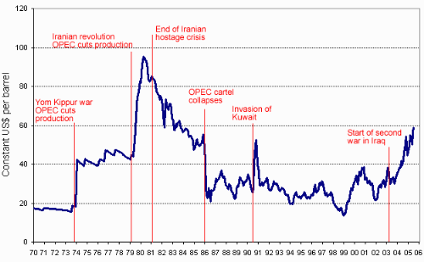

Slide 14
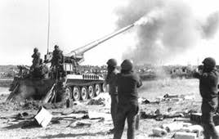

Slide 15
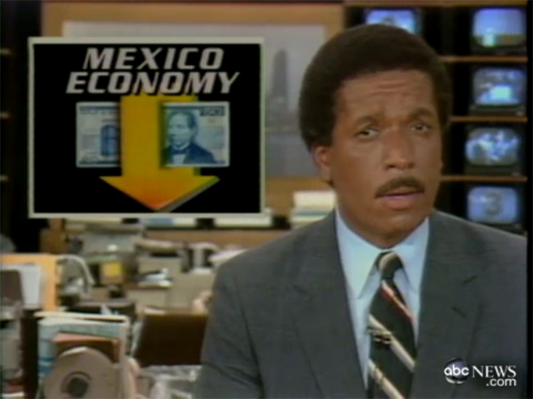

Slide 16
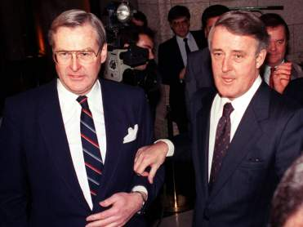

Slide 17
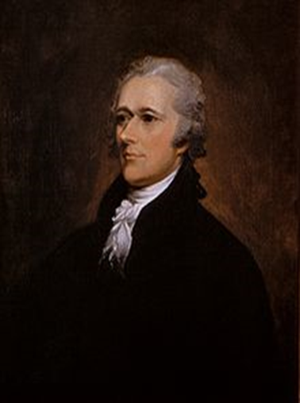
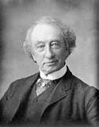
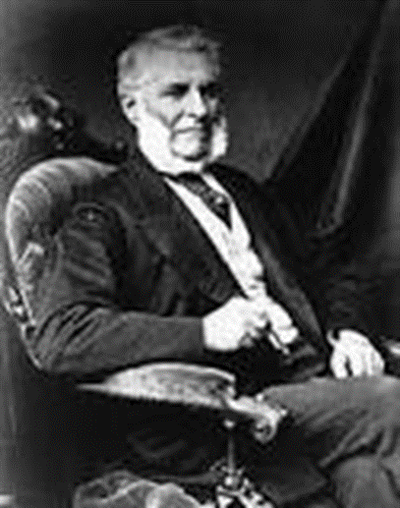
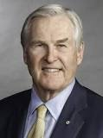

Slide 18
DIVIDER SLIDE ONE

Slide 19
DIVIDER SLIDE TWO

