Slide 1



The Future of Payments
Elevating your Finance Function
AMERICAN EXPRESS
2019 FEI CANADA ANNUAL CONFERENCE

Slide 2

Peter Barnett
AMERICAN EXPRESS CANADA
DIRECTOR,
LARGE MARKET SALES

Slide 3




Technology has changed the way we do business.

Slide 4



This material contains information that is proprietary and confidential to American Express. It cannot be shared with third parties without
American Express’ written consent. AMERICAN EXPRESS PROPRIETARY & CONFIDENTIAL. DO NOT COPY. DO NOT DISTRIBUTE.

Slide 5

Businesses must adapt, or
they’ll be left behind.

Slide 6

Payments are one of the fastest- moving parts of the financial services industry.
New & differentiated services
Technology & data-driven solutions
Infrastructure modernization
Workforce evolution

Slide 7
Tech disruption = uncertainty
43%
of CFOs say Blockchain presents challenges
87%
of organizations don’t think IT can proactively manage risks
33%
of business leaders say cybersecurity is a top business barriers
46%
of business leaders abandoned a strategic initiative over cyber threats

Slide 8



Percy Gyara
VP of Finance Hotels & Resorts
Sunwing Travel Group
Darren Stevenson
Greg Mixon
Director
Payments Consulting
American Express Canada
VP of Finance
Palliser Furniture Holdings Ltd

Slide 9



Slide 10
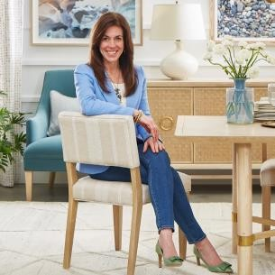
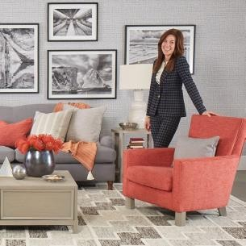



SARAH RICHARDSON FOR PALLISER
Four Unique Collections.
Product Line Up:
Four case collections
Five upholstery series
20 unique rugs
Six throws
12 accent pillows
Retail Footprint:
100+ retail commitments across North America
Shore
Vist a
E-Commerce:
- Fully realized website, optimized for unique e-commerce
functionalities
Marketing:
- Social media, digital marketing campaign, print and broadcast campaigns
Annex
Boulevard

Slide 11


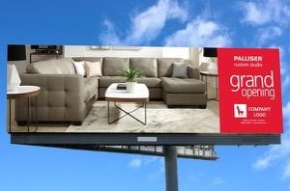
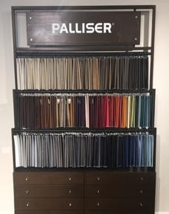
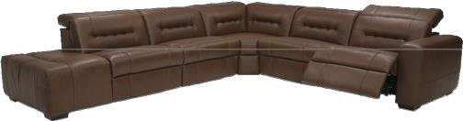
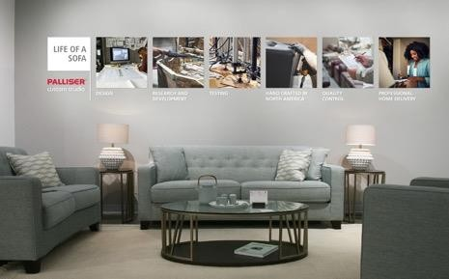







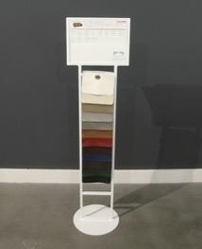
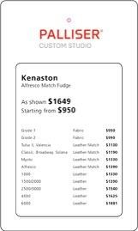
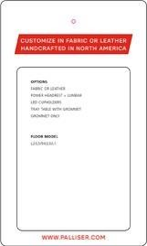
CUSTOM STUDIO SUPPORT
Elevated Ranking on Palliser.com
Professional Design Services
Marketing Services
Millwork Package
Exclusive Products
Wall Graphics
Exclusive Promotions
Sales Associate Training Guide
Floor Stands and Tear Pads
Price Tag
May 18 - June 6,2019
25% OFF RETAIL
Cairo
40132
All sku’s 15% Off Wholesale
Evoque and Evoque Match colour only
S e a ttle
77625
All sku’s 15% Off Wholesale
Evoque and Evoque Match colour only
E th a n
77012
All sku’s 15% Off Wholesale
Evoque and Evoque Match colour only
Floor model orders can be placed immediately, tag Custom Studio Exclusive Offer.
Orders will not be accepted two days following the promotion end date.
EXCLUSIVE OFFER

