Slide 1




DE-RISKING REPORTING IN THE AGE OF DISRUPTION
Reporting Beyond the Numbers
2019 © Company Confidential
14 June 2019

Slide 2




DISRUPTION
forcible separation or division into parts.
a disrupted condition.
Business. a radical change in an industry, busin
involving the introduction of a new product or
2019 © Company Confidential
14 June 2019

Slide 3
WE DON’T KNOW WHAT WE
KNOW
’T
2019 © Company Confidential
14 June 2019

Slide 4

WHAT IS NARRATIVE PERFORMANCE REPORTING?
2019 © Company Confidential
14 June 2019

Slide 5








NARRATIVE PERFORMANCE REPORTING DEFINED
Monthly management reports, board reports, budget books, etc. are just some of the examples of reports that fall into this category.
Are you producing these types of reports in your organization today?
Narrative performance reports are typically high frequency, highly collaborative, and owned by the business.
Many of these reports should contain both the numbers and the story
behind the numbers, but often do not.
* Linking Numbers and Narratives: Correlating Quantitative Reports with Qualitative Analysis

Slide 6
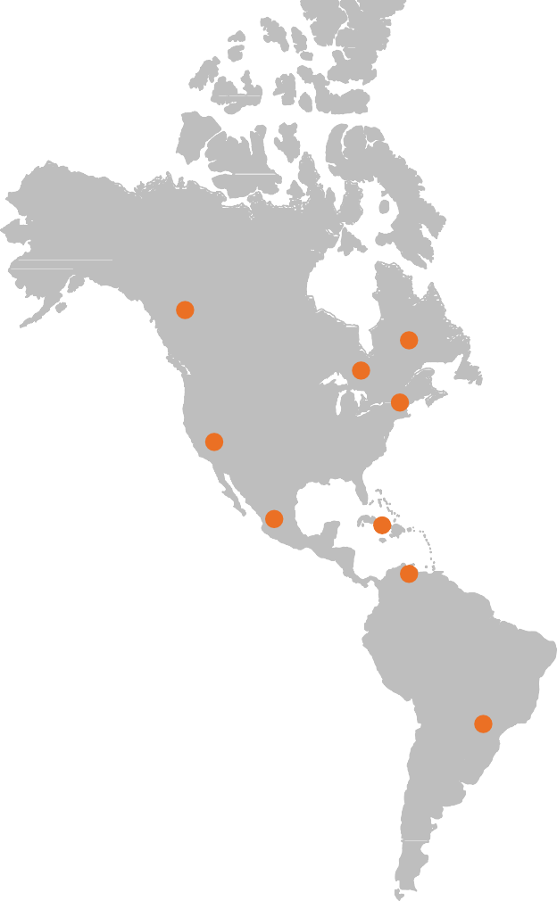
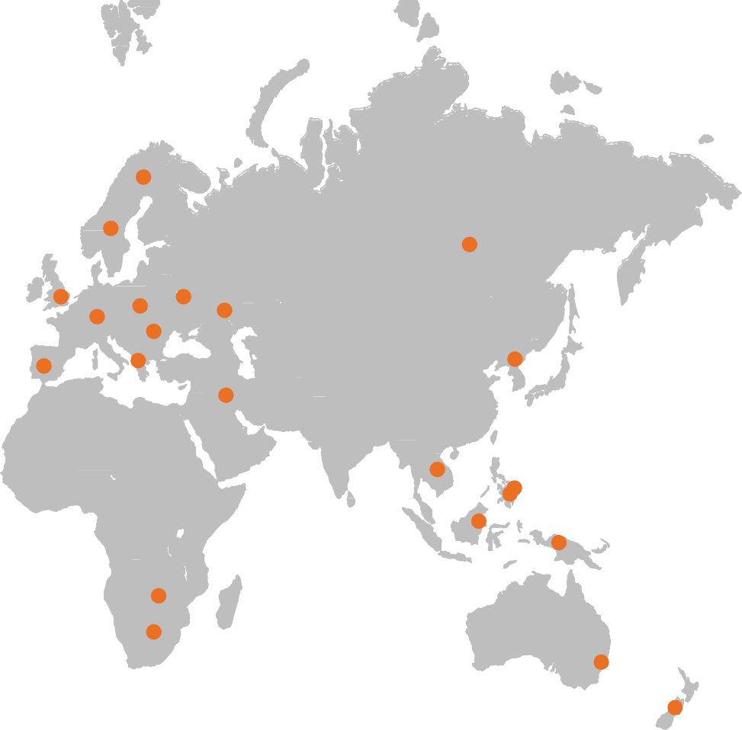
IT IS A GLOBAL REPORTING BUSINESS PROBLEM

Slide 7


Challenging the Current Narrative Performance Reporting Methods
“Our company currently use Excel, Word and PowerPoint for our internal reporting requirements…”
“Our company currently use a corporate performance management solution for our internal reporting requirements…”

Slide 8
NARRATIVE PERFORMANCE REPORTING DEFINED
 | Cash By Region
Northwest | Actual 5,000 | Plan 15,000 | Management Briefing Deck Adjusted and Consolidated March, 2018 Variance Var % (10,000) (67%)
March
2018
In USD
(thousands)
Cash

Slide 9
NARRATIVE PERFORMANCE REPORTING DEFINED
 | Cash By Region
Northwest | Actual 5,000 | Plan 15,000 | Management Briefing Deck Adjusted and Consolidated March, 2018 Variance Var % (10,000) (67%)
March
2018
In USD
(thousands)
Cash
Net Sales eroded substantially from prior quarter against plan to $5.0 million, a period over period decrease of $10 million. This was due to a Days Sales Outstanding (DSO) increase to 120 days versus 90 in 2017 Q4. The DSO increase was due to an unanticipated departure of several associates in A/R Collections Department and an substantial increase in net-new orders.
Global Initiative #45 is to decrease DSO to 75 days by Q4 2018. We are just starting to implement #45 in April with the hiring of 15 new A/R Collections associates. Based on our planned ramp-up schedule we anticipate getting to plan by Q3 2018, for both Cash balance and Days-Sales-Outstanding.

Slide 10




controlled, and created efficiencies in the production of these reports?
Based on the definition of Narrative Performance Reporting do you feel you have automated,
14.30%
85.70%
Yes
No

Slide 11
WHAT MARKET TRENDS ARE WE SEEING?
2019 © Company Confidential
14 June 2019

Slide 12





CERTENT FSN STUDY DETAILS
The survey drew responses from 616 international senior finance professionals from our 53,000 strong FSN Modern Finance Forum on LinkedIn.
This survey covered finance professionals across 23 different industries. 87% of these professionals were considered to have
senior job titles and above.
12

Slide 13







61%
Only 61% say their data is accurate and trustworthy
(LY:59%)
CFOS AND THEIR TEAMS NEARLY ALWAYS GET THE JOB DONE
59%
Only 59% say they can easily trace a number in a report back to its source
(LY:58%)
47%
Only 47% say their spreadsheets are well controlled and error free
(LY:45%)
Yet 64% say they never miss a reporting deadline (LY:64%)
39%
Only 39% Say they can easily see the status of reporting process at any time
(LY:42%)
37%
37% say the number of reports is growing uncontrollably

Slide 14
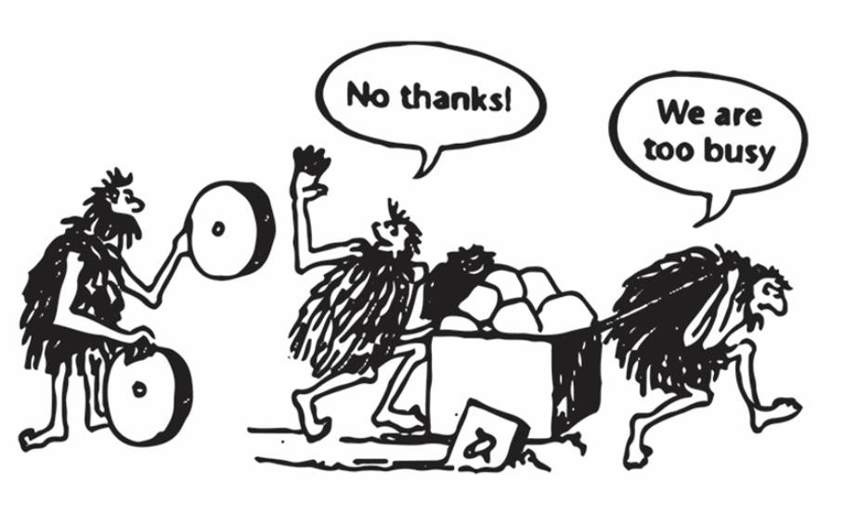

Slide 15


CFOS NEED TO DRIVE ACTIONABLE INSIGHT NOT JUST MEET DEADLINES
Seems that we have created a bureaucratic machine. Reports are produced in 2-3 days and the management accounts for a business unit can be 90 pages long per month. This is a remarkable achievement.
However, the balance between standardized reporting requirements and interpretation of said results has become skewed.
Finance has lost time to be able to distil key risks/opportunities from the reports, prioritize actions and deliver change.
Head of financial reporting, PLC

Slide 16

COLLABORATION IS STILL RELYING ON OLD TECHNOLOGY
When things go unexpectedly wrong in reporting, what is your preferred method of communication?
Walking the corridors
42%
Impromptu meeting
58%
WhatsApp, Chatter, Instant messanger
18%
Text message
12%
Telephone/conference call
77%
Email
76%
0%
10%
20%
30%
40%
50%
60%
70%
80%
90%

Slide 17
BIGGEST OBSTACLES TO COLLABORATION IN REPORTING
Factors Driving Growth in Financial Data Volumes
Not being able to share screens to look
at an issue together at the same time
Not knowing if someone I want to talk to is available
h'
63%
s
56%
c
Working in different time zones
45%
Colleagues starting new email threads
about the same topic
s
36%
e
Constant stream of emails
31%
Everyone working off different reports - not having 'one version of the truth'
e
29%
0%
10%
20%
30%
40%
50%
60%
70%

Slide 18
THE
CURRENT STATE
2019 © Company Confidential
14 June 2019

Slide 19







(i.e. Management Reports, Board Presentations, etc.)
How do you currently create your internal narrative performance reports
68.20%
18.20%
9.10%
4.50%
Microsoft Office Tools
Corporate Performance Management Solution (i.e. Budgeting & Forecasting and/or Consolidation Solution)
Business Intelligence Solution
Other

Slide 20



narrative reports is collaborative and controlled?
Do you feel the current process for producing these internal
4.50%
68.20%
27.30%
Yes
Somewhat
No

Slide 21






COMMON CHALLENGES
“Manual effort on updates.
Tailoring message to multiple parties.”
“Too high level with very poor level of insight that actually provides value to business decision making.”
“Currently it’s too manual of a
process that is susceptible to error.
It also takes too much resource capacity and time to deliver.”
“Using mostly non-dynamic data, which makes the whole process a lot like storytelling and not really captivating. Too much focus on past events and not enough on actions and anticipated outcomes.
“Too many numbers and not enough thoughtful narrative because people are too focused on the tables and tables
of numbers”.
“FP&A and Management Reporting teams using different versions of reports to communicate business performance.”
“Many stakeholders involved in the report cycle which makes it very difficult to control versions and workflow events...”

Slide 22



















THE REPORT PRODUCTION CHALLENGE
Data Inputs
Narrative Performance Report Outputs
Relational / DW
Peer Analysis
Reporting Managers
Excel Extraction
(Financial Statements)
Consolidations
Internal Report Consumers
External Report Consumers
Approvers
Report Consumers
Process is typically:
Manual (using MS Office)
OLAP - cube
Accounting Standards
Time-consuming
Excel Working Papers
Schedules / Checklists
Contributors
Reviewers
Error-prone
CPM / BI
Uncontrolled (e.g. versioning)

Slide 23















EVER BEEN ON THIS CALL…?
No time for analysis…. we constantly need to update
and validate the data…
Not surprised the data is different…these reports took a week to put together
How did this happen…again
CxO: This is not the data that we have… why is your data different? And where is the analysis?

Slide 24

NARRATIVE PERFORMANCE REPORTING AT THE ENTERPRISE LEVEL
Consolidated GAAP Financial
Statements and Footnotes
Executive Compensation Asset Management Operational & Risk Measures
Business Unit 1 Sales & Revenue Business Unit 2 Sales & Revenue Plan and Forecast Data
CEO/CFO Packages
Board Books
Monthly Management Reports
Regulatory & Statutory Reports
Plan & Forecast Packages

Slide 25
WHAT IS THE BUSINESS PAIN?
2019 © Company Confidential
14 June 2019

Slide 26







Risk of ensuring proper security and controls of the documents and data
within them.
Risk of the data not tying to source system(s) and other documents.
RISK
Risk of low employee satisfaction (work life balance, controlling employee workload and time)
Risk of missing deadlines and ensuring the story is correct and on time.

Slide 27

Time to distill and transpose the data to the appropriate application (i.e. Word, PPT).
Time to collect and organize data.
TIME
Time to organize
the many stakeholders, manage workflows, and version control.
Time write thoughtful
and insightful narrative.

Slide 28


Confident the team of high valued employees are
doing high value work.
Confident that the
story is correct, not only for a single report but anywhere this story
is being told across the organization.
CONFIDENCE
Confident that you are able to rollover\change the report structure in a timely fashion.
Last minute adjustments update the in working document.

Slide 29



“WHAT IS THE DIFFERENCE BETWEEN WHAT I DO TODAY AND THE ADDITIONAL VALUE CAN CERTENT PROVIDE?”
2019 © Company Confidential
14 June 2019

Slide 30
CERTENT + INTERNAL SOLUTIONS AND PROCESSES = NARRATIVE PERFORMANCE REPORTING
Traditional internal reporting solutions and developed processes provide all the data your organization requires in a structured reporting format.
It may also provide minor commentary around
certain balances.
More often than not, data and minor commentary are not telling the full story behind the numbers.
This is where Certent allows you to extend your internal investment to create narrative performance reports in multiple output formats.
2019 © Company Confidential
14 June 2019
30

Slide 31

THE CERTENT CDM SOLUTION
2019 © Company Confidential
14 June 2019

Slide 32


















OUR SOLUTION
Risk Management &
Internal Control
Single Version
of the Truth
Structured Data Sources
Corporate Governance
Cloud Reporting Platform
Data Warehouse/ Relational Tables
FP&A
Solution
ERP
Financial Consolidation
Internal
Report Consumers
General
Ledgers
Source
Data Files
Peer Analysis/ Benchmarked Content
Compliance Checklists
Harmonization Standardization Collaboration Attestation
Contributors Reviewers Approvers Managers Directors

Slide 33



SUPPORT MULTIPLE REPORTING REQUIREMENTS
Narrative Performance Reports Finance and Accounting Operations
Sustainability/CSR
Treasury Reporting
Management Accounts
Line of Business/Central Service
Function Reports
Corporate Business Plans
Divisional
Budget Books/Decks
Inter-^{I}d^{nt}e^{e}p^{rn}aªr^{l}tmental
Report Consumers
Board Books/Decks
Project Management
Business Unit Performance
Industry Specific Operational Reporting
Lender Reporting
Profitability Analytics – Customer,
Geography, Channel

Slide 34
CLIENT CASE STUDY
2019 © Company Confidential
14 June 2019

Slide 35





Industry:
Financial Services
Client and Position:
Andy Young, Head of Finance
Key Result:
Decreased risk, improved process
controls, increase confidence in reports.

Slide 36


THE BUSINESS PROBLEM
“Our subsidiary Statutory Accounts were prepared in Word and were produced from Excel files from our trial balances. These Word documents were rekeyed into our consolidated spreadsheet.
That got us our subsidiary information, with a fair amount of pain, and then that consolidated spreadsheet had to be put into a Group Accounts template, which was then copied into a desktop application…”
“But the biggest single issue was changes coming from the subsidiaries – from the bottom up – at the ninth-hour, always a critical time, when we had to get the reports done and filed, limiting our review and checking time, which in turn put pressure on us not to miss key changes to the information,” said Young. “In effect, it was the ‘last mile’ in producing reports that was exposing us.”

Slide 37

THE SOLUTION
“Simply put, Certent CDM giveAs susthoeniemvpelermsioenntoaftion of CMDoMrectohnatninhuaeldf oafnLdVt=hesubsidiaries were set up to the truth. Since CDM pulls strsaoigluhtitofnrowmasoiuntrrotrdiaulced to rtehpeobrtrouasdinegr CDM and all teams reported balances, rather than pushinogrgdaantiazathtioronu, gthhe productiosunbostfamntoianltcholyntrol improvements and user Microsoft Excel, we have thamt aasnsaugreamnceentthreapt orts, weaedkolyptMioannoafgtehme seonltution. “Existing Word and
key data is coming straight fIrnofmormouartiGonenreerpaol rts, finanEcxicael lrifsokrmreaptsorwtienrge, easily copied into CDM and
Ledger…” and more became a part ouf rthaeudpirtoocresslsovaesdwthelal.t they, and ourselves,
were able to track changes between versions, to the point where we had a single version of the truth when we produce our Company
Annual Accounts,” said Young.

Slide 38



THE RESULT
For the weekly ManagemenCt uInrfroernmtlyattihoenrpeaacrke over 70“Bpeeofoprlee wuseinwgeCreDMproadnducing eight separate alone, prior to CDM one peYrosuonngwsuocucldessspfuelnlydrolled mthoenstohlluytimonaonuatgaecmroesnst information packs, several days a week collattihnegodrgaatanifzraotmion to improvwehaiccchoouvnetarbailllittyo, taled 200-250 pages. We’ve different areas to gather thceonnseiscteesnscay,ryand process pcuosnhtreodl athcarot sasll ainllto CDM so when we now issue information to produce thederpeaprotmrte—ntswaitnhdCmDaMking osuurremthoant tahllly“kpeaecpkesrsthoef y’re all created from the that process was cut downdattoa 3s0oumrcinesu”teasre. aware osfatmheeirprelascpeo,nwsiibthilitcieosnsistent data appearing
surrounding data.
across the whole package, rather than having people pulling different information from different areas across the company, in different ways.”

Slide 39













ABOUT CERTENT
Purpose
To make complex financial compliance and narrative performance reporting processes easier.
Solutions
Narrative Reporting Management
Growth and Momentum
Founded in 2002, headquartered Bay Area, California
Equity Compensation Management
2,500 customers in EMEA, North America, and APAC
Professional and Administration Services
280 Employees, 4 Global Offices

Slide 40
THANK YOU
2019 © Company Confidential
14 June 2019

