Slide 1


Slide 2
CHRISTA DEGNAN MANNING DIRECTOR, HCM INNOVATION
Panelist, Economic Outlook Friday, June 7, 12:20-1:20 pm

Slide 3

MAJOR ECONOMIC TRENDS

Slide 4
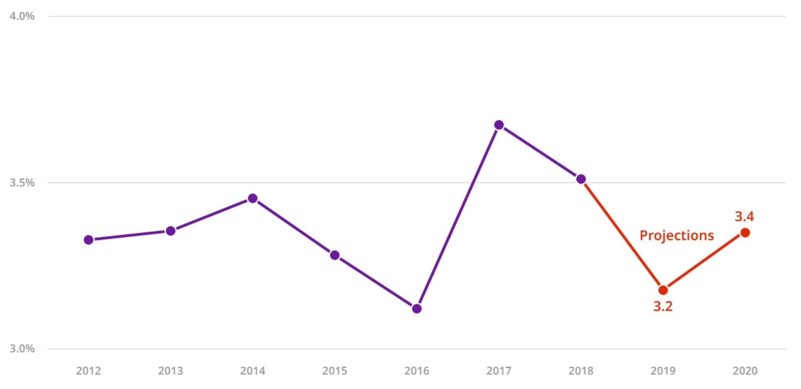
Global growth stable but
weak…
Source: http://www.oecd.org/economy/economic-outlook/

Slide 5
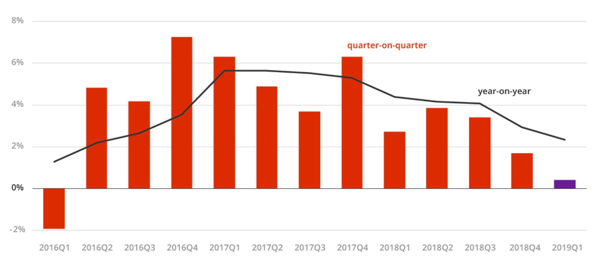
…as trade growth fallen
sharply
Source: http://www.oecd.org/economy/economic-outlook/

Slide 6
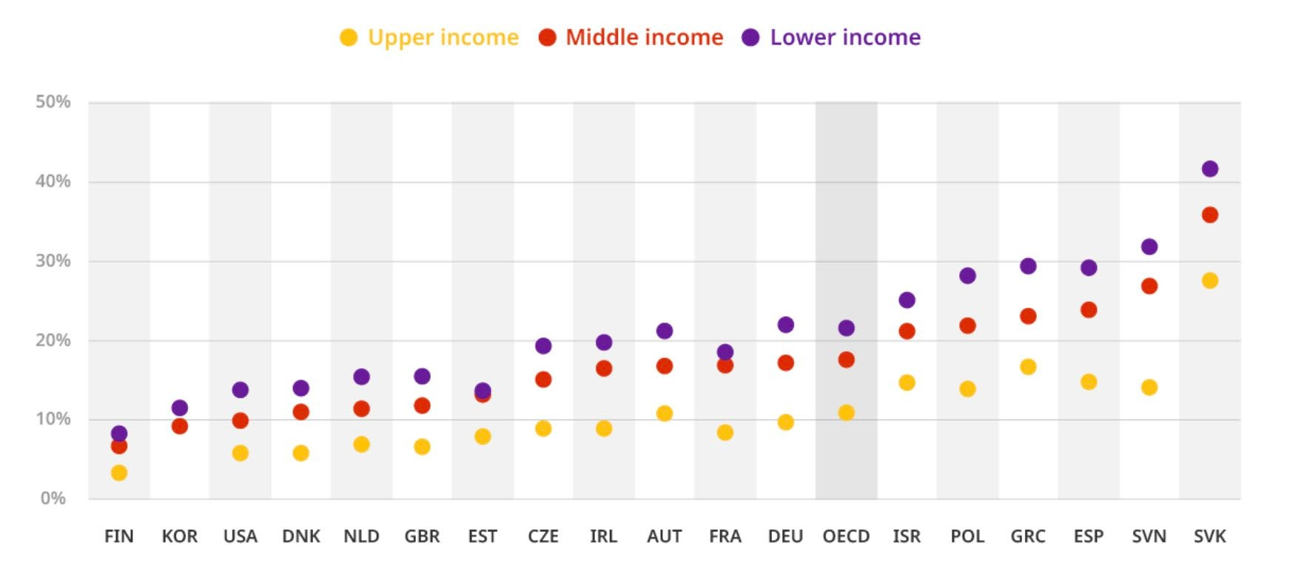
Workers at high risk of automation
Source: http://www.oecd.org/economy/economic-outlook/

Slide 7
“Governments must intensify international dialogue to restore confidence, and invest to prepare for tomorrow’s challenges: better skills and infrastructure for a digital world are sorely
~ Laurence Boone, Chief Economniest,eOdECeD,dM.a”y 2019

Slide 8

WHAT CAN BE DONE?

Slide 9
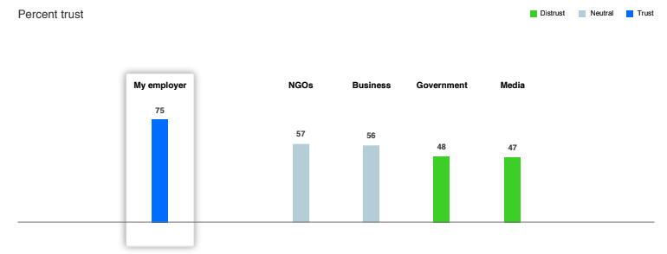
Employers most trusted today
Source: 2019 Edelman Trust Barometer

Slide 10
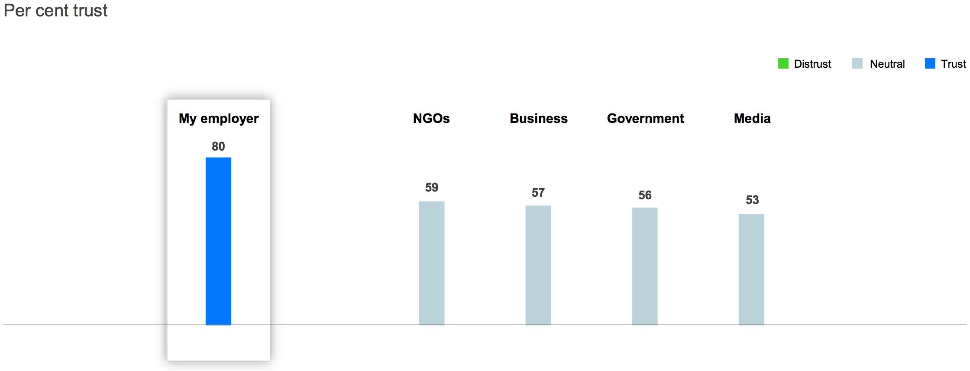
Canadian results on trust
Source: 2019 Edelman Trust Barometer

Slide 11
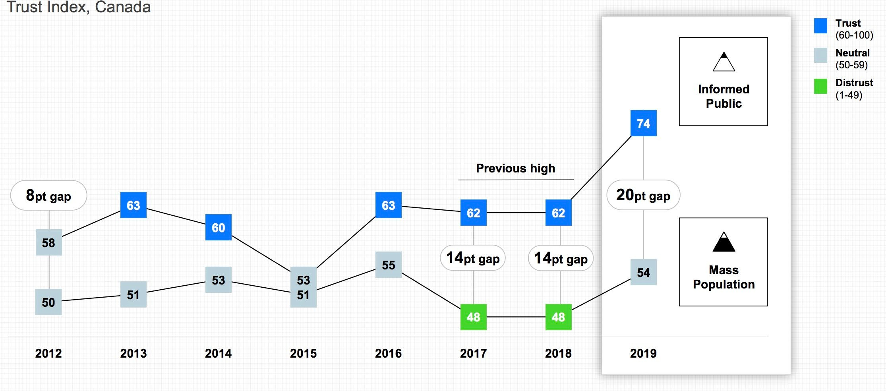
Trust inequality at record high
Source: 2019 Canadian Edelman Trust Barometer

Slide 12
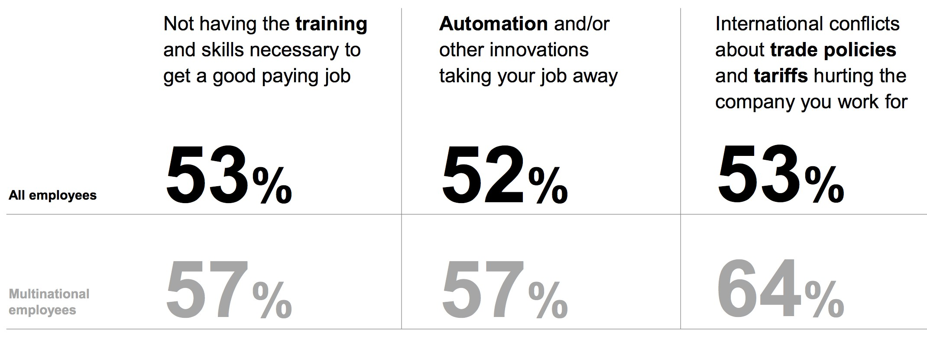
Canadian employees worried
Source: 2019 Canadian Edelman Trust Barometer

Slide 13
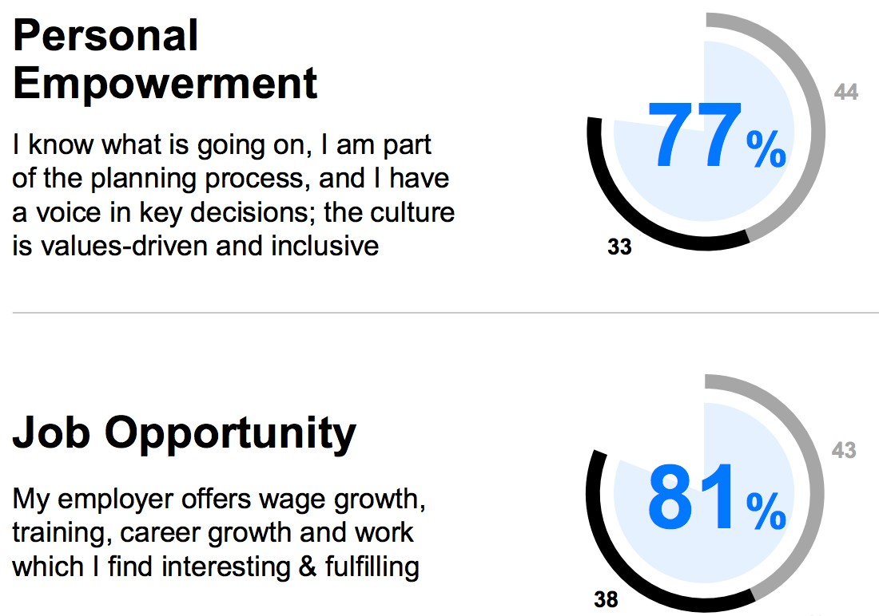
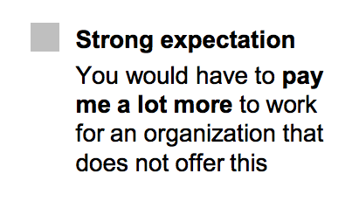
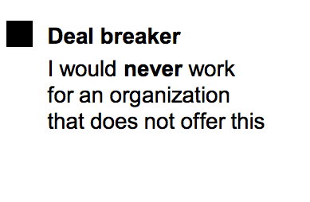
Worker voice and growth are paramount
Source: 2019 Canadian Edelman Trust Barometer

Slide 14
HUMAN CAPITAL INVESTMENT PROBLEMS & PAYOFFS

Slide 15
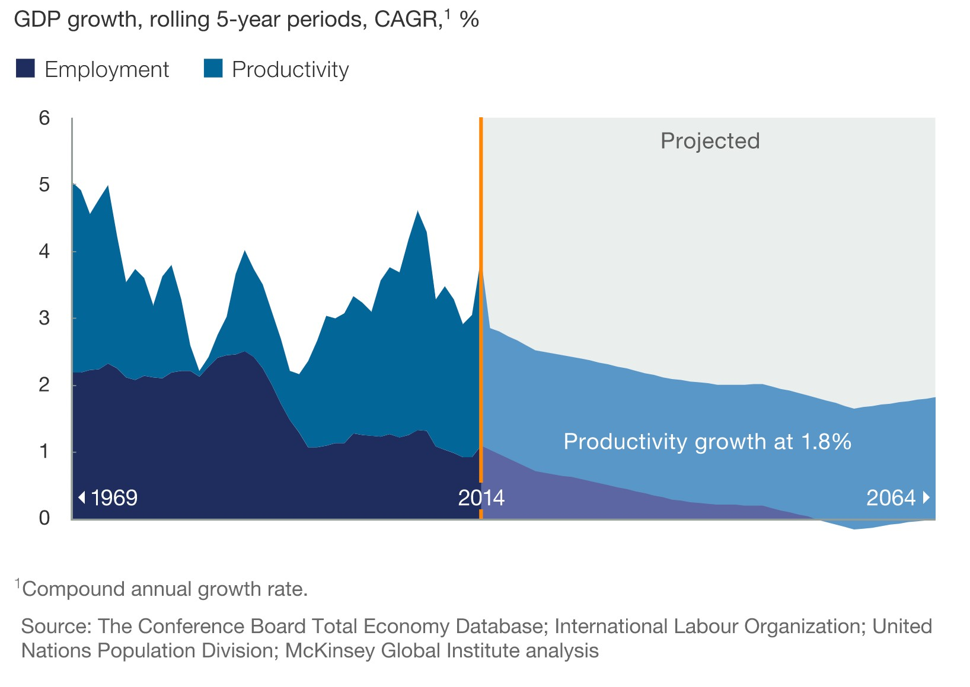
Productivity plateau projected
Source: SOLVING THE PRODUCTIVITY PUZZLE: THE ROLE OF DEMAND AND THE PROMISE OF DIGITIZATION,
McKinsey Global Institute

Slide 16
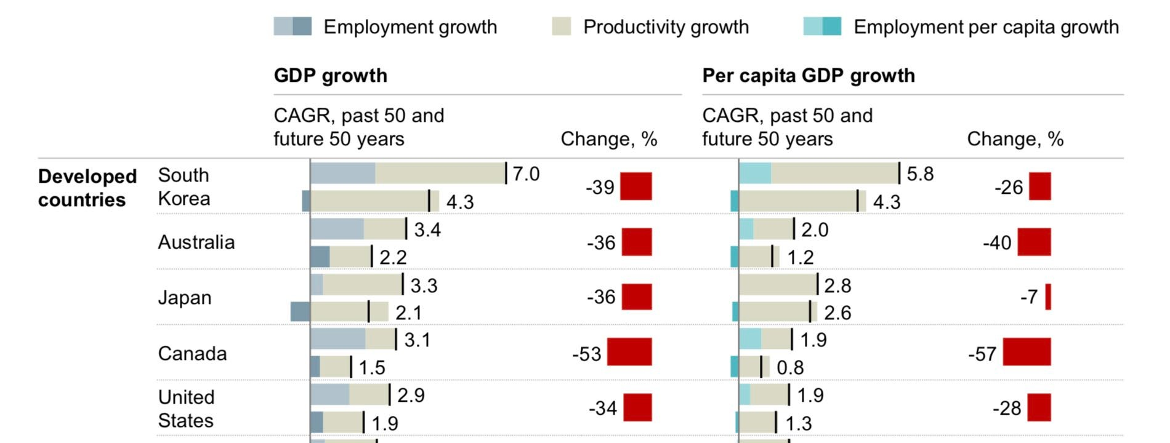
Canada’s challenges climb
Source: Global Growth: Can Productivity Save the Day In an Aging World? McKinsey Global Institute

Slide 17
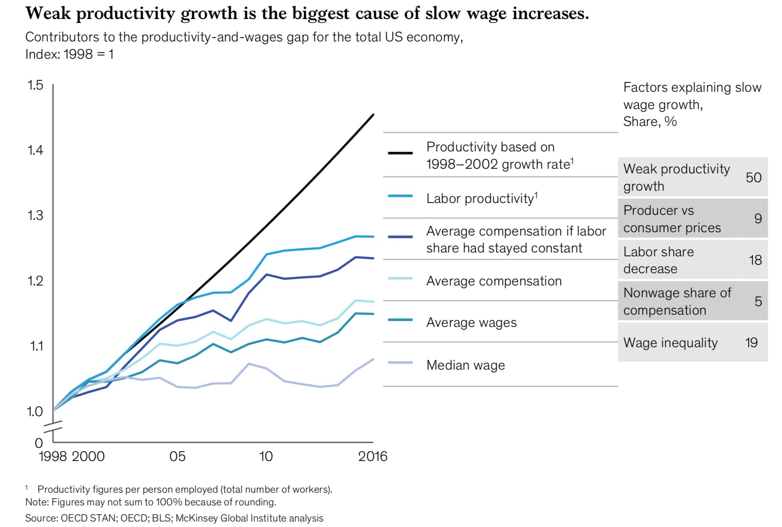
Flat wages limit life quality
Source: A new look at the declining labor share of income in the United States, McKinsey Global Institute

Slide 18
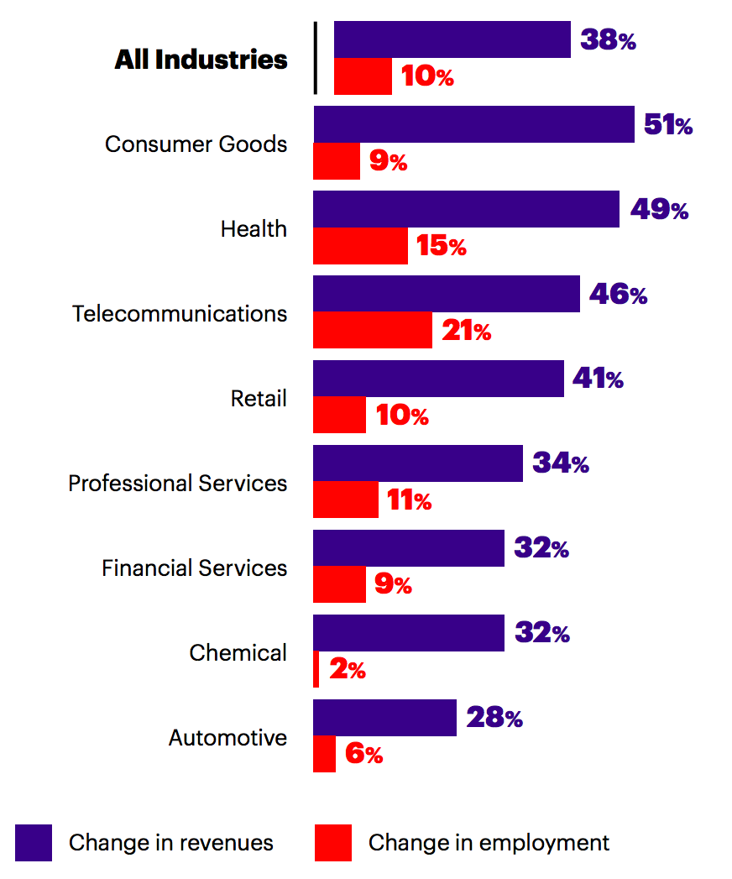
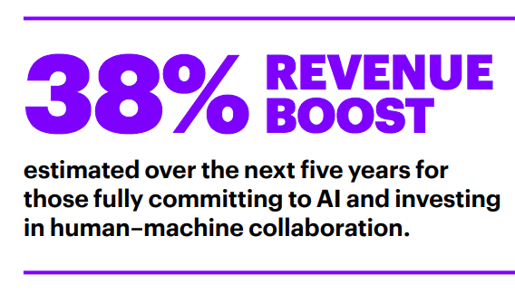
Source: Reworking the Revolution, Accenture

Slide 19
Key take aways / questions to ask your organization: Are you:
Ready to embrace automation and analytics to ethically augment uniquely human capabilities to drive improved performance?
Offering an employee experience that eliminates wasted time searching for information and completing tedious transactions and focuses on collaboration and innovation?
Prepared to listen to employees and meet their development and productivity needs and support continuous on the
job training and coaching?

