Slide 1

Canada 2030
The Defining Forces Disrupting Business
Jane Cooper
Senior Research Associate

Slide 2

Two Canadians, with their heads deep in sand…
4:00 p.m.
November 8, 2016
Clinton Headquarters, Lower Manhattan…

Slide 3




Insights you can build the future on.
3

Slide 4
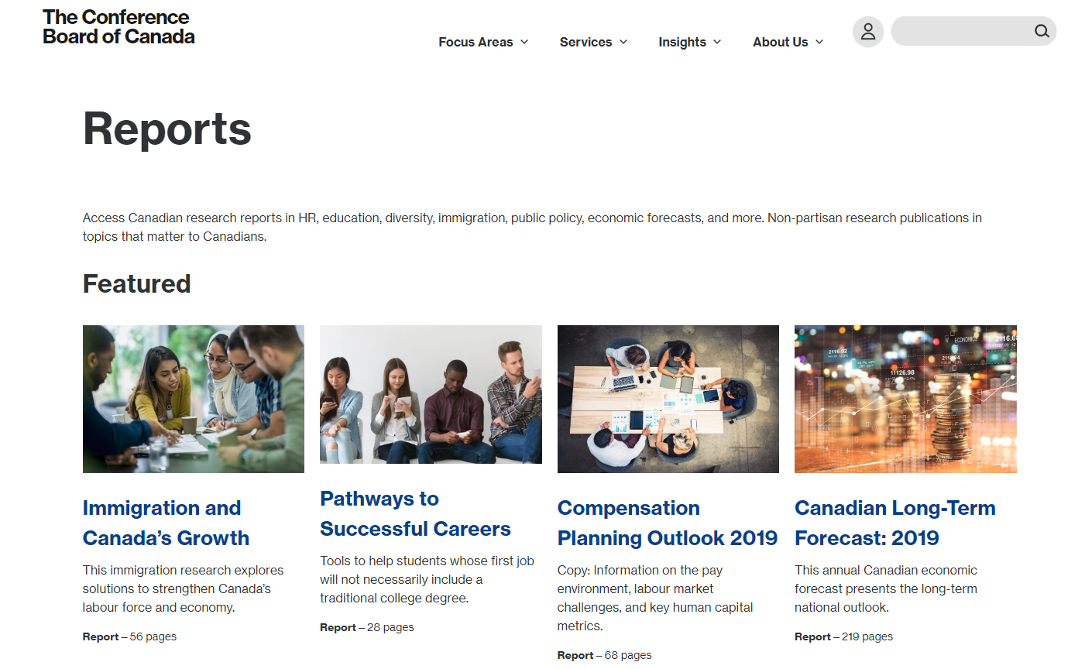
https://www.conferenceboard.ca/services/reports

Slide 5
How We Conducted This Research
Polled 200 participants at The Conference Board of Canada’s “2017 Business [Un]Usual: Profit From Purpose” conference.
Extensive literature review of government institutions, independent think tanks, non-profits, consulting firms, academic institutions, professional organizations.
Sponsored by Jarislowsky Fraser
Supported by the Corporate Responsibility and Sustainability Council and its founding funders.

Slide 6
At a Glance
Over the next decade, the world is facing political, social, environmental, and technological transformation's that will have profound implications for investors and businesses operating in Canada.
Ten key forces have been identified which revolve around the overarching trend of disruption.
To succeed, corporate leaders will need to think ahead, make bold decisions, and innovate to improve prospects for themselves, for the communities in which they operate, and for Canada as a whole.

Slide 7
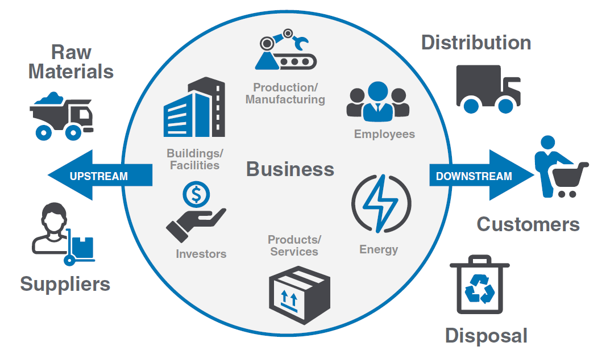
Impacts Up and Down the Value Chain
Notes:
Considering how these trends will impact operations presents an opportunity to stress-test current strategies against emerging risks and opportunities to identify ways to mitigate, manage or adapt.

Slide 8
Ten Trends to Keep Your Eyes On
Trend 1: Demographic Shifts
Trend 2: Urbanization
Trend 3: Health and Diet
Trend 4: Natural Capital Constraints
Trend 5: Climate Change
Trend 6: Technological Advances
Trend 7: Economic Uncertainty
Trend 8: Public Policy
Trend 9: Indigenous Reconciliation
Trend 10: Changing Values and Expectations

Slide 9
1. Demographic Shifts

Slide 10
Key Findings
A Growing Population
Canada’s population is expected to grow by 20% (reaching 42M)
An Aging Population
Seniors aged 65+ will represent 25% of the population in Canada
Greater Immigration
80% of population growth will be due to immigration

Slide 11
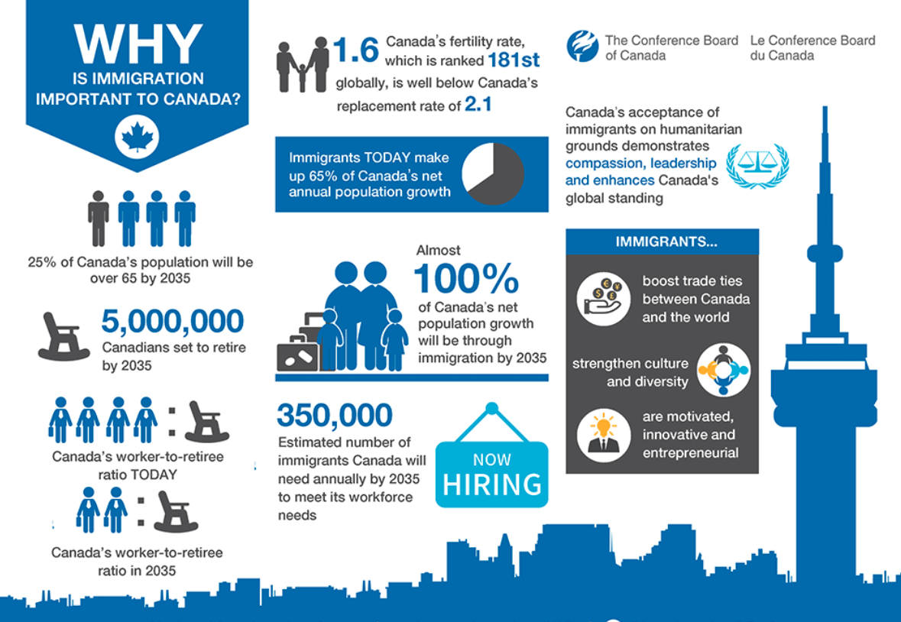
The Importance of Immigration to Canada

Slide 12
2. Urbanization

Slide 13
Key Findings
Growing Urban Populations
84% of Canadians will live in urban areas.
Reduced Service Provisions in Rural Areas
Small communities may struggle to generate the local tax revenue to maintain infrastructure, attract new workers, and provide access to products and/or services.
Increased Need for Infrastructure Investment
Infrastructure investments will generate sector growth and further opportunities for business.

Slide 14
Key Findings
Greater Densification
Urban intensification means proximity to amenities, more vibrant communities and greater housing choices.
Cleaner, Greener Cities
Tackling climate change and air pollution will mean higher carbon pricing, more stringent waste regulations, and road use charges.
Growth of “Smart Cities”
The 2017 Smart Cities Challenge provides $300 million to transform cities into smart cities.

Slide 15
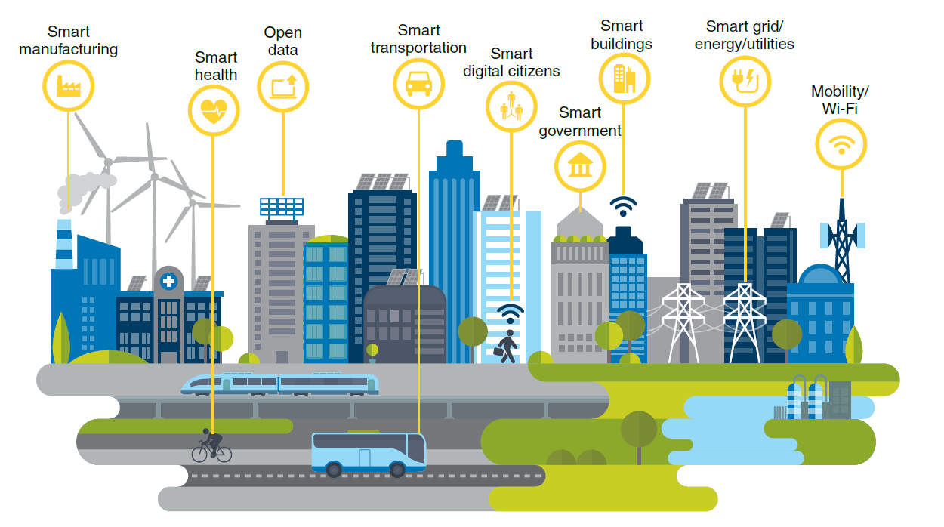
Smart City Components

Slide 16
3. Health and Diet

Slide 17
Key Findings
Greater Incidence of Obesity and Lifestyle Diseases
Obesity is expected to rise until at least 2030. Cardiovascular disease is likely to remain the leading cause of death. Increasing numbers of Canadians are expected to have diabetes or pre-diabetes.
Rising Cost of Mental Illness
By 2030, the cost of mental illness on the Canadian economy will rise to $29.1 billion a year.

Slide 18
Key Findings
A Surge in Superbugs
Antibiotic-resistant bacteria are predicted to cause 10 million deaths a year worldwide by 2050.
Diets Higher in Local, Organic, Plant-Based Foods
Demand for local, organic and plant-based foods will increase. Health Canada guidelines recommend people increase their consumption of plant-based foods; which could save up to 8 million lives globally by 2050.

Slide 19
4. Natural Capital Constraints

Slide 20
Key Findings
Increasing Water Scarcity
By 2030, a large area of Central Canada is expected to be at high-risk of water stress.
Ecosystem Decline and Loss of Biodiversity
At the end of the century 20-50% of all species now living on earth may be extinct. Canadian industries such as agriculture, forestry, and food, are all risk being impacted by this trend.

Slide 21
Key Findings
A Growing Circular Economy
Global use of natural resources is forecast to double between 2015 and 2030. The circular economy could generate an additional $4.5 trillion of economic output globally.
Growth in Renewable Energy and Clean-Tech
Renewable energy is expected to continue to increase, with the transition away from coal-fired power, pricing carbon pollution, and investing in clean technology.
Electric vehicles are forecast to make up half of the global auto market by 2030.

Slide 22
5. Climate Change

Slide 23
Key Findings
Mobilizing to Tackle Climate Change
The Paris Agreement; the Sustainable Development Goals
The Pan-Canadian Framework on Climate Change
Impacts of Climate Change Will Be Felt Across Canada
Direct costs of natural disasters (e.g. floods, wild fires) to Canadians is forecast to reach $5 billion per year by 2020 and $21-$43 billion by 2050. Indirect risks for business could include regulations, taxes, tariffs, and challenges to their social license to operate.

Slide 24
Key Findings
Rising Expectations for Climate-Related Financial Disclosures
More investors, lenders and insurers are asking for climate-related financial disclosures on how these risks are being assessed, priced and managed.
Increasing Fossil Fuel Divestment
Over 800 institutions worldwide have committed to divesting $5.58 trillion in investments from fossil fuel operations. Enhanced transparency is needed around economic risks and resiliency of the Canadian energy sector.

Slide 25
6. Technological Advances

Slide 26
Key Findings
Artificial Intelligence (AI)
The ‘Sharing Economy’
The ‘Internet of Things’ Connected Devices
3-D Printing
Cryptocurrencies
Blockchain
Robotic Automation
Cyber Security Risks….

Slide 27
7. Economic Uncertainty

Slide 28
Key Findings
The Continuing Economic Power Shift
By 2030, the E7 economies are predicted to overtake those of the G7 in terms of size and purchasing power.
China, the U.S. and India will remain the world’s largest economies.
Rising Financial Inequality
By 2016, top Canadian CEOs were earning 209 times more than the average worker. Growing economic inequality can impact a business’s value chain.

Slide 29
Key Findings
Greater Consumer Debt and Financial Vulnerability
By the end of 2017, Canadian households had $1.70 of credit-market debt for every dollar of disposable income. The Gov’t of Canada predicts levels of household debt will rise.
Increasing Female Economic Empowerment
If women take advantage of certain career equalizers, and if businesses, government, and academia provide crucial support, it has been suggested that the gender pay gap could be eliminated in Canada by 2035.

Slide 30
8. Public Policy

Slide 31
Key Findings
New Trading Agreements and a Growth in Canadian Exports
Canada could expect to see growing trade with counties outside the U.S.
The UN’s Sustainable Development Goals
Governments worldwide are establishing regulations and guidelines in support of the SDGs that will impact business.
Growing Public Debt
Debt-to-GDP ratios globally have increased significantly in recent years and are foreseen to continue to rise.

Slide 32
9. Indigenous Reconciliation

Slide 33
Key Findings
The Enduring Legacy of Policies, Legislation, and Injustice
Harmful policies continue to impact indigenous peoples in Canada and create large socio-economic gaps.
Truth and Reconciliation Commission’s Calls to Action
Call to Action 92 is directed to the business sector
Importance of Reconciliation Moving Forward
Businesses will be asked to be more transparent around policies, practices and relations regarding Indigenous peoples.

Slide 34
10. Changing Values and Expectations

Slide 35
Key Findings
Generation Z’s Coming of Age
By 2030, members of Generation Z will be in their 20s and early 30s, and are forecast to account for 30% of the global population.
Growth in E-Commerce Disrupting the Retail Sector
By 2020, e-commerce is expected to account for 10% of total retail sales in Canada (up from 5.8% in 2015). This growing trend is expected to continue.

Slide 36
Key Findings
Calls for greater Corporate Transparency
Rise of social media is adding pressure on companies to consider steps they can take to build trust with customers, communities, and wider society.
The Rise of Purpose-Driven Business
By 2030, we expect to see more businesses articulating their purpose beyond profit, and playing a stronger role in tackling social and environmental challenges.

Slide 37
Questions for Business Professionals and Investors
Governance
Which trends will materially impact the business, including its value chain and operating context?
Has the board evaluated how these trends may impact the business and its value chain or operating context, from both risk and opportunity perspectives?
Is the company disclosing the risks associated with these trends?
What is the company’s risk appetite for each of these trends?

Slide 38
Questions for Business Professionals and Investors
Strategy
Has management identified the risks and opportunities associated with these trends over the short, medium and long terms?
Are they considered in the company’s approach to enterprise risk management?
Has management used these risks and opportunities to shape the organization’s strategy and financial planning?
Has management evaluated the resilience of the organization’s strategy, taking the trends into consideration?

Slide 39
Questions for Business Professionals and Investors
Measuring Progress
Which metrics and targets are management using to assess and manage relevant risks and opportunities, where such impacts are material?
How is management measuring and incentivizing performance against targets?

Slide 40
Contact
Jane Cooper
Senior Research Associate
The Conference Board of Canada
cooper@conferenceboard.ca
613-526-3090 ext.403

Slide 41


Where leaders turn when faced with Canada’s toughest problems.
conferenceboard.ca
41

