Slide 1
A real cause for leadership worry: The impact of the Anxiety Epidemic
Stephen Liptrap
June 15, 2018
Notes:
• Thank you – good morning. [mention others on panel? They are after me but I can weave something from earlier in the conf]
• As CEO of one of the largest companies in the HR field = Leadership always on my mind
• Not just how companies are being led today
• But how they develop their leaders for tomorrow

Slide 2
BCC study on challenges managing people
Notes:
• Recently we completed a study with Business Council of Canada represents 150
• We had over 95 of Canada’s largest orgs complete the study = 850,000 employees
• Good cross section of the economy – geographic and industry perspectives
• We asked about the challenges they faced in managing people

Slide 3
Employer view: Creating a culture supporting well-being and mental health is a top priority
Notes:
• One of the CEO’s top priorities – creating a workplace culture that supports employee well-being and mental health
• Most CEOs cited this as a major concern with significant financial implications if we don’t get it right
• Employers strongly believe they have started to create that culture today

Slide 4
over 70%
Employee view:
afraid of stigma; believe revealing will hurt career
Notes:
• That’s fine – but how does that square with our data
• 71% of employees are afraid of the stigma re mental health
• 77% believe revealing a mental health issue will hurt their careers.
• Vast majority of employees do not believe their organizations nor leaders are properly addressing this issue
• Clearly, there’s a disconnect– a GAP -- between employers and employees
• What that GAP means – and the risks it presents – is what I’ll talk about today.

Slide 5
Psychological resilience = good leaders = productive employees
Notes:
Of course, employee well-being is a broad term –
• From mental health perspective, it has a practical meaning in the context of leadership
• It suggests the need for PSYCHOLOGICAL RESILIENCE as a condition
• for becoming a good leader
• a productive employee
• AND overall organizational success

Slide 6
Millennial challenges: disability leave x 2
Notes:
Within this context one of the pressing priority: supporting psychological resilience in next generation of leaders – Millennials.
• Millennials have clinical levels of stress, anxiety, depression, more than twice as likely to go on disability leave for a mental disorder than other age group
• Not marginal issue – a challenge of major significance
• Globally, Millennials make up 46% of the workforce.
• In 10 years, 75%.
• 53% of young Canadians are grappling with depression/mental health.
• Millennials canaries in the coal mine: a window into major leadership crisis.

Slide 7
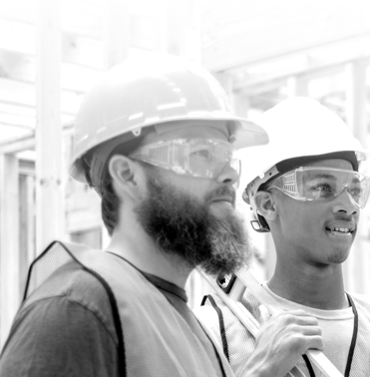
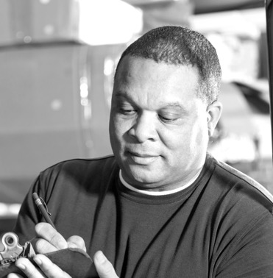
Let’s take a walk Canadian workforce
Notes:
• And that crisis is best explored in the terms that really matter:
• Human terms.
• Let’s take a walk into a portrait of the Canadian workforce.
• With three people at different stages in their careers.

Slide 8
Jim in Calgary: Life couldn’t be better
Notes:
Let’s start with Jim – a middle manager in a resource company in Calgary
At 57, his pension is vested, the kids in college
About to retire soon – play golf, do some volunteering
Life couldn’t be better.

Slide 9
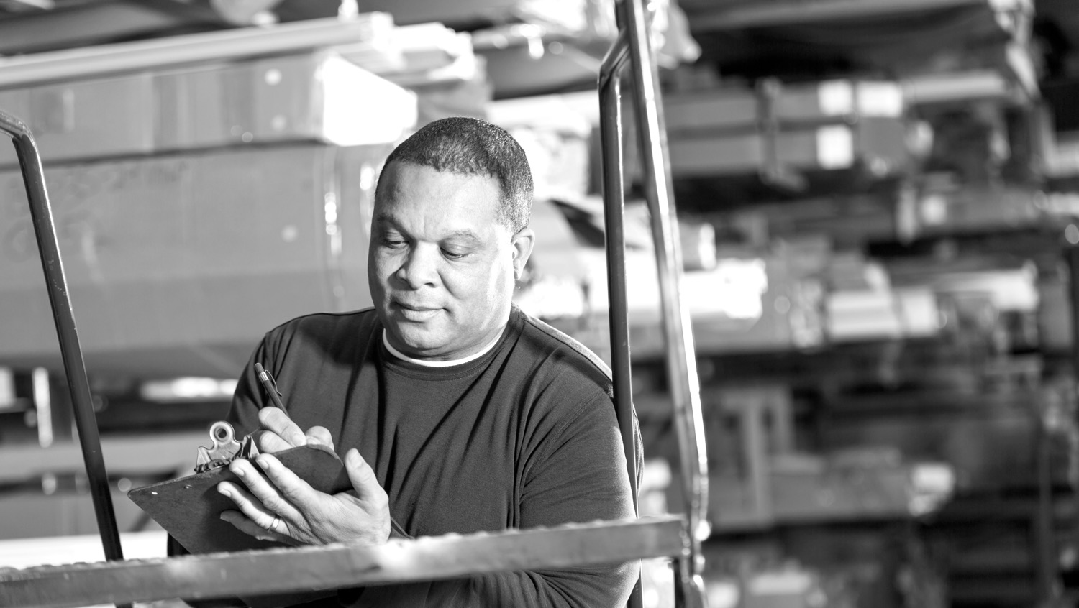
Shawn in Truro: Life couldn’t be better
Notes:
• Next, there’s Shawn – 43 – from Truro
• Just promoted to manage a warehouse for a manufacturing company
• Started out as a truck driver – so this is a big step
• And he just bought the family a bigger house
• Life couldn’t be better

Slide 10
Sophie in Toronto: Life couldn’t be better
Notes:
• And now, in Toronto -- let’s turn to 25-year old Sophie
• Young woman with an MBA who has just started first big job in a large, fast-moving company
• Life couldn’t be better

Slide 11
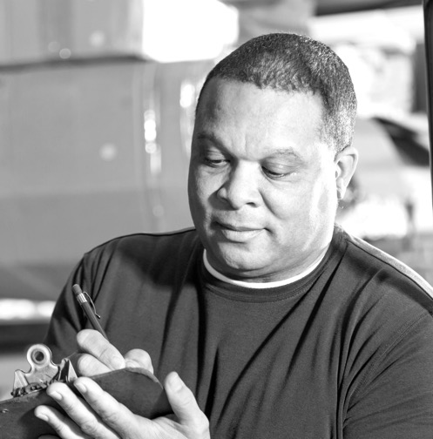
A quick quiz
I can’t get out of bed today
I can’t take it anymore
I just want to lie here – and hide
Notes:
This portrait of the Canadian workforce isn’t perfect – but go with it!
• So – I have a little quiz for you
• Who – among them – is thinking
• I can’t get out of bed today
• I can’t take it anymore
• I just want to lie here – and hide
• How about all three?
• What is so troubling that they can’t get out of bed?

Slide 12
We have an anxiety epidemic in today’s organization
Notes:
Anxiety – that’s what – manifesting differently in each person,
With very real organizational consequences
What I’m talking about – actually -- is an anxiety epidemic spreading like wildfire in the organization – in your organization, if you look closely
And I am focusing on anxiety because it makes a powerful case for the bigger picture of the mental health challenges in the workplace that impact our future success and having the leaders we need

Slide 13
Anxiety disorder
45 million affected
<40% receive treatment
$17 billion – economic cost
Notes:
Anxiety disorder is the clinical umbrella – the general term – for the most common group of mental illnesses today
It covers panic disorders, phobias, social anxiety, obsessive compulsive disorder, PTSD, separation anxiety and so on
Affects some 45 million people in North America
Less than 40 per cent are receiving ANY treatment and they are in key leadership roles in your organizations
Conference Board says anxiety costs our economy $17 billion a year.
Let’s look closer at those costs.

Slide 14
Jim in Calgary: Or could it?
Jim in Calgary: Life couldn’t be better
Notes:
Let’s start again with Jim – our middle manager in Calgary
• He knows it’s a brutal world– global competition, technology, commodity prices, business speeding up
• Has survived several restructurings -- let people go himself – friends
• A decent man, doing difficult things for greater good: like a first responder
• But it’s taken a toll – In a state suppressed anxiety for years
• Not something he talks about or deals with, not in his corporate culture

Slide 15
Jim’s bullying/anxiety cost the business
Notes:
When anxiety starts to redline, he can be a bully, telling people to toughen up or they can walk out ... right through that door
• Lost two star performers in past year -- both Millennials
• As a leader, Jim is indulging in behaviours that others have imitated
• Created a hothouse for bullying behavior to flourish – like mold
• Invisible at first – but as it builds up – dangerous – a real organizational risk!
• Jim’s a terrible boss right now -- if he’s in your business, he’s hurting it

Slide 16
Shawn in Truro: Or could it?
Shawn in Truro: Life couldn’t be better
Notes:
Back to Shawn – our warehouse manager in Truro
His company on fire right now, growing in leaps and bounds.
And Shawn is a part of success -- worked up from bottom of corporate ladder.
Personal life is good -- married, teen kids, but also aging parents
Bigger house when promoted comes with a bigger mortgage
But now add the stress in his personal life to what is happening at work
60-hour work week
His boss is in the office after dinner most nights –AND expected of him
• Shawn’s never felt more overwhelmed -- at a psychological tipping point

Slide 17
Shawn’s anxiety/costs
Notes:
Sometimes, he leaves work, drives around until he calms down
• Some nights he can’t sleep without a pill –that clouds his brain the next day
• On those days, he triple-checks work, fearful of errors, causing an accident
• Everyone knows him as great guy – top performer – so everyone shocked when he goes on disability leave
• And those disability costs –a big part of the $17 billion I mentioned
• Conditions in company for burn-out, a real need to rethink values about work

Slide 18
Sophie in Toronto: Or could it?
Sophie in Toronto: Life couldn’t be better
Notes:
And finally -- Sophie – our Millennial – the future of the workforce –
• A knowledge worker, idealistic, the pride of her parents in small town
• With MBA in hand, Sophie’s just moved to the big city – into a big job at a fast-moving company – with big expectations, hers and her employer’s
• On her own for the first time. Living alone in condo downtown, alone
• Her best friend, right now, is her iPhone
• She’s isolated, even if surrounded by opportunity

Slide 19
Sophie’s anxiety/costs
Notes:
[SLIDE 1 of 2]
Sophie’s anxiety/the costs
• At work, Sophie, not an introvert, but intimidated by experienced colleagues
• Doesn’t feel like she cuts it.
• Everyone else thinks she’s doing well for a new recruit
• The deadlines are tighter than at school. Her project team always changing
• Her boss on the road a lot... too busy to spend much time with her
• She’s isolated to begin with – now starts to isolate more and more
• Sometimes says she’s working from home, but in bed, paralyzed with fear

Slide 20
Sophie’s anxiety/costs
Notes:
[SLIDE 2 OF 2]
• Anxiety isn’t something she can talk to her family about. What she feels is guilty – for not being more upbeat
• Our research -- 61% of Millennials experience isolation as a major stressor
• Bottom line, here’s a young, talented hardworking person you are investing a lot of money in -- but it will take time to get a return on that investment
• And do you want to lose Sophie – because you weren’t there to help her bridge the gap between university and corporate life?

Slide 21
Three very human problems – but one business story
Where do we go from here?
Notes:
Psychological resiliency not a given for anyone entering the workforce
• If we don’t support the Sophies – helping them develop cognitive skills and emotional poise to thrive in business – you are going to hurt your business
• Okay – three very human problems – but one business story
• How anxiety is hurting your organization
• Where do we go from here?

Slide 22
Yes, everyone has a role
Notes:
• Yes, gov’t leadership required in evolving mental health care system
• Yes, schools and parents need to work together to help young people develop the psychological resiliency for the pressures of today’s workplace
• Yes, we need to keep working on eliminating the stigma of mental illness
• Yes, we need to reinforce the idea that everyone is responsible for their own mental health

Slide 23
What your organization can do – four steps
Notes:
• Let’s talk about what you can do in your organization, practically speaking, to stop this growing anxiety epidemic in its tracks
• There are four steps in any methodology for dealing with an epidemic

Slide 24
Step one Track it
Notes:
First – you need to track what’s going on – learn who is struggling and where in your organization
• Not just looking at employee turnover and disability rates. That’s too late. You need data on what’s happening today – not last year
• Data from a wide range of leading and lagging indicators – engagement scores, employee health surveys, onboarding programs, sick leave
• You need to recognize employees who may be at work but show signs of strain, lack of focus, or changes in their usual ways of working

Slide 25
Step two Contain it
Notes:
Next -- you need to contain – and understand why a problem has escalated?
• What are the drivers, what is the source of the problem?
• Again, using all data at your disposal –– you want to know where to intervene
• All things being equal, why is one group showing more anxiety than another?

Slide 26
Step three Manage it
Notes:
Third, you need to manage – and fix things on the principle of “do no harm”
• You actively support the need for clinical interventions with those suffering
• You create a work culture where employees can express the strain and stress they experience at work
• The big question is, are your managers trained to identify people at risk of mental illness and to accommodate and support them?

Slide 27
Step four Prevent it
Notes:
Finally – you need to prevent –
• You need to understand how you got into this situation in the first place, so that you can make the changes in how you operate as an organization
• And so – if you do all these things – where could it lead?

Slide 28
A workplace that values employee well-being
Notes:
[SLIDE 1 OF 2]
• It leads to a workplace culture that truly values employee well-being
• And that means --
• An integrated mental health strategy, where people are encouraged to look after their physical and mental health
• Managers are trained to identify and support people at risk of mental illness
• Rethinking values you hold about work and evolve your culture to reduce workplace stress where you can
• Consistent communication from the top of the house – from leadership – about how your organization is changing – and why. (cont’d on next)

Slide 29
A workplace that values employee well-being
Notes:
[SLIDE 2 OF 2]
• You will be a company where people at all levels – within reason –
are empowered to express what they really think, without fear of retribution
• And for those young people entering the workforce – the future of our economy –
your organization will onboard them in ways that respect where they are – and very importantly –
ensures they develop with and through the organization, and justifies the investment in their potential.

Slide 30
Building a resilient workforce
Notes:
[FINAL SLIDE]
• These are the ways you build a resilient workforce
• These are the ways that today’s leaders like yourselves can succeed in a very important part of your job: developing tomorrow’s leaders
• Thank you.

