Slide 1
Financial Executives International: Canada
10 Things That Will Change the World
Mark J. Barrenechea | Vice Chair, CEO and CTO
markb@opentext.com
June 14, 2018

Slide 2
Safe Harbor Statement
Certain statements in this presentation related to Open Text Corporation (“OpenText” or “the Company”) may contain words such as "anticipates", "expects", "intends", "plans", "believes", "seeks", "estimates", "may", "could", "would", "might", "will" and variations of these words or similar expressions are considered forward-looking statements or information under applicable securities laws. In addition, any information or statements that refer to expectations, beliefs, plans, projections, objectives, performance or other characterizations of future events or circumstances, including any underlying assumptions, are forward-looking, and based on our current expectations, forecasts and projections about the operating environment, economies and markets in which we operate. Forward-looking statements reflect our current estimates, beliefs and assumptions, which are based on management's perception of historic trends, current conditions and expected future developments, as well as other factors it believes are appropriate in the circumstances, such as certain assumptions about the economy, as well as market, financial and operational assumptions. Management's estimates, beliefs and assumptions are inherently subject to significant business, economic, competitive and other uncertainties and contingencies regarding future events and, as such, are subject to change. We can give no assurance that such estimates, beliefs and assumptions will prove to be correct. Such forward-looking statements involve known and unknown risks, uncertainties and other factors and assumptions that may cause the actual results, performance or achievements to differ materially. Such factors include, but are not limited to: (i) the future performance, financial and otherwise, of OpenText; (ii) the ability of OpenText to bring new products and services to market and to increase sales; (iii) the strength of the Company's product development pipeline; (iv) the Company's growth and profitability prospects; (v) the estimated size and growth prospects of the EIM market including expected growth in the Artificial Intelligence market; (vi) the Company's competitive position in the EIM market and its ability to take advantage of future opportunities in this market; (vii) the benefits of the Company's products and services to be realized by customers; (viii) the demand for the Company's products and services and the extent of deployment of the Company's products and services in the EIM marketplace; (ix) downward pressure on our share price and dilutive effect of future sales or issuances of equity securities (including in connection with future acquisitions); (x) the Company's financial condition and capital requirements; and (xi) statements about the impact of product releases. The risks and uncertainties that may affect forward-looking statements include, but are not limited to: (i) integration of acquisitions and related restructuring efforts, including the quantum of restructuring charges and the timing thereof; (ii) the potential for the incurrence of or assumption of debt in connection with acquisitions and the impact on the ratings or outlooks of rating agencies on the Company's outstanding debt securities; (iii) the possibility that the Company may be unable to meet its future reporting requirements under the U.S. Securities Exchange Act of 1934, as amended, and the rules promulgated thereunder, or applicable Canadian securities regulation; (iv) the risks associated with bringing new products and services to market; (v) failure to comply with privacy laws and regulations that are extensive, open to various interpretations and complex to implement including General Data Protection Regulation (GDPR); (vi) fluctuations in currency exchange rates; (vii) delays in the purchasing decisions of the Company's customers; (viii) the competition the Company faces in its industry and/or marketplace; (ix) the final determination of litigation, tax audits (including tax examinations in the United States and elsewhere) and other legal proceedings; (x) potential exposure to greater than anticipated tax liabilities or expenses, including with respect to changes in Canadian, U.S. or international tax regimes including the new tax reform legislation enacted through the Tax Cuts and Jobs Act in the United States; (xi) the possibility of technical, logistical or planning issues in connection with the deployment of the Company's products or services; (xii) the continuous commitment of the Company's customers; and (xiii) demand for the Company's products and services.
For additional information with respect to risks and other factors which could occur, see the Company's Annual Report on Form 10-K, Quarterly Reports on Form 10-Q and other securities filings with the Securities and Exchange Commission (SEC) and other securities regulators. Readers are cautioned not to place undue reliance upon any such forward-looking statements, which speak only as of the date made. Unless otherwise required by applicable securities laws, the Company disclaims any intention or obligation to update or revise any forward-looking statements, whether as a result of new information, future events or otherwise.

Slide 3
NASDAQ, TSX: OTEX
A TSX-60 Company
We are The Information Company, enabling intelligent & connected enterprises, inspiring new ways to work.
#1 market leader in Enterprise Information Management
8 trillion in annual transacted value over our business network
300 Million End Users
12,000 employees strong in over 40 countries
Deeply passionate about customer success and innovation
Notes:
Enterprise Information Management is the space in which we, at OpenText, operate. As the leader in EIM, we help companies manage information to improve productivity, competitiveness and customer experiences. Our objective is to help our customers to go through a successful Digital Transformation managing the information flow end to end, that is from customer engagement to business insights.

Slide 4


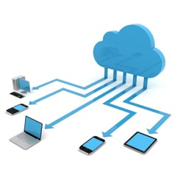

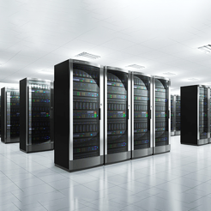
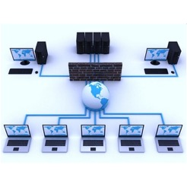
Computing has changed
Always ON, Connected, Real Time
Visual and has sensors
Workforce is fluid and global
Takes ONE finger to use
Users are changing the way IT works
Wicked smart
Cognitive
AI
Automation
Calculation
Digital
Cloud
Internet
Client server
Mainframes
Monolithic
Client server
Webservices
Microservices

Slide 5
The Intelligent and Connected Enterprise Top Trends
Security & Privacy
Augmented Intelligence
Augmented Humanity
Total Workforce
New Commerce
1 Trillion Machines
IQ of 1,000
Living to 100
Changing Climate
Nature of Conflict

Slide 6
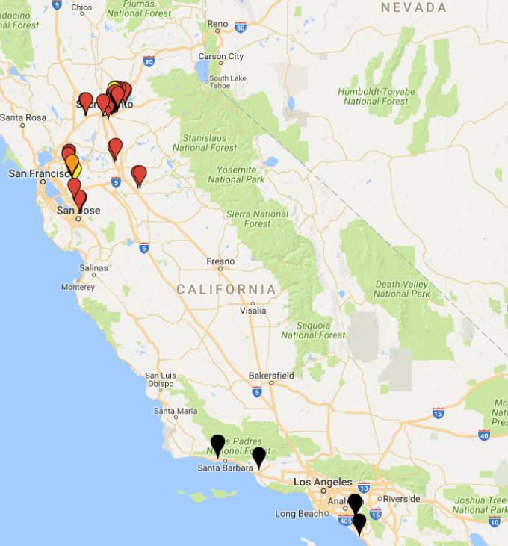

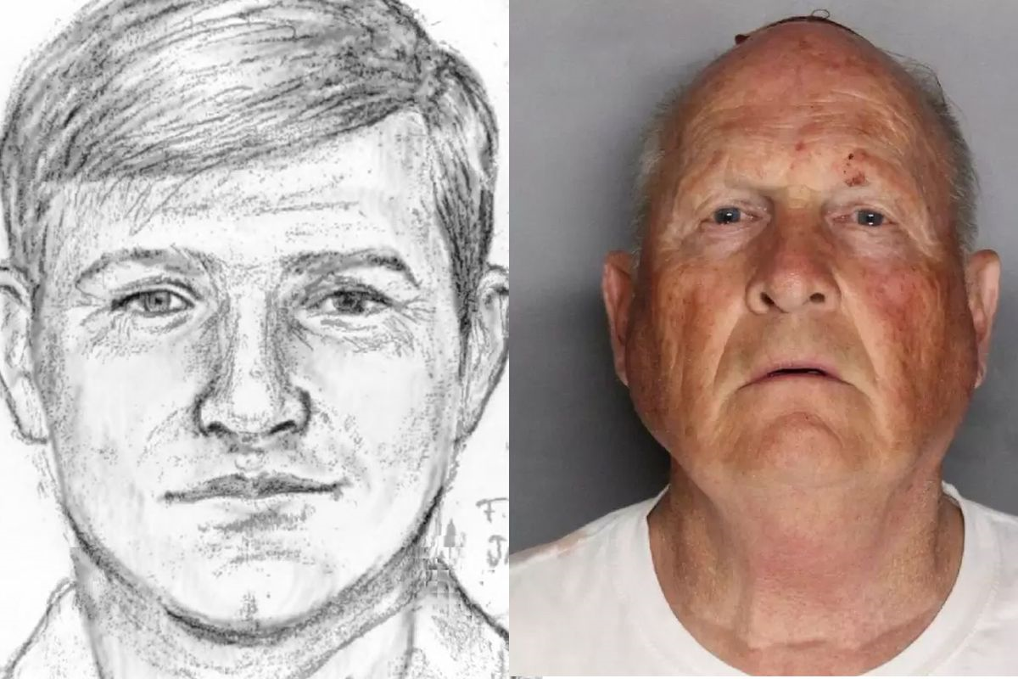
Security & Privacy
Actors involved in breaches
The Golden State killer
Advancing technology for humanity
60%
External
40%
Breaches
Internal
20%
Partner
Multiple
0%
2010
2011
2012
2013
2014
2015
2016
2017
28% of attacks are internal

Slide 7
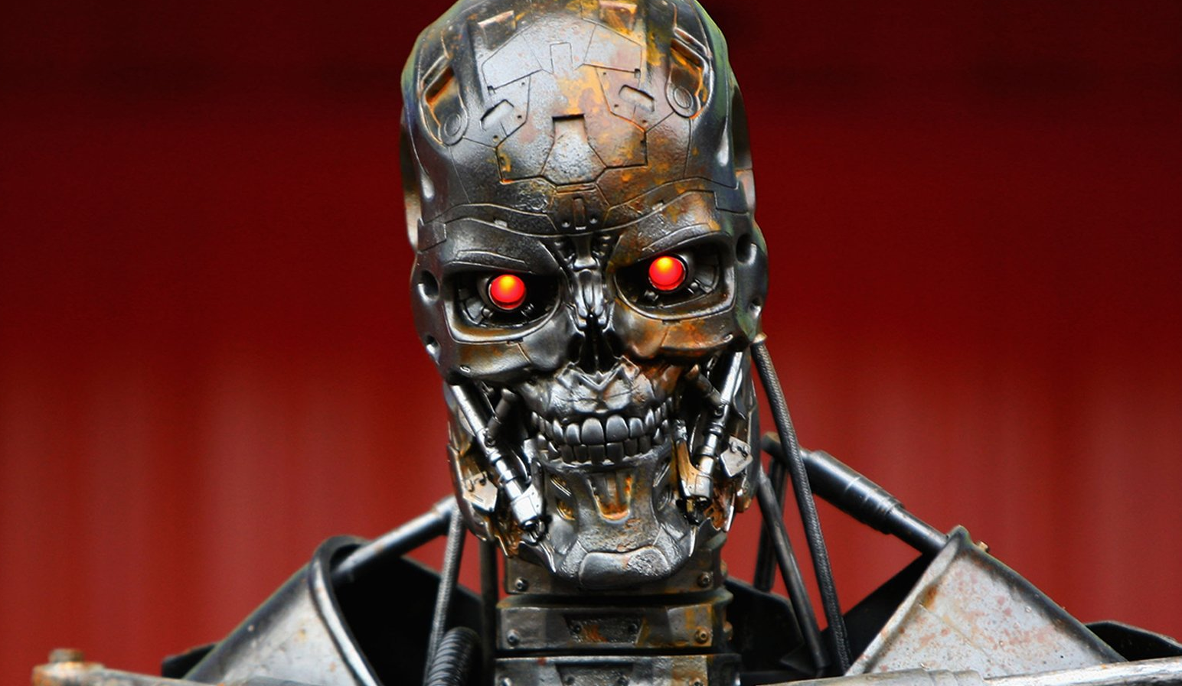
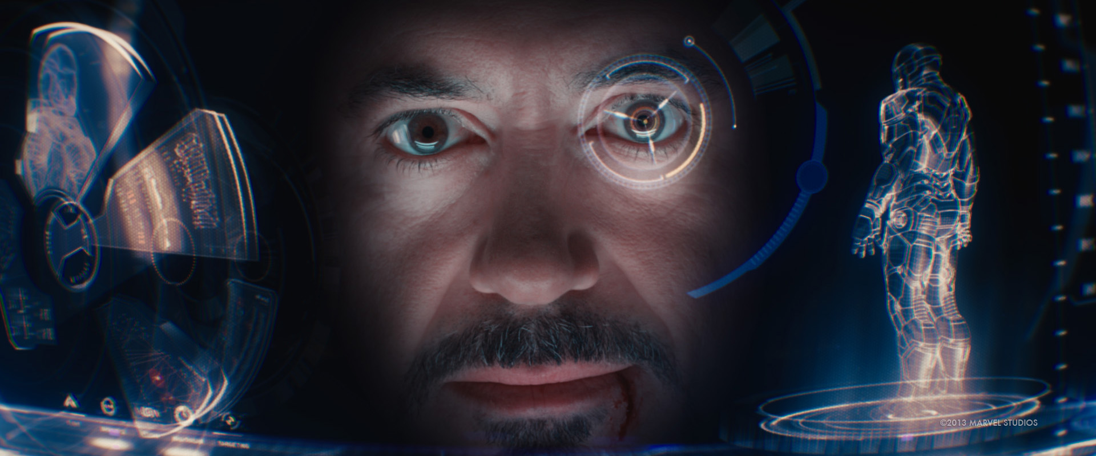
Augmented Intelligence
AI driven business
Man v Machine (Less like this)
Man + Machine (More like this)

Slide 8
Augmented Humanity
World hunger and poverty
Technology gives enormous power to humans
How do we feed 9 billion people by 2050?
By 2025, 6.3% (512 million people) continue to live in extreme poverty
#1 UN Priority: Eliminating poverty
14%
11%
of Canadians live in poverty
(1 in 7 people)
of the world lives in extreme poverty
(767 million people live on less than $2 dollars a day)
Notes:
https://www.cpj.ca/poverty-trends-2017
https://www.cpj.ca/sites/default/files/docs/files/PovertyTrendsReport2017.pdf
Additional Points:
http://uis.unesco.org/en/news/education-data-release-one-every-five-children-adolescents-and-youth-out-school
https://www.theguardian.com/environment/2018/may/21/human-race-just-001-of-all-life-but-has-destroyed-over-80-of-wild-mammals-study
https://worldpoverty.io/

Slide 9
Total Workforce: New Geography of Work
Percentage of jobs, by skill level, at a high risk of being automated in 20 years.
Low-skill jobs at great risk
Gen Y/Z booming
Workforce is global and contingent
60% of people now live in countries with stagnant or shrinking workforces
Tech job seekers are 50% more likely to search across borders compared to others
China and India will be the world's main source for skilled workers over the next two decades, adding 184 million workers to the global labour market
Notes:
https://medium.com/@nath_leigh/low-skilled-humans-need-not-apply-the-growth-quality-and-polarization-of-new-jobs-9e41049b863c
For additional consideration:
https://www.weforum.org/agenda/2016/01/four-changes-shaping-the-labour-market/
http://reports.weforum.org/future-of-jobs-2016/employment-trends/
http://www.industryweek.com/talent/5-employment-trends-2018
http://blog.indeed.com/2016/06/22/global-economy-employment-trends/

Slide 10
New Commerce
Bitcoin vs. Gold Year to Date
Shift from high value – low volume … to low value – high volume
Ecommerce 18% of the worlds commerce
Bitcoin worth more than gold
Gold
Bitcoin
$20,000
$15,000
$10,000
$5,000
0
A
M
J
J
A
S
O
N
D
J
F
M
(Last Data Point on March 2018)
2018
Notes:
https://www.cnbc.com/2018/04/21/bitcoin-nipping-at-gold-demand.html

Slide 11
1 Trillion Machines
Number of Devices In the Internet of Everything
1 Trillion Machines by 2030
End-points are changing (cars, planes, engines, drones, ATM, wearables, RFID tags, and more)
End-points are smart, and vulnerable
The Industrial IoT will add $14 trillion to the global economy by 2030
Internet of Things
Connected Cars
Wearables
Connected/Smart TVs
Tablets
Smartphones
Personal Computers
35
30
25
Five-Year (2014-2019)
CAGR 35%
20
Billions of devices
15
10
5
0
2013
2014
2015E
2016E
2017E
2018E
2019E
Notes:
file://wlfile01/CEO_PMO_Shared/CEO%20PMO%20(sschultz)%20(sschultz)/Ad%20Hoc%20Presentations/Financial%20Executives%20International%20(FEI)%20-%20Keynote/Research/enabling-IOT.pdf
Bullets:
https://www.visioncritical.com/internet-of-things-stats/
https://www.fool.com/investing/2017/08/11/11-internet-of-things-stats-that-will-blow-you-awa.aspx
https://www.skyhookwireless.com/blog/iot/internet-of-things-statistics

Slide 12
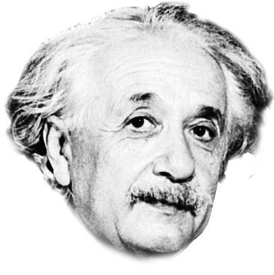
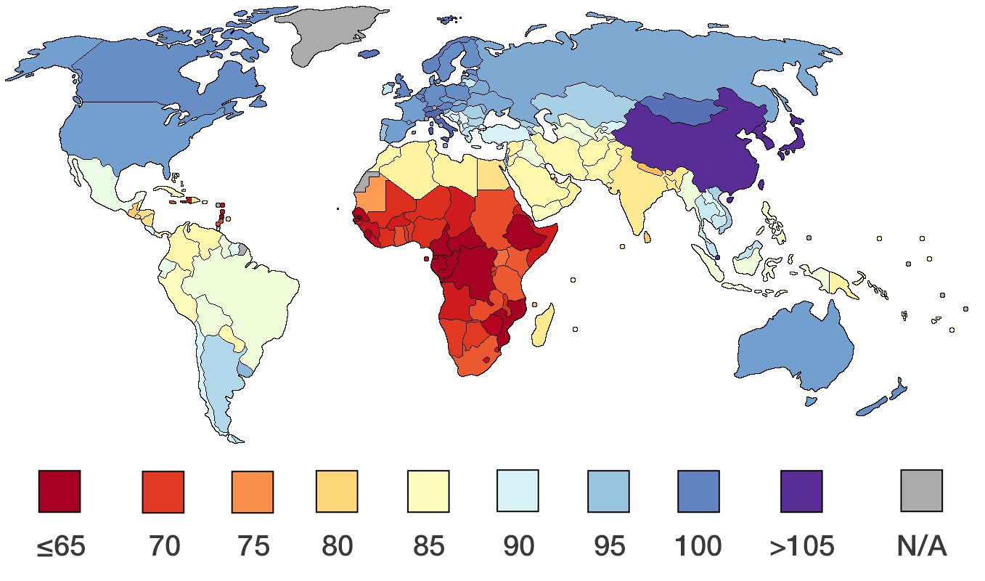
IQ of 1,000
Einstein’s IQ
Average IQ by country
Einstein’s IQ = 160+
70%
55
70
85
100
115
130
145
Mentally inadequate
2.3%
Low intelligence
13.6%
Above average
34.1%
High intelligence
13.6%
Superior intelligence
2.1%
Exceptionally gifted
0.13%
Average
34.1%

Slide 13
Living to 100
More people will soon be living past 100
Life Extenders v. Immortalists
50% of babies born in the US in 2007 have a life expectancy of 104 or more
In Canada, the average life expectancy for males born in 2012 is 80 and for females 84
The traditional 3-stage lifecycle (education, career, retirement) will evolve into multiple lifecycles containing two or more different careers in a lifetime
4 million
3,676K
3
Projected
2
2015: 451K
1
95K
0
1990
2000
2010
2020
2030
2040
2050
Notes:
https://ei.marketwatch.com/Multimedia/2016/04/21/Photos/ZH/MW-EK848_centen_20160421103101_ZH.jpg?uuid=ab9e3e1a-07cd-11e6-9e86-0015c588dfa6
Top 3 points:
http://www.everythingzoomer.com/health/longevity/2017/07/24/live-to-100/
https://hbr.org/2016/06/how-work-will-change-when-most-of-us-live-to-100

Slide 14
Changing Climate
Florida
Eastern US Coastline
By 2045, sea levels could rise 5.5 feet higher than today causing significant risk to life and property (affecting over 1.5 million Floridians)
2011 to 2015, sea level rose an inch per year in some locales from North Carolina to Florida

Slide 15
Nature of Conflict
Bombing Gaza Power Plant - 2014
Cyber attack at Iran Bou Ai Sina Complex Fire - 2016

Slide 16
It’s an Amazing Time
Security & Privacy
Augmented Intelligence
Augmented Humanity
Total Workforce
New Commerce
Actors involved in breaches
14%
11%
Gold
Bitcoin
$20K
External
of Canadians live in poverty
(1 in 7 people)
of the world lives in extreme poverty
(767 million people live on less than $2 dollars a day)
$15K
60%
$10K
Breaches
40%
Internal
$5K
20%
Multiple
0
Partner
A
M
J
J
A
S
O
N
D
J
F
M
0%
2018
2010
2011
2012
2013
2014
2015
2016
2017
(Last Data Point on March 2018)
1 Trillion Machines
IQ of 1,000
Living to 100
Changing Climate
Nature of Conflict
35
Einstein’s IQ = 160+
What about yours?
4 million
Five-Year (2014-2019)
CAGR 35%
30
3,676K
25
3
Billions of devices
20
Projected
15
70%
2
10
2015: 451K
5
1
95K
0
2013
2014
2015
2016
2017
2018
2019
55
70
85
100
115
130
145
0
1990
2000
2010
2020
2030
2040
2050
Notes:
Nature of conflict: http://foreignpolicy.com/2018/03/26/the-drones-are-back/
Machines everywhere: https://cdn.ihs.com/www/pdf/enabling-IOT.pdf
AI everywhere: https://www.automationworld.com/natural-progression-artificial-intelligence

Slide 17
Thank you
twitter.com/opentext
facebook.com/opentext
linkedin.com/company/opentext
opentext.com

