Slide 1


HAS YOUR DB PENSION PLAN FAILED YOU?
Speaker: Mathieu Tessier
Managing Director, Client Relationships, Defined Benefit Solutions, Sun Life
June 2019

Slide 2


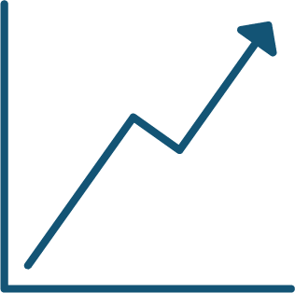
A NEW BUSINESS IDEA?
Notes:
Once upon a time there was a company with a subsidiary
Public company with a subsidiary that started back in the 1970s
Back then it was generating lots of cash and didn’t really cause the company much concern

Slide 3



WELCOME TO THE DB PENSION DIVISION
DB Pension Division
Annuity
Plan members

Slide 4

YOUR PENSION PLAN’S BUSINESS MODEL
Plan members
DB Pension Division
Annuity
Plan members

Slide 5





YOUR DB PENSION DIVISION IN PERSPECTIVE
Small widgets
Large widgets
Shinier widgets
DB Pension Division
U.S. business
Asia business

Slide 6
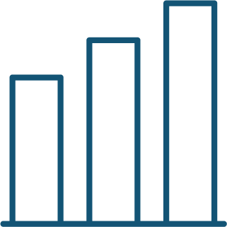


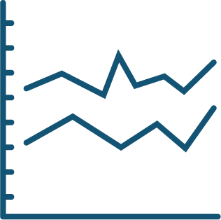


TOO MANY RISKS, TOO MANY BETS
Equity risk
Interest rate risk
Credit mismatch
risk
Yield mismatch risk
Longevity risk
Foreign exchange risk
Inflation risk
Notes:
Many divisions of a company operate by borrowing money and investing it in the hopes of achieving a superior return. For example, if you borrow money to build a new manufacturing facility or make an acquisition, you do so with the expectation of achieving a return that exceeds the cost of servicing the underlying debt. This concept is often referred to as financial leverage.
Thinking of the DB pension plan as a division within your company helps illustrate how asset allocation decisions in the pension plan affect financial leverage, even if this financial leverage doesn’t show up in traditional accounting presentations.
In essence, your DB pension plan is an insurance subsidiary – the “DB Pension Division” – that provides a single product (an annuity) to a single group of customers (your pension plan members).
Just like other divisions, the DB Pension Division has creditors (in this case it’ the plan members) and invests the borrowed money with the hopes of achieving a superior return.
The DB Pension Division is profitable if its investments perform well and outpace its payments to creditors.
However, if its investments perform poorly, the DB Pension Division may require cash infusions from other areas of the company. This is financial leverage.
Perhaps surprisingly, even if a company expects equity returns in the DB Pension Division to outpace the underlying cost of servicing the liabilities, it may not be a good use of financial leverage.
For example, if pension plan assets are invested in equities, the business model of the DB Pension Division can be boiled down to issuing debt (by making long term debt-like promises to its pensioners) to invest in return-seeking assets like equities. It’s unlikely that a company would employ this business model in any other division because it doesn’t create a competitive advantage for its shareholders.

Slide 7
YOUR DB PENSION DIVISION HAD A BUMPY RIDE
130%
Pension health index
120%
110%
100%
Solvency ratio
90%
80%
70%
60%
1999
2000
2001
2002
2003
2004
2005
2006
2007
2008
2009
2010
2011
2012
2013
2014
2015
2016
2017
2018
2019
MERCER PENSION HEALTH INDEX

Slide 8

AN EXPENSIVE BUSINESS MODEL
Pension deficits have been costly for Canadian companies:
$124 BILLION
IN DEFICIT CONTRIBUTIONS BETWEEN 1997-2016
Notes:
Click – everything on the slide except the $124 Billion
The average DB plan is close to fully funded now but when you think about it… it was close to fully funded 20 years ago
Click – $124 Billion appear
Over a period of 20 years (between 1996 and 2016), companies in Canada have had to contribute more than $124 billion to shore up the funding levels in their DB pension plans
If the traditional DB business model had been successful, plans would be well over 100% funded and these additional contributions wouldn’t have been required.
In other words, the pension plan has destroyed value for the company’s shareholders and put the plan participants’ retirement at risk.
TRANSITION: Market has accelerated because so many companies liked the deal on the table… pay a one time amount of money, get benefit security for your plan members, and get rid of the pension related risks, so that risk budget can be re deployed in the core business
Click – everything except the suitcases

Slide 9

THE FUTURE IS CLOUDY
The world needs to start panicking about Brexit
Eurozone slowdown fuels fears about global growth
Why US-China trade war is a ticking time bomb
Interest rate hikes on hold as economy slows
Notes:
Click – everything on the slide except the $124 Billion
The average DB plan is close to fully funded now but when you think about it… it was close to fully funded 20 years ago
Click – $124 Billion appear
Over a period of 20 years (between 1996 and 2016), companies in Canada have had to contribute more than $124 billion to shore up the funding levels in their DB pension plans
If the traditional DB business model had been successful, plans would be well over 100% funded and these additional contributions wouldn’t have been required.
In other words, the pension plan has destroyed value for the company’s shareholders and put the plan participants’ retirement at risk.
TRANSITION: Market has accelerated because so many companies liked the deal on the table… pay a one time amount of money, get benefit security for your plan members, and get rid of the pension related risks, so that risk budget can be re deployed in the core business
Click – everything except the suitcases

Slide 10

SPEND MORE TIME ON YOUR CORE BUSINESS
Human resources
Pension plan
Human resources
Finance
Operations
Technology
Finance
Marketing
Pension plan
Technology
Business strategy
Operations
Business strategy
Innovation
Innovation
Marketing

Slide 11

“These transactions continue our objective to de-risk the balance sheet ... while retirees and their beneficiaries will receive equivalent pension benefits from highly rated insurance companies.”
— Walter G. Borst, executive vice president and Chief Financial Officer, Navistar International Corp.
“We're in the business of making great cars — that's our core competency. It's not managing pension investments to provide a lifetime income to folks.”
— Jim Davlin, vice president of finance and treasurer, General Motors
Notes:
Click – everything on the slide except the $124 Billion
The average DB plan is close to fully funded now but when you think about it… it was close to fully funded 20 years ago
Click – $124 Billion appear
Over a period of 20 years (between 1996 and 2016), companies in Canada have had to contribute more than $124 billion to shore up the funding levels in their DB pension plans
If the traditional DB business model had been successful, plans would be well over 100% funded and these additional contributions wouldn’t have been required.
In other words, the pension plan has destroyed value for the company’s shareholders and put the plan participants’ retirement at risk.
TRANSITION: Market has accelerated because so many companies liked the deal on the table… pay a one time amount of money, get benefit security for your plan members, and get rid of the pension related risks, so that risk budget can be re deployed in the core business
Click – everything except the suitcases

Slide 12


SMART COMPANIES ARE TAKING ACTION
Reduce
time and attention
Reduce cash and accounting surprises
Enhance
benefit security

Slide 13
MARKETS REWARD COMPANIES THAT DE-RISK
+1.75%
Molson Coors
2017
Risk reduced by 5%
+1.42%
CBS Corporation
2017
Risk reduced by 4%
+0.60%
International Paper
2017
Risk reduced by 5%
+1.08%
Hartford Financial
2017
Risk reduced by 8%
-1.14%
United Technologies
2016
Risk reduced by 2%
-1.08%
WestRock
2016
Risk reduced by 22%
+0.12%
PPG Industries
2016
Risk reduced by 6%
+5.58%
J.C. Penney
2015
Risk reduced by 58%
+0.65%
Philips
2015
Risk reduced by 6%
+0.06%
Kimberly-Clark
2015
Risk reduced by 6%
Note: announcement day returns relative to the S&P 500 Index.
Source: Divesting to create shareholder value; The Prudential Insurance Company of America; 2018.
Notes:
Click – title + call out box appear
Prudential recently published a study in the U.S., to look at that impact.
In the article, they talk about the fact that these transactions are more than “annuity purchases”, they are a divestiture of a non-core operation
No different than any other M&A work done proactively to strategically shrink unprofitable segments, to focus on core businesses
Click – all the blue boxes appear
The study looked at companies that reduced pension liabilities. And for each case, looked at the stock price outperformance on the date the transaction was announced to the public – we show some examples on the page here.
TRANSITION: Really the only way to make the pension plan a profitable business segment, is to get the crystal ball out and make accurate predictions for all the different drivers that have an impact on the funded status – how long will people live, the level of interest rates, equity markets, inflation.
Note to Math – some examples on the slide were impacted negatively (2 out of 10). I understand we don’t want to pick and choose and should we only show the most recent ones (2017) to avoid that?

Slide 14

REDUCE FINANCIAL LEVERAGE IN YOUR PLAN
Put it in run-off
Liability driven investments
Divest it
DB Pension Division
Annuities
Notes:
Two simple ways
1) Maintain the flatline with LDI
2) Trade away the unhealthy (volatile) habits completely - annuities

Slide 15
DE-RISKING SOLUTIONS 101
LIABILITY DRIVEN INVESTMENTS
LDI 1.0
Sell equities, buy bonds
Buy longer bonds
LDI 2.0
Duration matching
Index benchmarking
LDI 3.0
Custom portfolio
Custom benchmark
Significant reduction in market risks
Self-insure against longevity

Slide 16

DE-RISKING SOLUTIONS 101
ANNUITIES
Comparing annuities to a passive fixed income portfolio
Insurer
Pension plan
Retirees
Elimination of market risks
Transfer longevity risk to insurer
Yield difference
17 bps additional yield

Slide 17
WHO’S DE-RISKING?
Navistar
2019
$333M
Large deal in January
Alcoa
2018
$750M
Another large
Canadian deal
Loblaw
2017
$350M
Inflation-linked solution
Confidential
2017
$900M
Largest deal
and in-kind transfer
Husky Energy
2017
$70M
First deal with
active members
Molson Coors
2016
$ UNDISCLOSED
Inflation-linked solution
Notes:
A curious feature of the Canadian annuity market is the reluctance of plan sponsors to announce their deals. Even with the steady growth of the annuity market over the past decade, there have been only a few companies that have shared this information publicly, with some examples on this page:
Two clicks – suitcases appear and we see the names of the companies
This is quite a contrast from the U.K. and the U.S. markets where news releases are common.
This trend is starting to change slowly in Canada, because companies realized that not only they got a deal, but the parties affected by the transaction did as well:
For plan members, knowing that their pensions are backed by the strict governance policies and financial strength of an insurer is usually welcomed news, especially after some of the recent bankruptcies
For shareholders, having a corporation redeploy pension risk to their core businesses where they can gain competitive advantages would be seen as good news as well.
TRANSITION: In fact, we don’t talk a lot about the positive impact a transaction like this can have on a company balance sheet

Slide 18
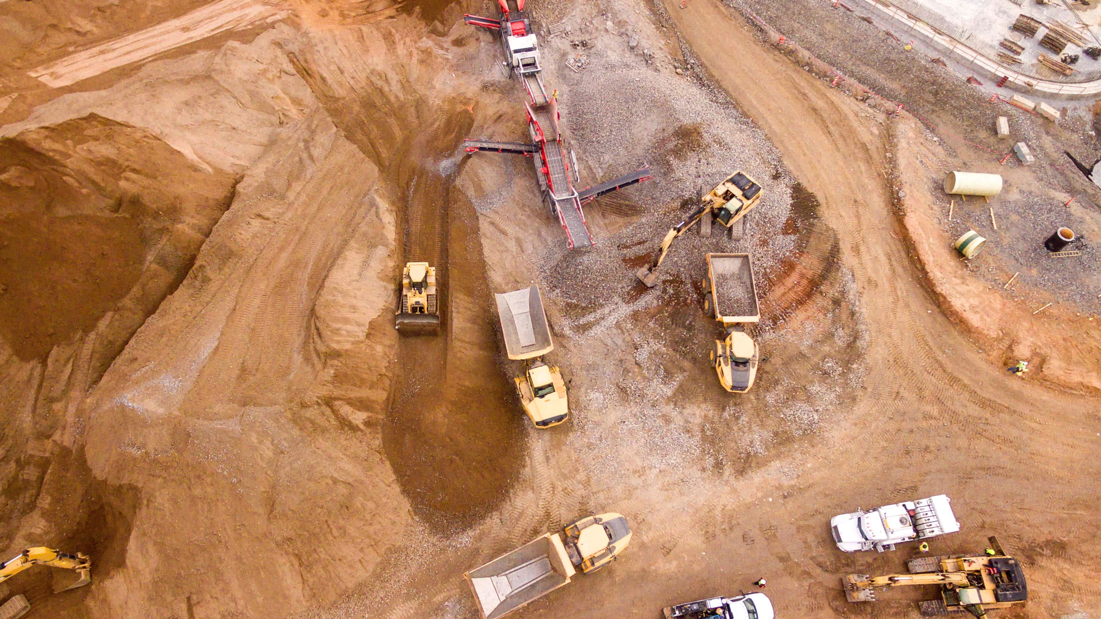
$164 MILLION ANNUITY BUY-OUT DEAL IN 2018
CASE STUDY
Mining company in northern Canada
Total DB assets of ~$430 million
Purchased annuities for over 1,000 inactives
PROACTIVE AND DATA-DRIVEN SPONSOR
A FEW MILLIONS IN SAVINGS + BENEFIT SECURITY FOR
THEIR MEMBERS
Notes:
Click – everything on the slide except the $124 Billion
The average DB plan is close to fully funded now but when you think about it… it was close to fully funded 20 years ago
Click – $124 Billion appear
Over a period of 20 years (between 1996 and 2016), companies in Canada have had to contribute more than $124 billion to shore up the funding levels in their DB pension plans
If the traditional DB business model had been successful, plans would be well over 100% funded and these additional contributions wouldn’t have been required.
In other words, the pension plan has destroyed value for the company’s shareholders and put the plan participants’ retirement at risk.
TRANSITION: Market has accelerated because so many companies liked the deal on the table… pay a one time amount of money, get benefit security for your plan members, and get rid of the pension related risks, so that risk budget can be re deployed in the core business
Click – everything except the suitcases

Slide 19

$230 MILLION HOLISTIC INVESTMENT SOLUTION
CASE STUDY
Global telecommunications firm
Goal of decreasing risk and increasing yield
Reduce cost of future annuity purchase
SPONSOR GOING TO NEXT DE-RISKING PHASE
REDUCED RISK BY HALF + ENHANCED YIELD BY 100 BPS
Notes:
Click – everything on the slide except the $124 Billion
The average DB plan is close to fully funded now but when you think about it… it was close to fully funded 20 years ago
Click – $124 Billion appear
Over a period of 20 years (between 1996 and 2016), companies in Canada have had to contribute more than $124 billion to shore up the funding levels in their DB pension plans
If the traditional DB business model had been successful, plans would be well over 100% funded and these additional contributions wouldn’t have been required.
In other words, the pension plan has destroyed value for the company’s shareholders and put the plan participants’ retirement at risk.
TRANSITION: Market has accelerated because so many companies liked the deal on the table… pay a one time amount of money, get benefit security for your plan members, and get rid of the pension related risks, so that risk budget can be re deployed in the core business
Click – everything except the suitcases

Slide 20



WHAT CAN YOU DO?
TAKE ACTION
Decide
on your DB Pension Division model
Get advice on solutions
Build a plan
and execute it
THE BENEFITS
Decide
on your DB Pension Division model
Get advice on solutions
Build a plan
and execute it
Free up time and effort
Focus on your core business
Protect your plan members
Add value
for your shareholders

