Slide 1


Risk and Insurance Services
Consulting
Marsh Risk and insurance services
Guy Carpenter Risk and reinsurance
Oliver Wyman Group Advisory services through three operating units
Mercer HR consulting, outsourcing, and investment services
Oliver Wyman Global Management Consultant
NERA Economic Consulting Economic analysis and consulting
Lippincott Corporate branding and identity
Brian Elowe
Chief Client Officer
Marsh, North America

Slide 2
Evolving Global Risk Landscape
Economic
Environmental
Geopolitical
Societal
Technological
Top 5 Global Risks in terms of likelihood
 | 2009 | 2010 | 2011 | 2012 | 2013 | 2014 | 2015 | 2016 | 2017 | 2018 | 2019
1 | Asset price collapse | Asset price collapse | Storms and cyclones | Income disparity | Income disparity | Income disparity | Interstate conflict | Involuntary migration | Extreme weather | Extreme weather | Extreme weather
2 | Slowing Chinese economy | Slowing Chinese economy | Flooding | Fiscal imbalances | Fiscal imbalances | Extreme weather | Extreme weather | Extreme weather | Involuntary migration | Natural catastrophes | Climate change mitigation and adaption failure
3 | Chronic disease | Chronic disease | Corruption | Greenhouse gas emissions | Greenhouse gas emissions | Unemployment/ under- employment | National governance failures | Weak climate change response | Natural catastrophe | Cyberattacks | Natural catastrophes
4 | Global governance gaps | Fiscal cries | Biodiversity loss | Cyber attacks | Water supply crises | Climate change | State collapse | Interstate conflict | Terrorist attack | Data fraud | Data fraud
5 | Retrenchment from globalisation | Global governance gaps | Climate change | Water supply crises | Aging population | Cyberattacks | High unemployment | Natural catastrophes | Data fraud | Climate change adaption failure | Cyberattacks
Top 5 Global Risks in terms of impact
 | 2009 | 2010 | 2011 | 2012 | 2013 | 2014 | 2015 | 2016 | 2017 | 2018 | 2019
1 | Asset price collapse | Asset price collapse | Fiscal crises | Systematic financial failure | Systematic financial failure | Fiscal crises | Water crises | Weak climate change response | WMDs | WMDs | WMDs
2 | Retrenchment from globalisation | Retrenchment from globalisation | Climate change | Water supply crises | Water supply crises | Climate change | Infectious diseases | WMDs | Extreme weather | Extreme weather | Climate change mitigation and adaption failure
3 | Oil and gas price spike | Oil price spike | Geopolitical conflict | Food crises | Fiscal imbalances | Water crises | WMDs | Water crises | Natural catastrophes | Natural catastrophes | Extreme weather
4 | Chronic disease | Chronic disease | Asset price collapse | Fiscal imbalances | WMDs | Unemployment/ under-employment | Interstate conflict | Involuntary migration | Water crises | Climate change adaption failure | Water crises
5 | Fiscal crises | Fiscal crises | Extreme energy price volatility | Volatility in energy and agri-cultural prices | Weak climate change response | Critical ICT systems breakdown | Weak climate change response | Energy price shock | Weak climate change response | Water crises | Natural catastrophes
Source: World Economic Forum, Global Risks Report 2019

Slide 3

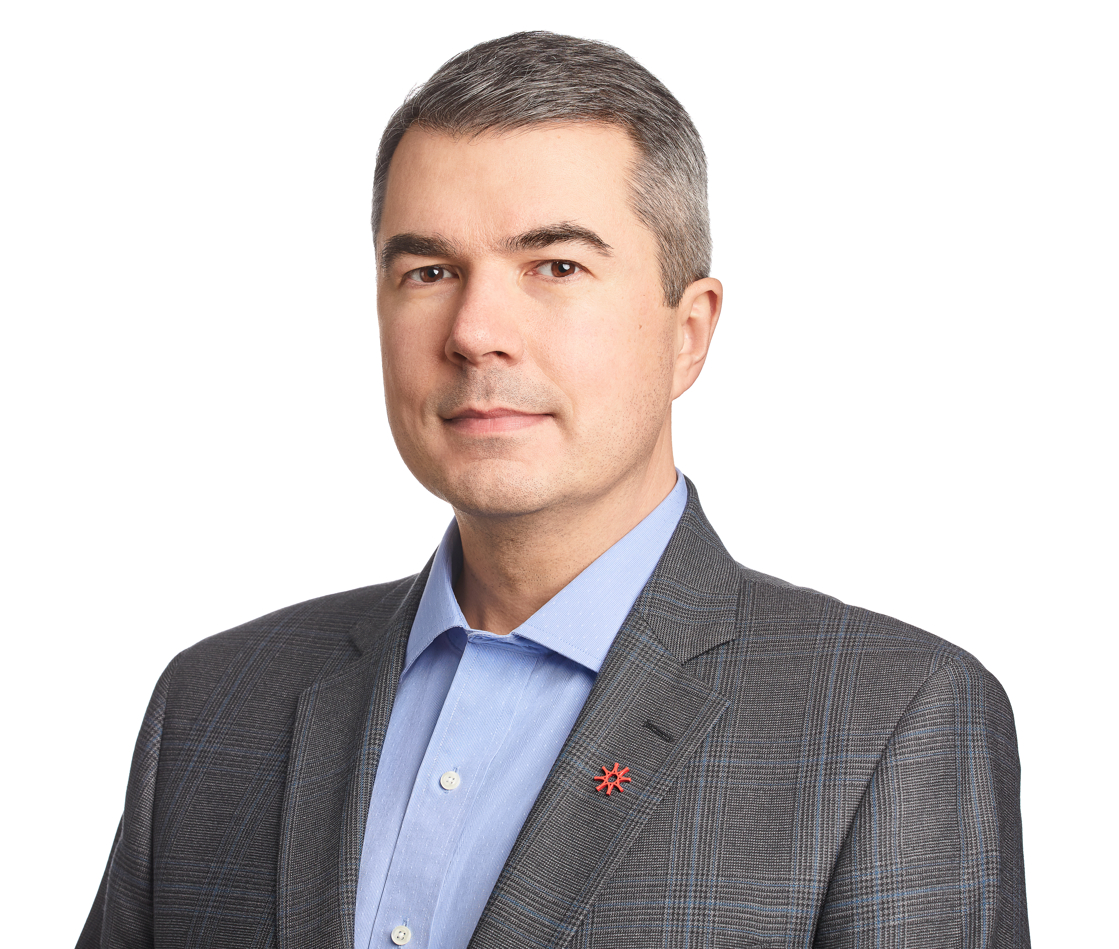

CRO at Payments Canada
Responsibilities: Enterprise-wide risk management programs & business continuity planning
Experience at FI in various corporate development and risk functions
Chartered Professional Accountant, MBA
OUR VISION
A modern payments system is fast, flexible and secure, promotes innovation and strengthens Canada’s competitive position.

Slide 4
DISRUPTION RISKS
Shift in consumer behaviour & desire for faster payments
Emerging technologies
New & changing regulations
ADDRESSING DISRUPTION RISKS
Future-proofing our systems within framework of safety & soundness
PMFI compliance
Modernization: foster innovation & provide convenient, safe & efficient payment options

Slide 5

Ricoh helps Finance leaders mitigate enterprise risk while improving workplace productivity
In Canada:
2,200 employees
18,000 customers
$0.5B annual revenue
2.5% of global business
Founded 1936
200+ global sites 100,000 employees
1.4M customers
$20B annual revenue
Innovation that transforms the way people work, communicate & exchange information through technology
Notes:
We bring practical & material value to the DX conversation starting with our brand promise: We empower the digital workplace. We provide solutions and services that enable digital transformation initiatives that contribute to organisational and transformative change.
For the past 80 years we have focused on innovation that transforms the way people work, communicate & exchange information through technology.
Enterprise risk: corner stone of finance buyer message (theme). o Ricoh helps Finance leaders manage enterprise risk while improving workplace productivity through communications & collaboration; access to information & security; and optimising business processes.

Slide 6
Innovating for the future
AI disrupts Field Service Delivery
Business model transformation
Global
Supply Chain disruption
Notes:
Glen bring s a CIO lens to the technology-driven business model and DX for Ricoh
Business model evolution
Our legacy business maintains dominant market share, however, evolving market needs have outpaced growth opportunities. As a data-driven organisation we’ve strategically expanded our offering based on a data-centric model that leverages cloud technologies to build a platform that drives profitable growth while mitigating risk & exposure.
AI demands a faster pace in Field Service Delivery
CX continues to be a key market differentiator. The rise of AI disrupted technical services delivery, demanding faster turnaround to stem competition risk. Embracing AI as an enabler is helping achieve productivity goals, improve CX, manage costs & reduce competition risk.
Global Supply Chain disruption
via U.S. tariffs to Chinese goods creates bottom line risk & threatens our legacy business.
Innovating for the future
Ricoh has a long history of innovating - for our customers & internally. We’re committed to continual process improvement to optimise information, productivity & employee engagement to align with our strategic objectives.

Slide 7

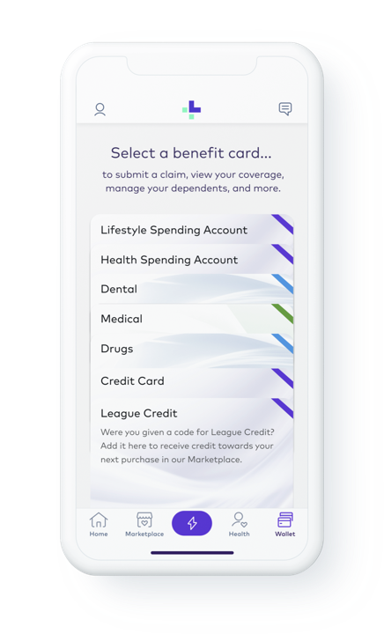






Transforming the Health Benefits Experience

Slide 8
Which of the following disruptors do you think will have the biggest impact on your organization over the next 2-5 years? 1. New competitors/competing business models (e.g. Uber vs. taxis, Airbnb vs. hotels, Amazon vs. traditional retailers) 2. Emerging technologies (e.g. AI, internet of things, drones) 3. Regulatory changes (e.g. carbon tax, data privacy) 4. Changing demographics/societal preferences (e.g. aging baby boomers, Millennials & digital services, social responsibility) 5. Climate change/other environmental risks 6. Customers becoming competitors 7. Not applicable

Slide 9
How did your organization identify your disruption risks? How did you prioritize?
Notes:
Lead response: Peter Dodic

Slide 10
How can a CFO/Finance Executive help in identifying and managing disruption risk?
Notes:
Lead response: Mike Serbinis

Slide 11
How do you think corporate innovation is best achieved? 1. Internal teams 2. External partnerships

Slide 12
What’s the biggest challenge in identifying and managing disruption risk?
Notes:
Lead response: Glen Renton

Slide 13
Does someone need to be responsible for identifying / monitoring disruption risk? If so, who?
Notes:
Lead response: Peter Dodic

