Slide 1
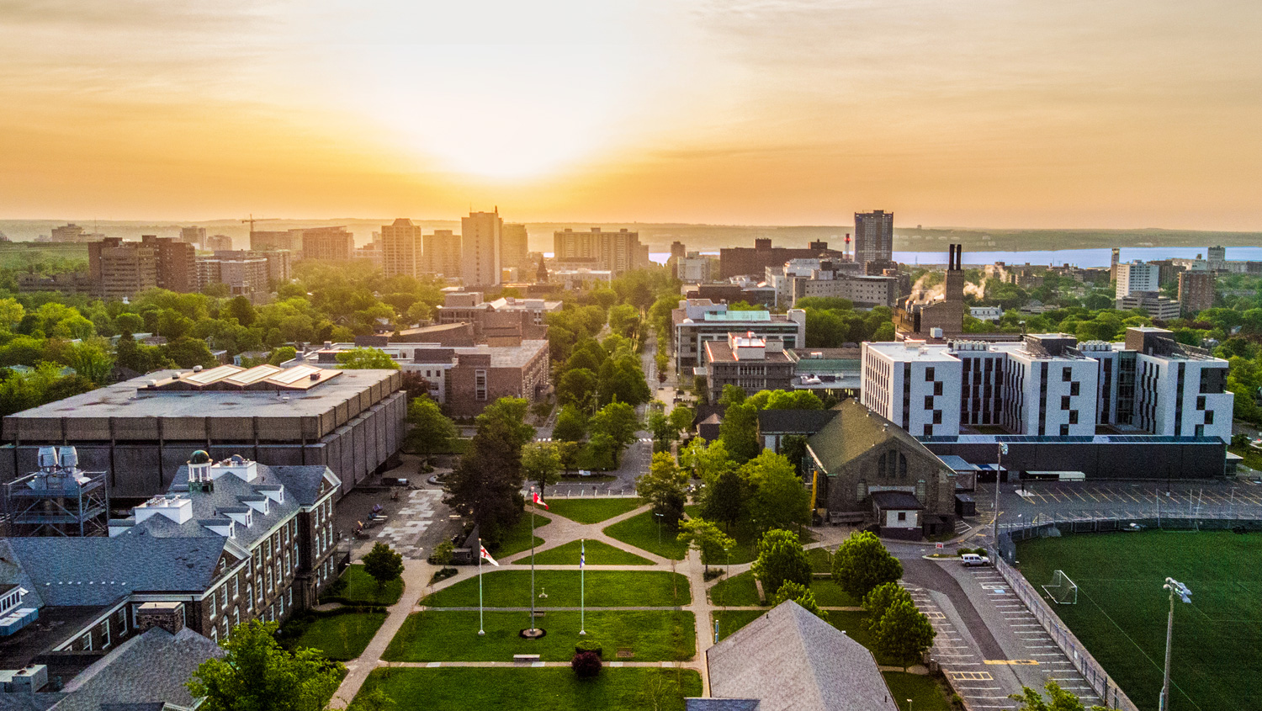

Slide 4
Atlantic Canada’s Economic And Demographic Challenges
Atlantic Canada: 1.57%
Canada : 3.63%
Atlantic Provinces : 0.14%
Canada : 1.11%

Slide 7
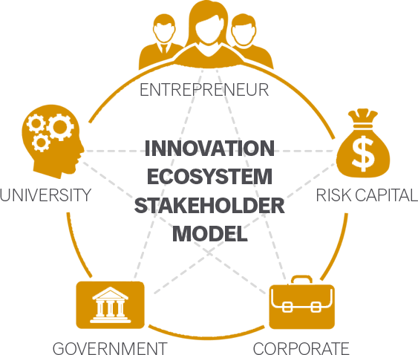
REAP Stakeholder Framework

Slide 8
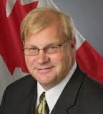
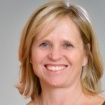
Team

Slide 9
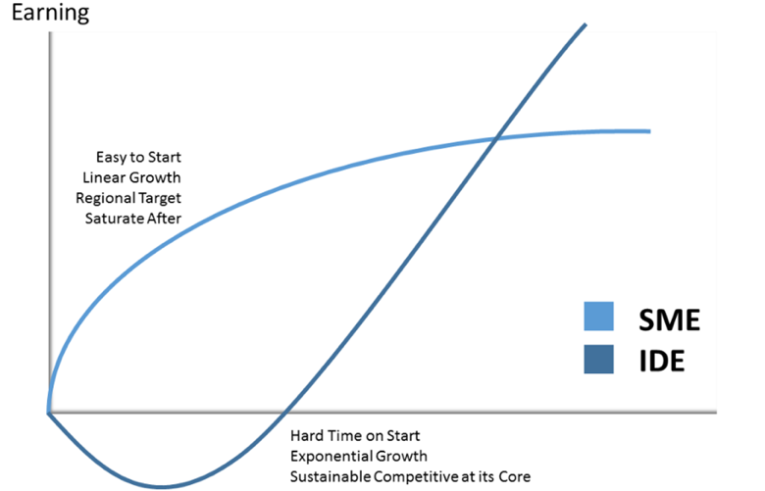
SME vs. IDE
SME: Focused on local and regional markets, not dependent on innovation, little external capital
IDE: Focused on global markets, based on innovation, diverse ownership, requires investment, experience early losses
SME
IDE

Slide 10
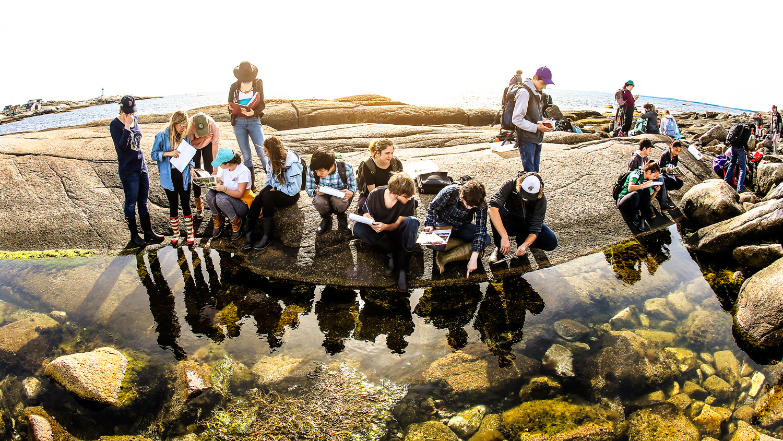

Slide 11
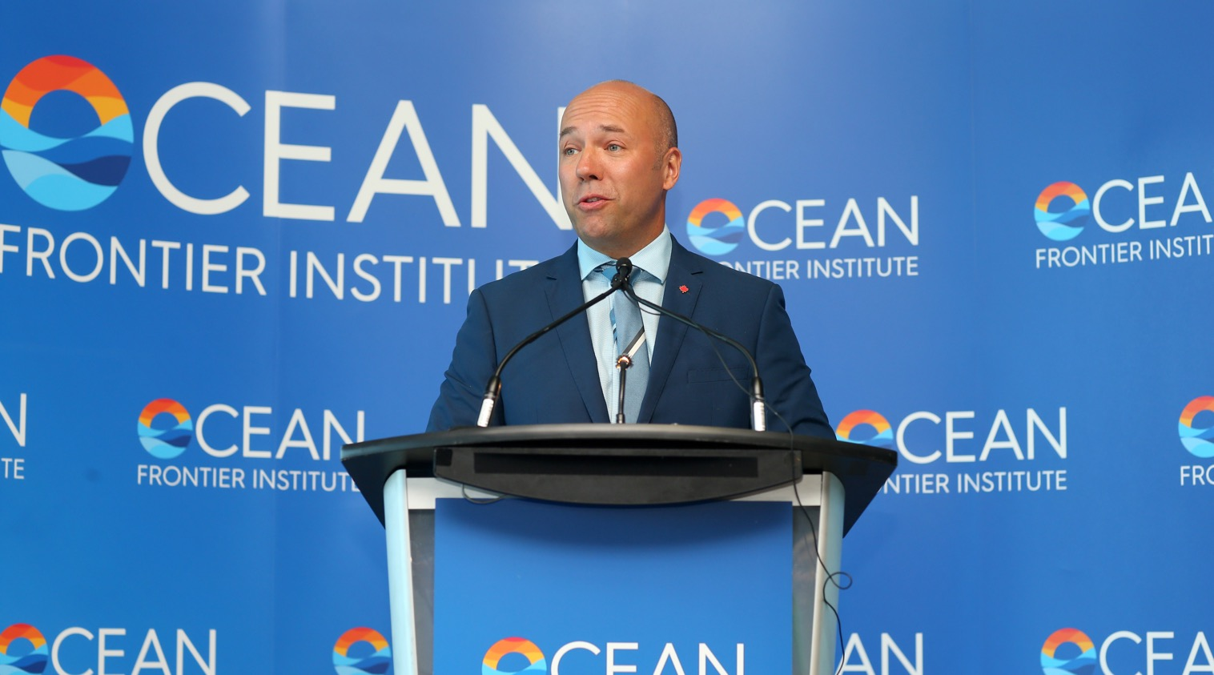

Slide 12
Notes:
John riseley

Slide 14
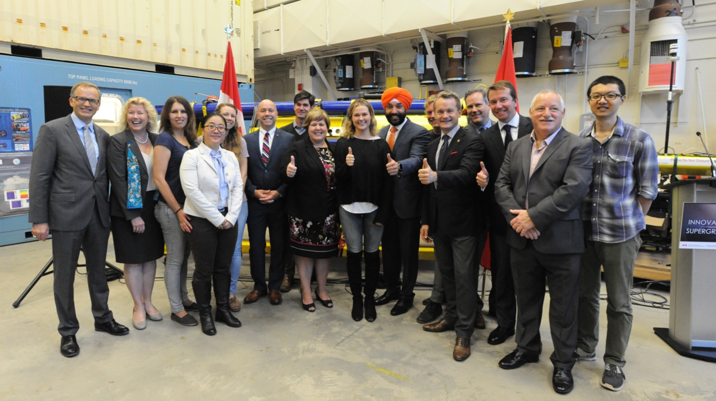
Notes:
Supercluster partnership Ottawa composite

Slide 15
Notes:
More than 100 partners have signed on to be part of the OSC on the basis of this model.
Important note: the large ocean industry members are not the ultimate recipients of funding because activity will be carried out predominantly by other partners in the ecosystem.

Slide 16
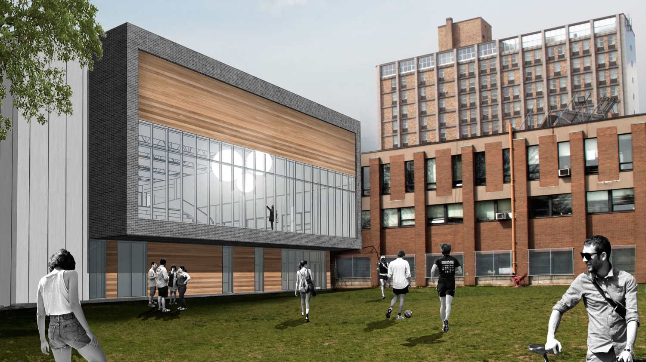

Slide 17
Halifax Innovation District

