Slide 1
FEI CANADA CONFERENCE 2019: DISRUPTED INDUSTRIES
June 6, 2019
Presented by Gord Nelson, CFO

Slide 2
Cineplex - 2003
A theatrical exhibition company
Film
Entertainment
and Content
Theatre
Exhibition
Cinema
Media

Slide 3
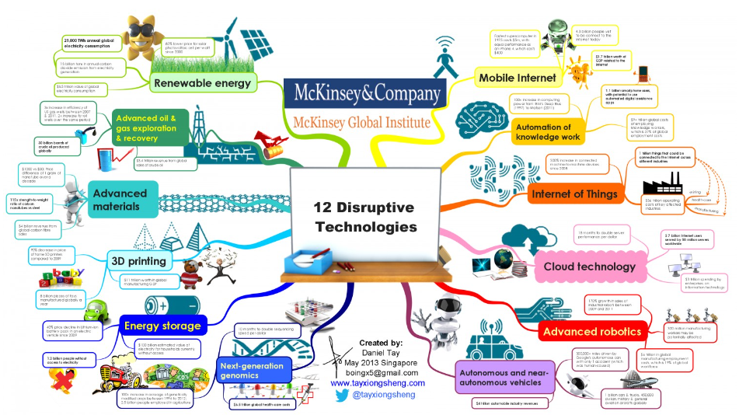
Disruptive Technologies - 2013

Slide 4

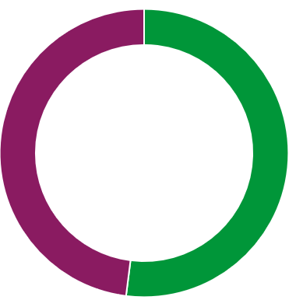
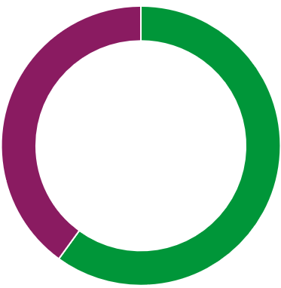
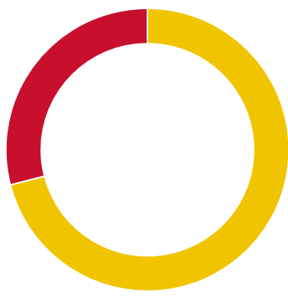


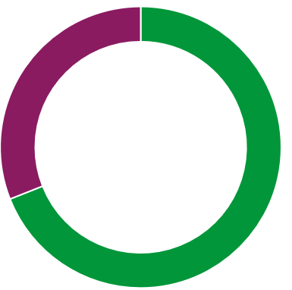

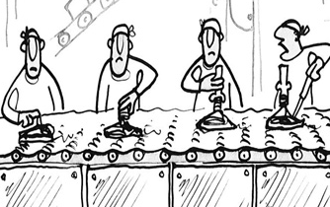
Key Disruptors
Customers more disruptive than competitors
60%
Competitors
52%
Distribution
71%
Customers
57%
Regulations
69%
Production
Source: PwC CEO pulse 2016,

Slide 5









Strategic Options
Technology and strategic partnerships most popular
8%
37%
28%
76%
Entering a new industry.
Other
Collaborating with
competitors
6%
70%
24%
+
4%
Investing in new
technologies
Leaving an
industry
-
Entering a
new region
Forming strategic partnerships
Leaving a region
Source: PwC CEO pulse 2016,

Slide 6

Cineplex Response
+
Entering a new
industry
Investing in new
technologies
Entering new region
Forming strategic partnerships

Slide 7
Cineplex Strategic Toolset
Value Migration
To identify where market (value) mass lives in the future and map activities to acquire and retain share
Bain Wheel
To comprehensively mine for growth opportunities for new and existing lines of business:
- new geographies
- new channels
- new customer segments
- new value chain steps
- new businesses
- new products
Blue Ocean
To exploit opportunities by systematically identifying and developing value drivers that help us create relevance and compete
Transformation
Do it better, Source it better, Do it differently, Drive Value.

Slide 8
Cineplex - 2003
Film
Entertainment
and Content
Theatre
exhibition
Cinema
Media

Slide 9
Cineplex Today
Alternative
Programming
Theatre
Food Service
An entertainment and media company
Digital
Commerce
Film
Entertainment
and Content
Media
Amusement
and Leisure
Theatre
exhibition
Scene
Loyalty
Amusement
Solutions
Cinema
Media
Location
Based
Entertainment
Digital
Place-Based
Media
eSports

