Slide 1
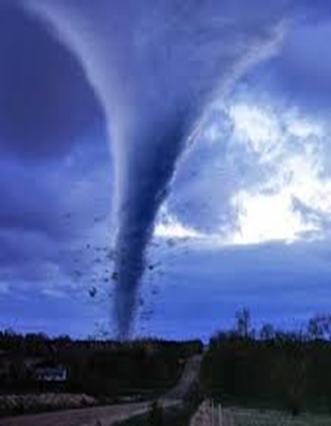
Cost of Execution (COEx)
Destructive vortex of activity ($0.64)
YOU
High costs of execution eventually led to the 2015 financial shortfall.
A
B
2015
Low cost of execution improve long-term sustainability.
Productive whirlwind of activity ($0.29)
COMPETITORS
©2018 Brohman, Brown & McSheffrey

Slide 2
The Destructive Vortex
2013 Performance
COEx
Lack of confidence, communication breakdowns, poor integration.
2014 Performance
COEx
Director disengagement, preferential treatment, infighting etc.
5 Year Strategic Goal
2015 Performance
$$$ ½ of Shortfall
$0.64 Cost of Execution (COEx)
5 Directors left, blame, excuses, lack of trust.

Slide 3
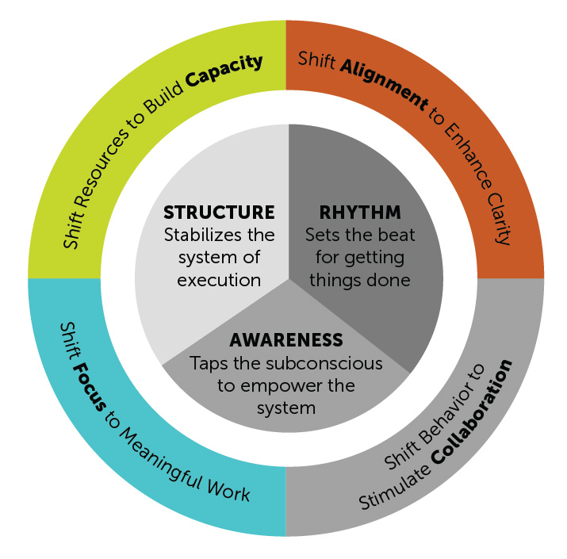
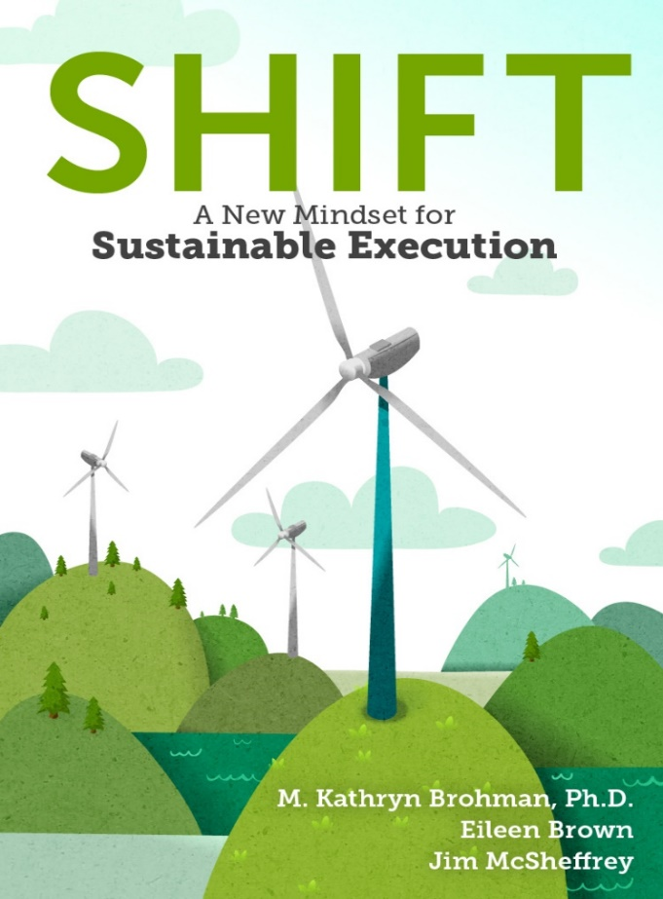
Execution Barriers
Brohman, M.K.. E. Brown, J. McSheffrey. SHIFT: A New Mindset for Sustainable Execution, forthcoming Fall 2018 .

Slide 4
The Road to Recovery
2016 Performance
$ ½ of Shortfall
$0.52 COEx
Reset targets reduced blame, enhanced trust.
2017 Performance
Adjusted Goals
$0.36 COEx
Change in leadership, investment in
integration, revitalized the ‘old way of doing things’
2018 Growth Plan
$0.32 COEx
Equity partner renewed their engagement & they continue to work on identifying and reducing barriers to execution.
New 5 Year Strategy

