Slide 1
Innovating From Within Financial Executives International Canada June 14, 2018
John Hugo, Vice President, Financials Products and Go To Market

Slide 2
“Wouldn’t it be cool if…”
https://www.youtube.com/watch?v=WHRWr7QqQCU
2

Slide 3
Sources of Innovation
Internal Innovation (among others):
Hackathons (light sabre not included)
Canvas Design System
High level of “technologically curious” employees
Embrace technology as it unfolds
External Innovation (among others):
Workday Community
Workday Cloud Platform
As a result of these and other innovation ideas, Forbes recently named Workday
# 2 on the list of “The World’s Most Innovative Companies”
2

Slide 4
The stars of “Wouldn’t it be cool if…”
3

Slide 5
Why Continuous Innovation Works
In-memory Object Model
“If you understand it, it’s not
Innovation…”
EVERY customer on same version
Semi-annual version updates
“If at first the idea is not absurd,
then there is no hope for it…”
Notes:
What was required to get P&L to business leader end of month

Slide 6
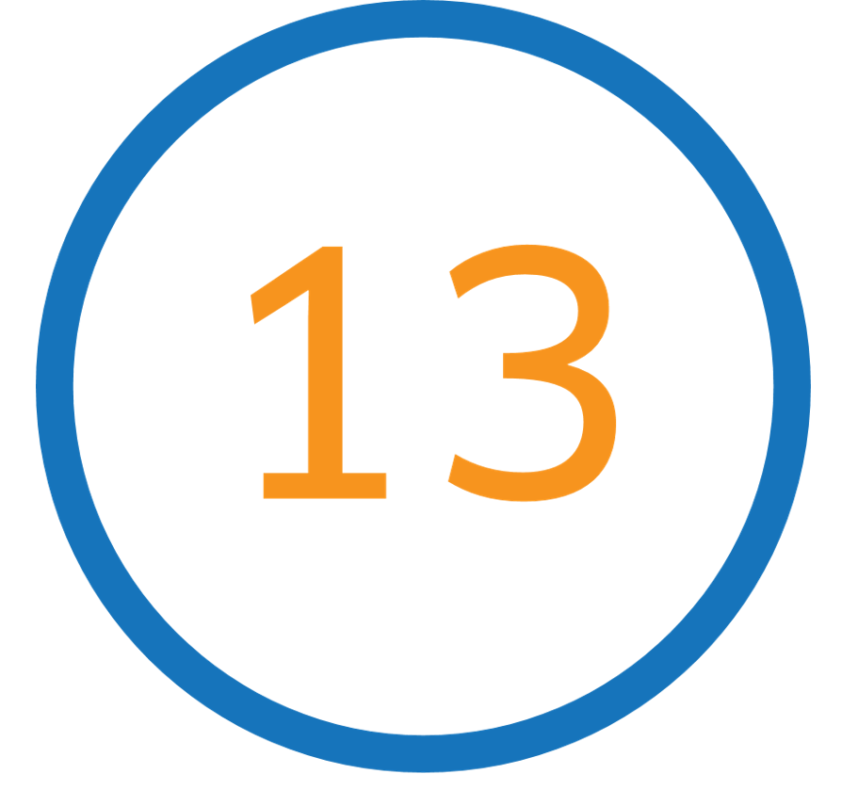
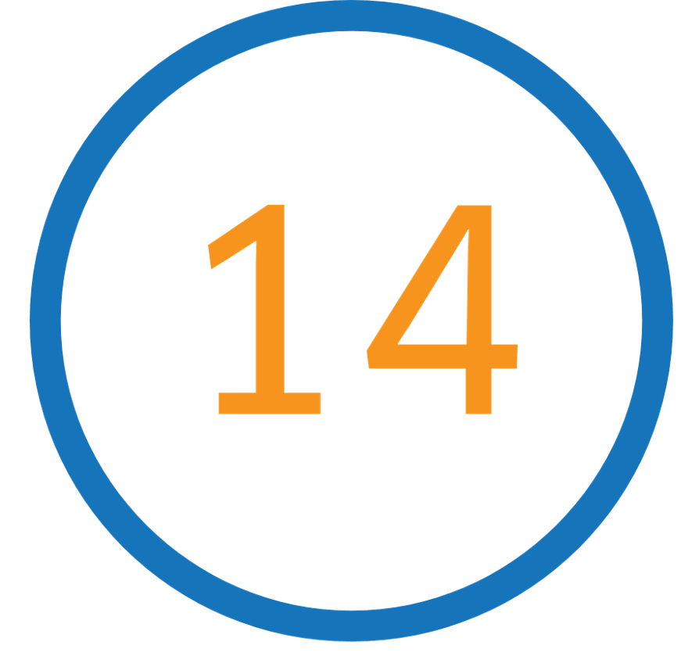
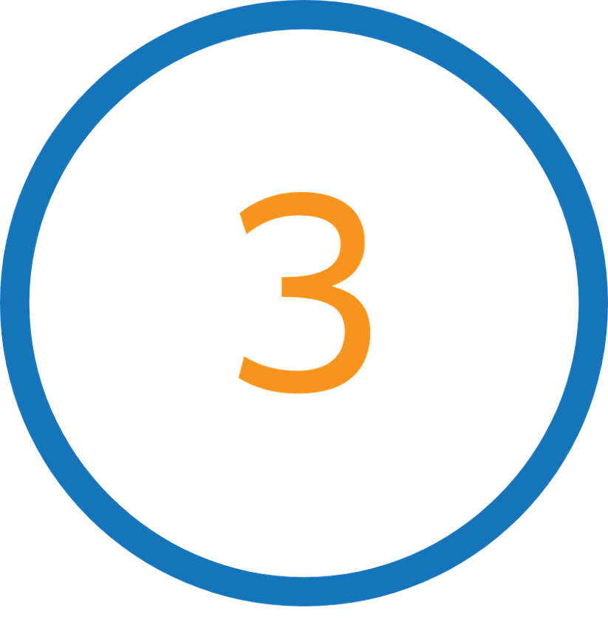
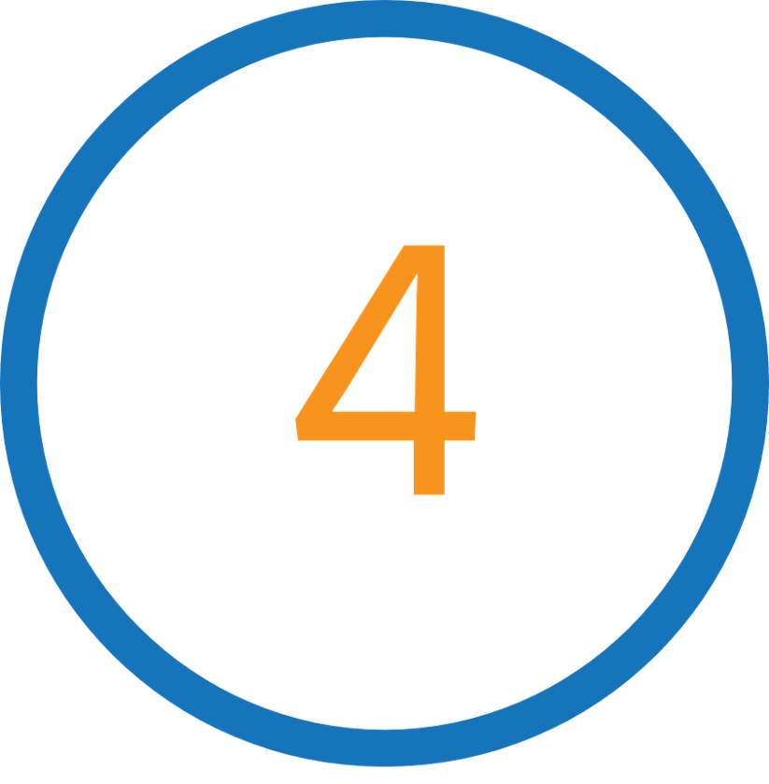
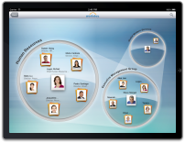
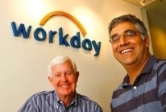
Continuously Innovative ERP Software
Time Tracking
Integration Cloud
iPad®
Payroll
Financials
Unified Talent and HCM
Dave Duffield and Aneel Bhusri
Found Workday
Best Places to Work Bay Area
Best Places to Work Bay Area
Best Places to Work Bay Area
2005 - 2010
2011
2012

Slide 7
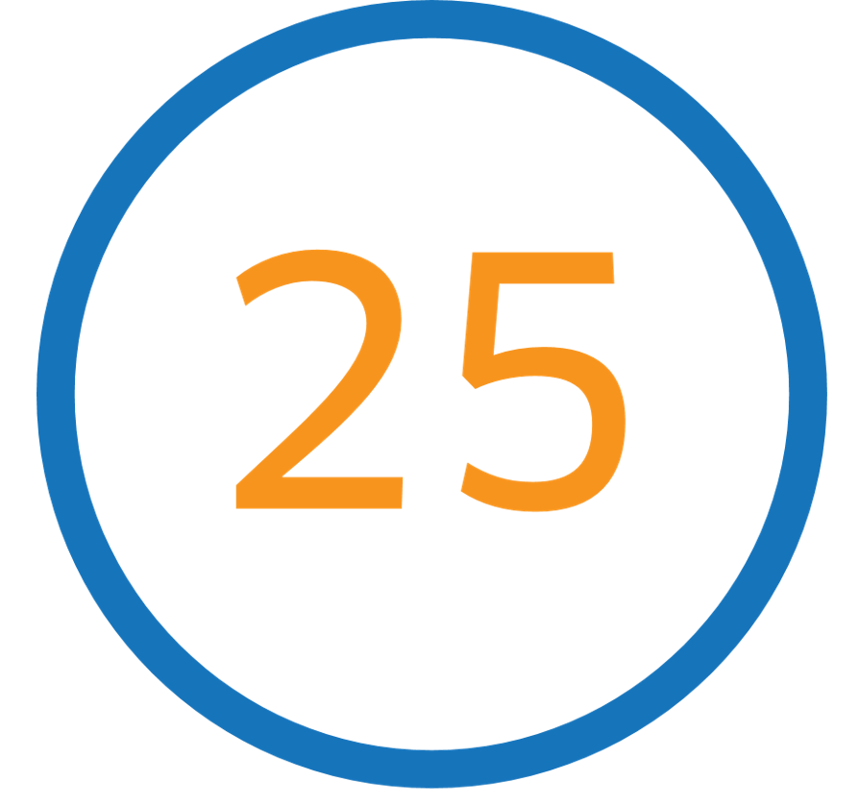
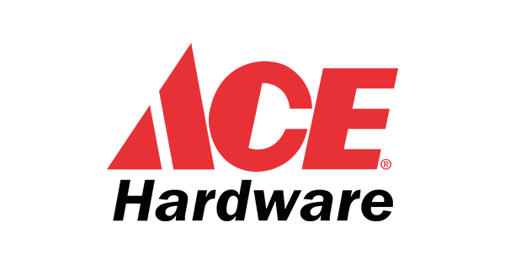
Revolutionizing Enterprise Software
Prism Analytics
Benchmarking
Financial Performance Management
Planning
Learning
Student
Talent Insights
PSA
Inventory
Student
Admissions
French Payroll
Student Recruiting
Big Data Analytics
#18 Forbes Best
Places to Work
#7 Fortune Best
Places to Work
Best Places to Work Bay Area
Best Places to Work Bay Area
Best Places to Work Bay Area
Best Places to Work Bay Area
#3 Best Places
to Work Europe
#3 Great Places to Work (Germany)
2013
2014
2015
2016
2017
2018

Slide 8
Thank you

