Slide 1



OUR CULTURE, OUR DEMOCRACY:
SERVING CANADIANS
^{IN A} TIME ^{OF} DISRUPTION

Slide 2



#1
MOBILE
#2
SOCIAL
#3
FAANG
2

Slide 3
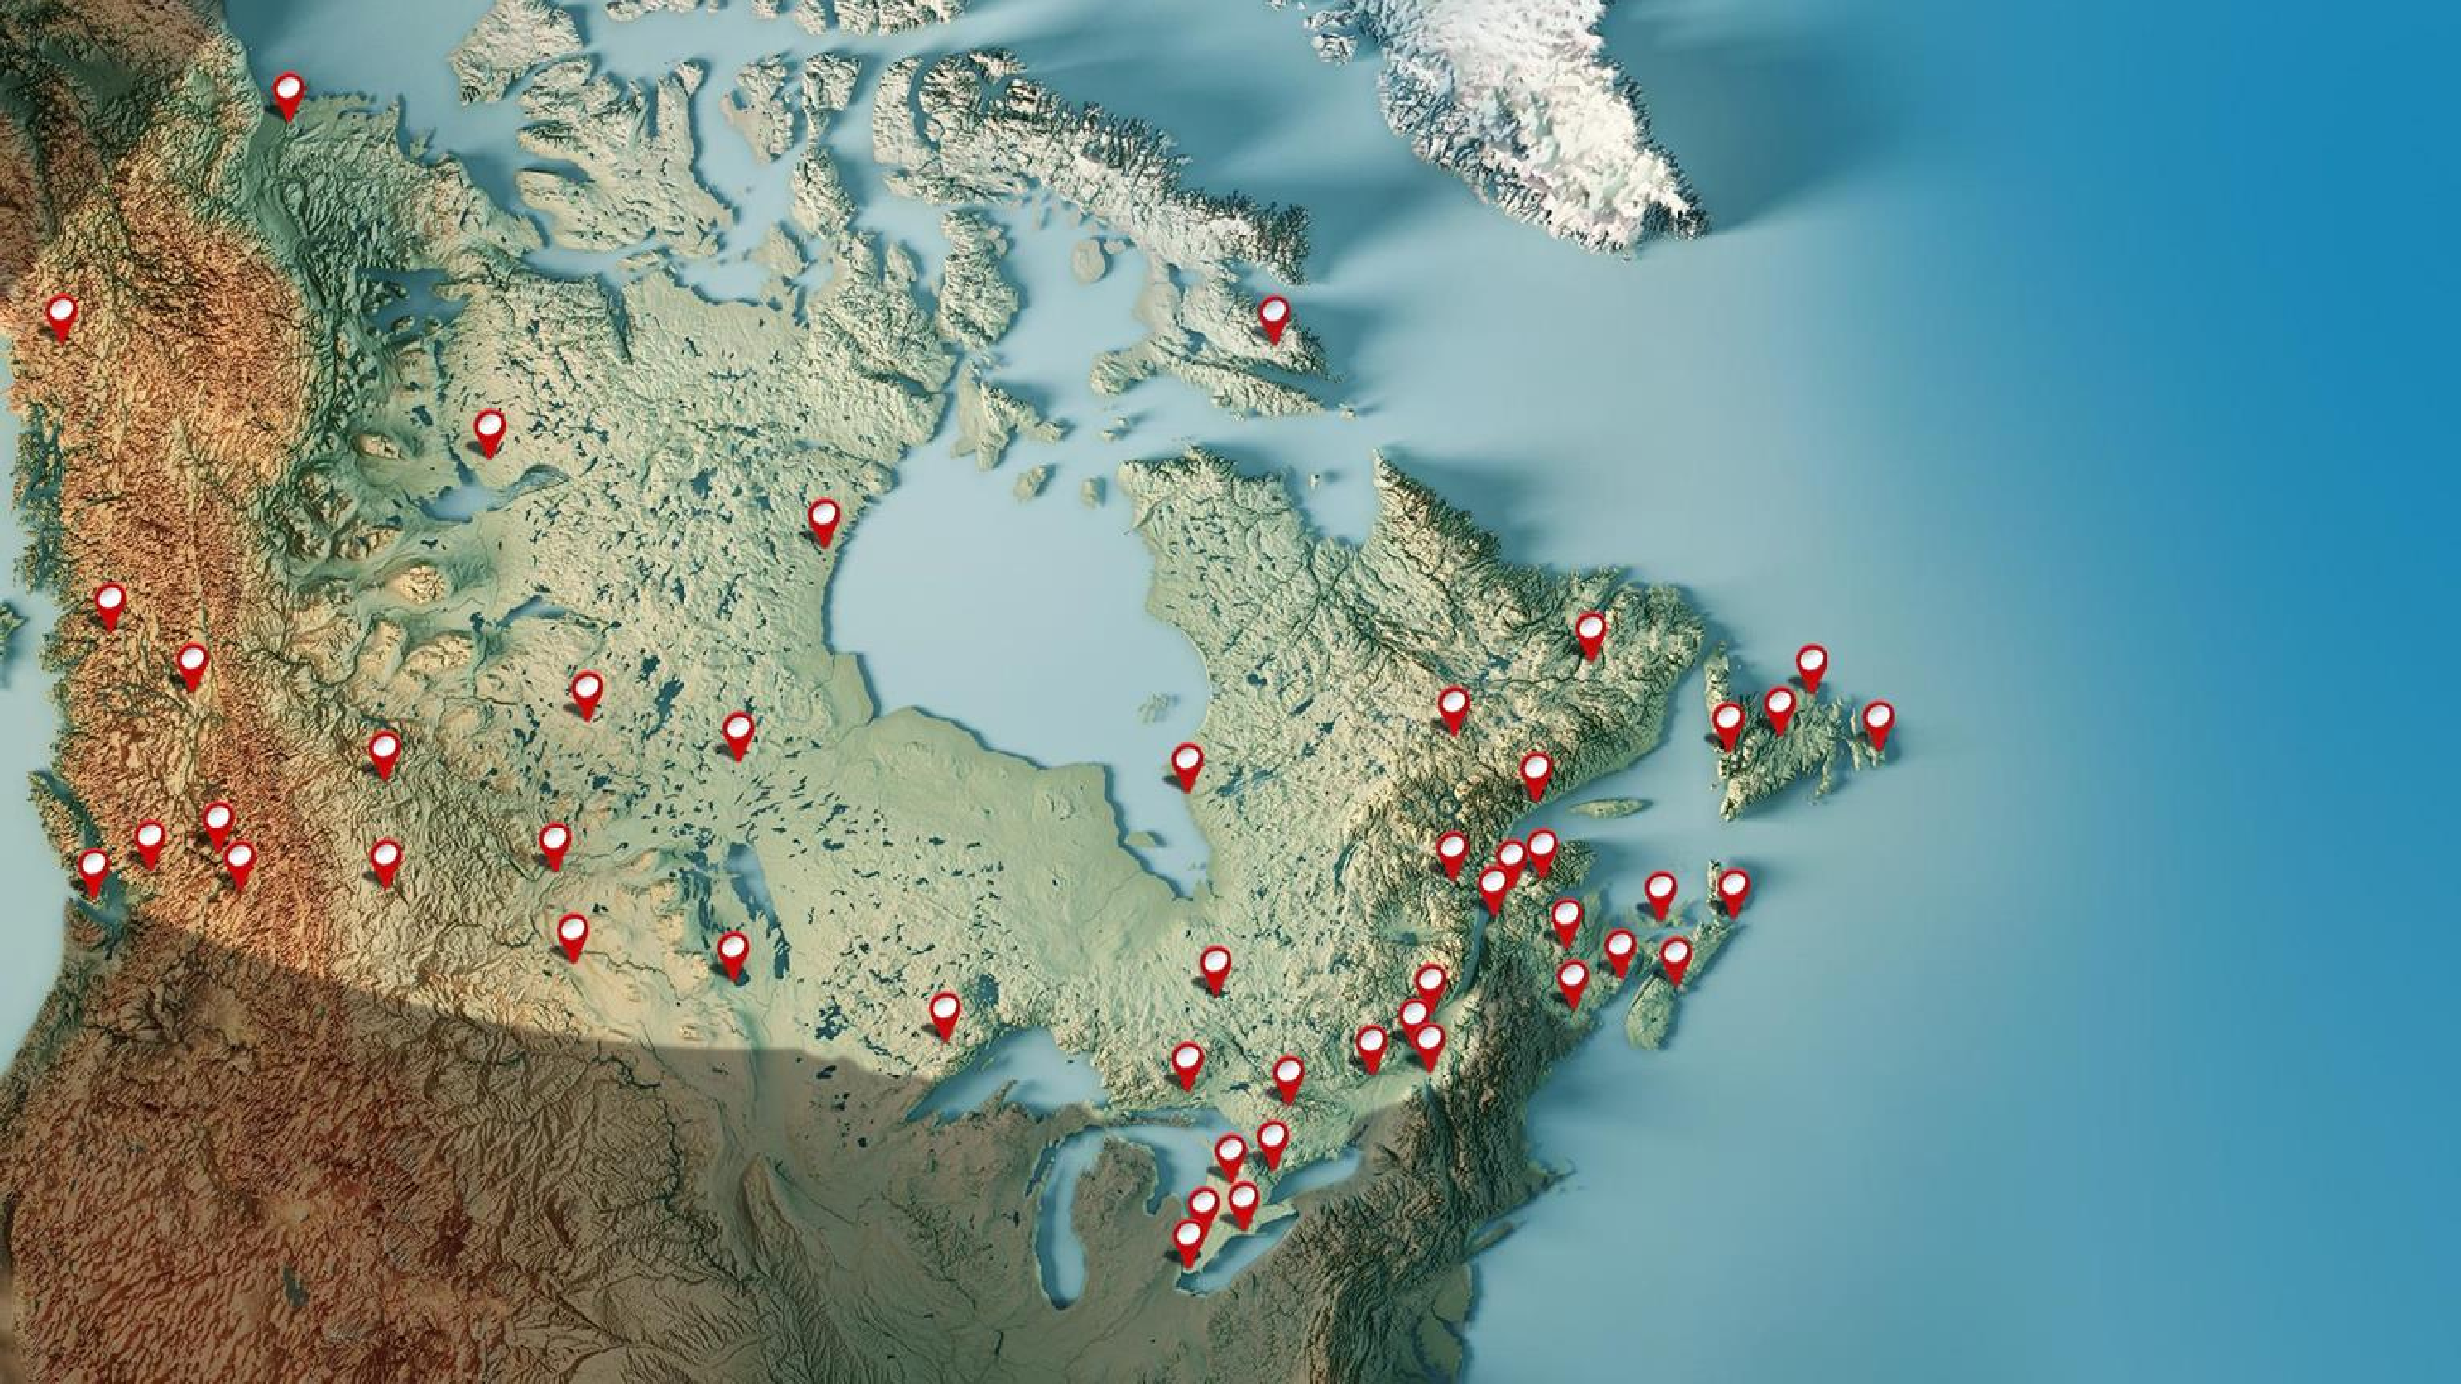

Canada's Unique Situation
Vast geography
6
time zones
Complex
and changing demographics
Bilingualism, Indigenous languages and high proportion
of new immigrants
CBC/Radio-Canada reaching all Canadians – affordable, accessible.
U.S. cultural influence
This map shows the locations of our CRTC-licensed and affiliated radio and television stations across Canada, as well as our designated digital station.
3

Slide 4


Slide 5
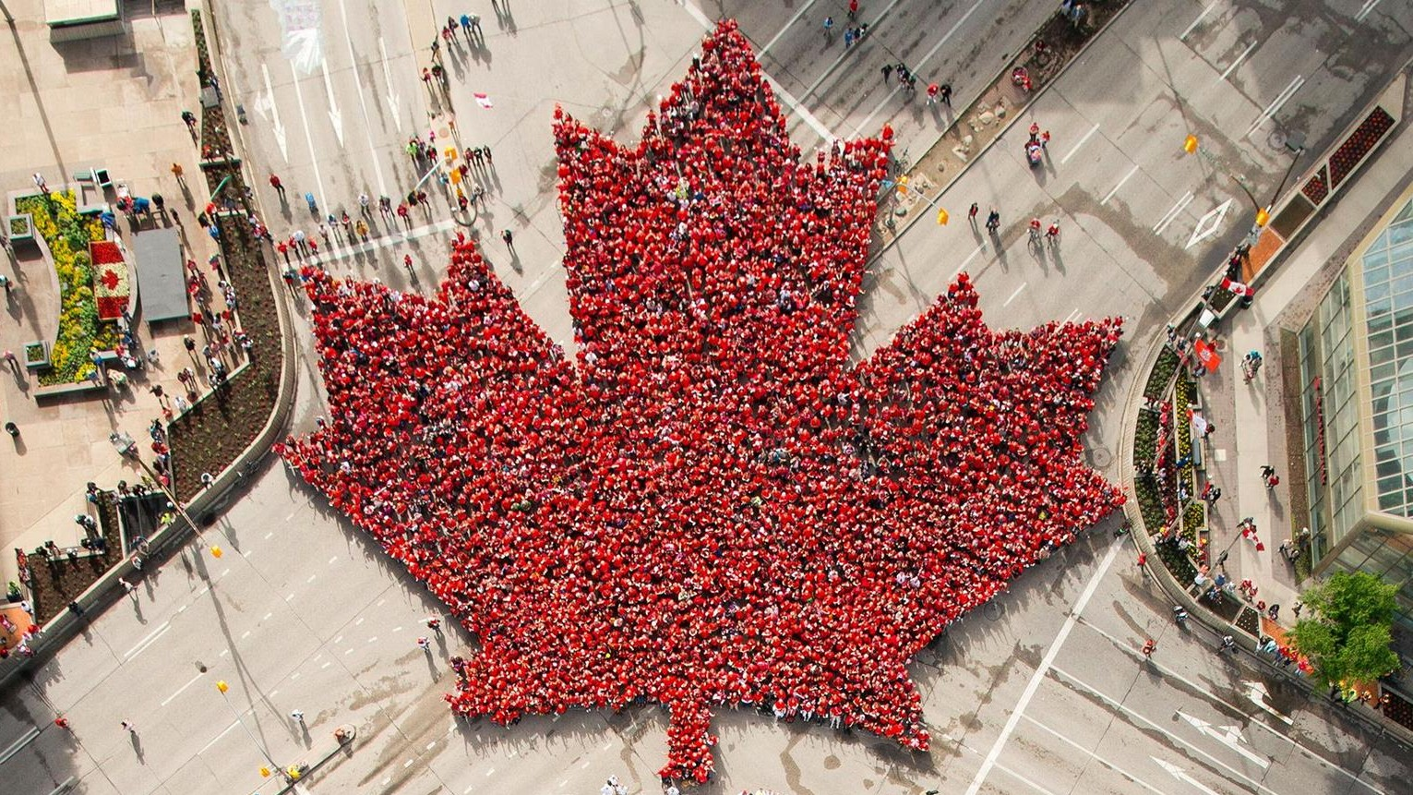
5

Slide 6

The Economic Impact
The public broadcaster is a vital part of a $54.6B industry¹
MUSIC INDUSTRY
$561M²
FILM AND TV
INDUSTRY
$7B³
NEWS MEDIA INDUSTRY
$13.6B⁴
NUMBER OF PEOPLE EMPLOYED
630,000⁵
Every $1 invested in = $3 In economic activity⁶
¹ Creative Canada policy framework, 2017, p.7 ² Creative Canada policy framework, 2017, p.8 ³ Ibid
⁴ News Media Canada: 2017 Net Advertising Volumes Canada Report
⁵ Creative Canada policy framework, 2017, p.8
⁶ Deloitte: Economic impact of CBC/Radio-Canada in 2013

Slide 7

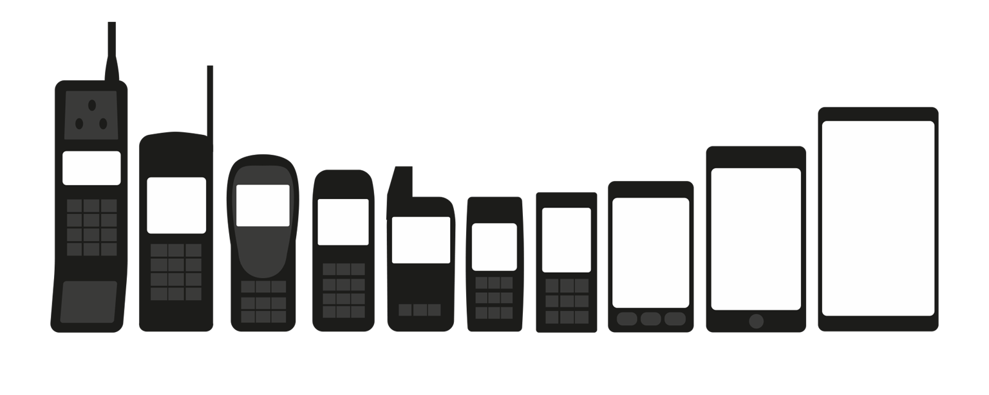
#1: Mobile (my life in phones)
1990
2019

Slide 8






Top 5 Activities on Mobile Phones
95%
Made a phone call
82%
Texted or instant messaged
80%
Checked the weather
79%
Sent or received email
74%
Social Networking

Slide 9

Mobile at CBC/Radio-Canada

Slide 10

#2: Proliferation of Social Media

Slide 11

Social Media Disruption

Slide 12
#3: The Global Digital Giants

Slide 13
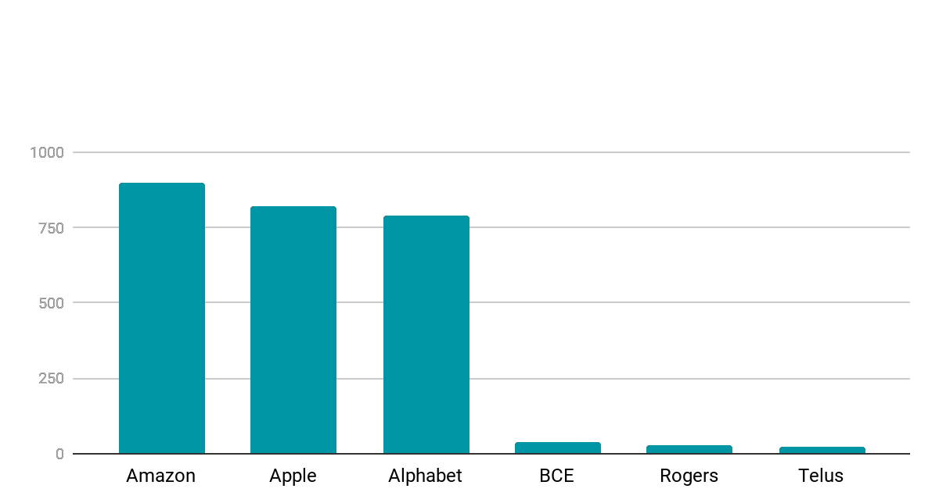
Even our media giants are minnows
Market caps as of Monday, May 27:
$897B
$823B
$788B
Billions (all US$)
$40B
$27B
$22B
(Google)

Slide 14
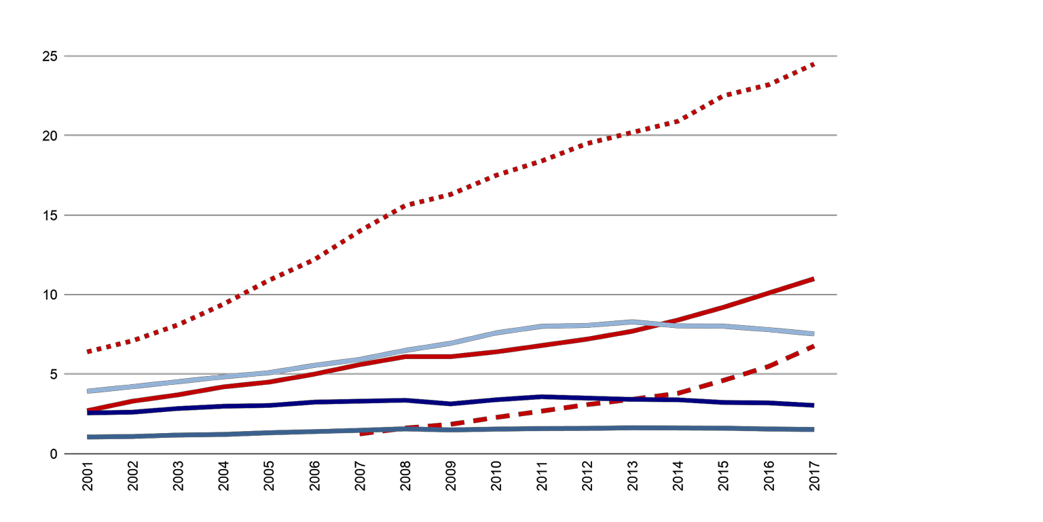
Impact on business models and the shift in dollars
Wireless Subscription
Billions $
Internet Subscription
TV Subscription Internet Advertising
Total TV Advertising Radio Advertising

Slide 15


CBC/Radio-Canada new 3 year strategy

Slide 16






Five Strategic Priorities
Customized digital services
Engaging with young audiences Prioritizing our local connections Reflecting contemporary Canada
Taking Canada to the world

Slide 17



