Slide 1

ESG Integration and Role of the CFO
FEI Canada Conference 2018

Slide 2

What is Responsible Investing?
Considering environmental, social, and governance (ESG) factors when selecting and managing investments
Responsible investing also includes contributing to initiatives that enhance the stability and integrity of global capital markets
Notes:
BCI’s definition – consists of two parts:
By considering ESG factors when selecting and managing investments – it allows BCI to manage long-term investment risk with the view of protecting and enhancing the financial value of the investments
It also includes our advocacy work and initiatives to ensure that the stability and integrity of the global capital markets
Definition is informed by our mandate of creating long-term client wealth and protecting the value of our clients’ funds

Slide 3
Why Does Responsible Investing Matter?
Long-Term Investment Time Horizon
Our primary mandate is to create long-term client wealth and protect the value of our clients’ funds.
The long-term investment horizon means that managing investment risk and opportunity that evolves over the longer term is an integral part of our responsibility.
Provides holistic Perspective
The combination of fundamental analysis and engagement with an evaluation of ESG factors provides a holistic understanding of risk, opportunities and value across the portfolio.
Stems from BCI Investment Beliefs
Companies that employ robust environmental, social and governance (ESG) practices are better positioned to generate long-term value than similar companies with less favorable practices
When investors take ESG matters into account, they can better understand, manage and mitigate risks associated with long-term investments
Notes:
Within the context of our mandate, we understand the importance of returns and the role returns play in ensuring that the pension plans can meet your long-term obligations
Our investment strategy and approach is also aligned with the Plans’ long-term investment horizons
Combination of returns and the long-term investment horizon means that managing investment risk - especially risks that may appear and evolve over the longer term and potentially affect cash flows – is an integral part of our responsibility
Responsible investing is one of our investment beliefs

Slide 4
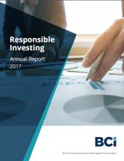
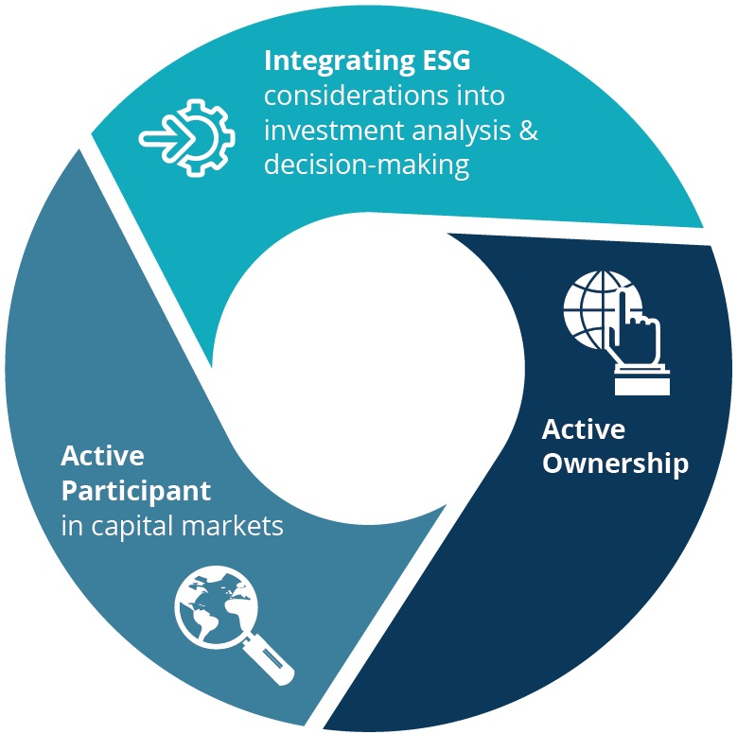
Our Approach
Responsible
Investing Report

Slide 5



The Role of the CFO
Investor relations
External reporting
Budget & strategy
CFOs are likely to field more questions from investors as ESG momentum continues to grow.
ESG reporting is trending towards a more integrated approach while assurance of this data is also increasing.
CFOs have influence over strategy and budgets and can encourage long term thinking.

Slide 6

Thank you
BRITISH COLUMBIA INVESTMENT MANAGEMENT CORPORATION
750 Pandora Ave, Victoria BC V8W 0E4 CANADA / BCI.ca
BCI is the investment agent for many institutional clients; the views and opinions expressed in this presentation are those of BCI and do not necessarily represent the views of its clients. The information in this presentation is provided as of the date hereof. Neither the delivery of the presentation nor any further discussions in relation to BCI will under any circumstances create any implication that there has been no change in the affairs of BCI since the date of this presentation. All rights reserved. Contents copyright © BCI 2018.
Images/Photographs provided by: BCI, ACME Corporation and Shutterstock.com

