Slide 1
Relevance of
Financial Reporting
FEI Conference
June 14, 2018
Draft Framework for
Reporting Performance Measures

Slide 2
Quality of performance measures matters
Source: Deloitte perspectives on corporate reporting, presentation, May 23, 2018
2

Slide 3
How it started
Launching
The Framework
Today!
RISE OF Non-GAAP METRICS
Veritas Investment Research
THE NUMBERS GAME
Globe & Mail
September 23
Audited Financial Information: Is it Losing Relevance? AASB & CPAB
2016
2017
2018
AcSB User Advisory Council: Discussions in April & June
AcSB Strategy Session: Presentation by Senior Leaders
AcSB takes action

Slide 4
Performance measures
For profit and not-for-profit entities
  Enhance the relevance of information users rely on to make resource allocation decisions
    First step
  We each have a role to play
  AcSB is leading a new initiative
    Get involved
Users
Directors
Assurance Providers
Preparers
4

Slide 5
Encourage best practices
Performance Measures
Develop a framework
Transparency
Consistency
Expectation Gap
Comparability
Management Compensation
5

Slide 6
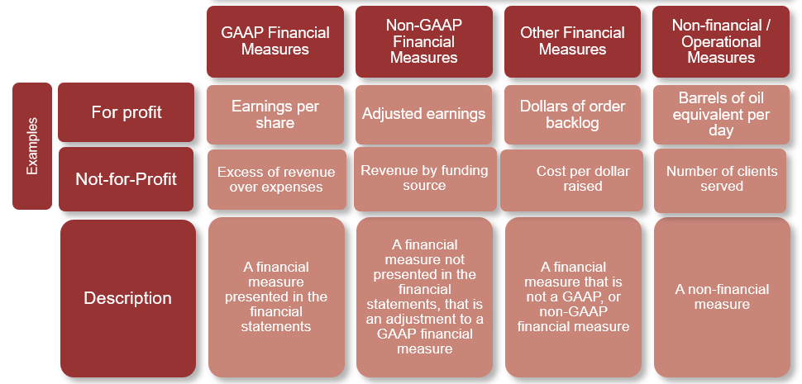
Types of performance measures
6

Slide 7
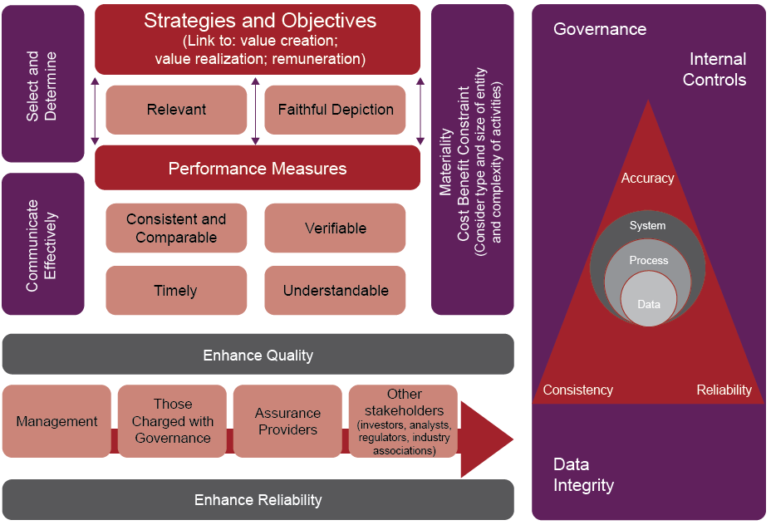
Framework: Key elements
7

Slide 8
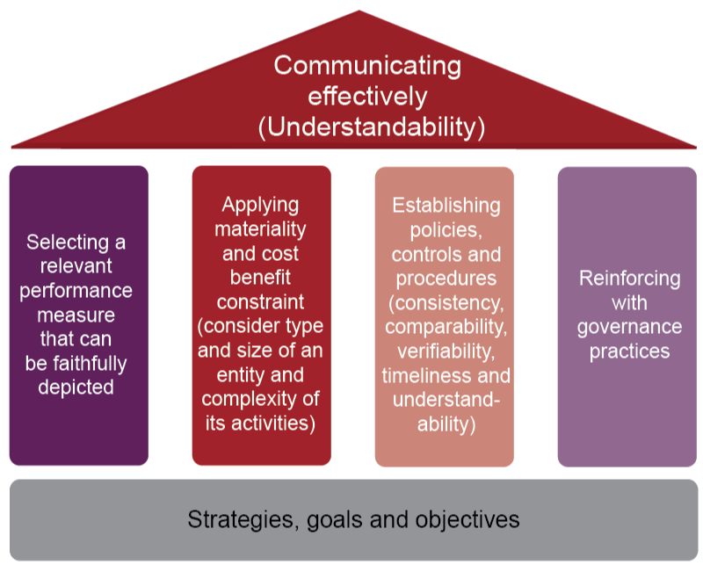
Developing and reporting performance measures
8

Slide 9

Upcoming next steps
Pick up your Draft Framework!
June to Sept – Consult
  Surveys and discussions
Mid-Dec – Publish revised
  Framework
Join the conversation
  Build the Framework
  Shape next steps (e.g. industry guidance)
9

Slide 10
For more information, visit www.frascanada.ca
Contact
Linda Mezon, FCPA, FCA
CPA (MI)
Chair, Accounting Standards Board
Phone: +1 (416) 204-3490
Email: lmezon@acsbcanada.ca

