Slide 1
The Agile CFO
Financial Executives International Canada
June 15th, 2018

Slide 2
Safe Harbor Statement

Slide 3
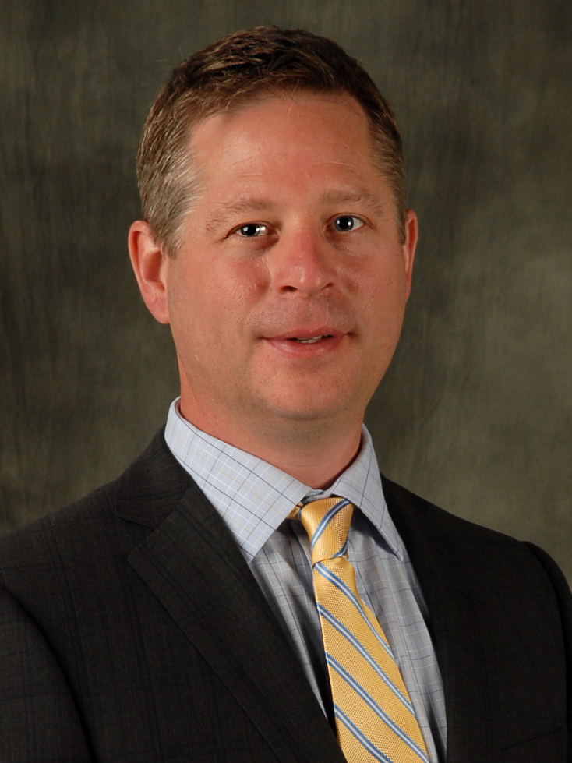
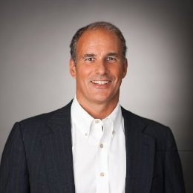

Introductions
Chris Prues
Chief Financial Officer,
Bruce Power
John Hugo
VP, Financials,
Workday and Former Controller at Life Time Fitness
Guy Williams
Canadian Financials Lead,
Workday

Slide 4
Q&A

Slide 5
Thank you!

