Slide 1

The Power of Perspective:
Embracing Disruption
Rosie MacLennan

Slide 2

Chase the dream.
Love the journey.

Slide 3


Slide 4


Slide 5


Slide 6


Slide 7
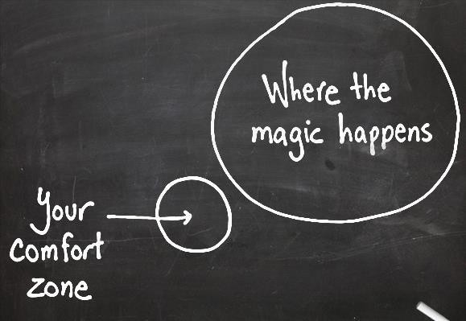

Slide 8
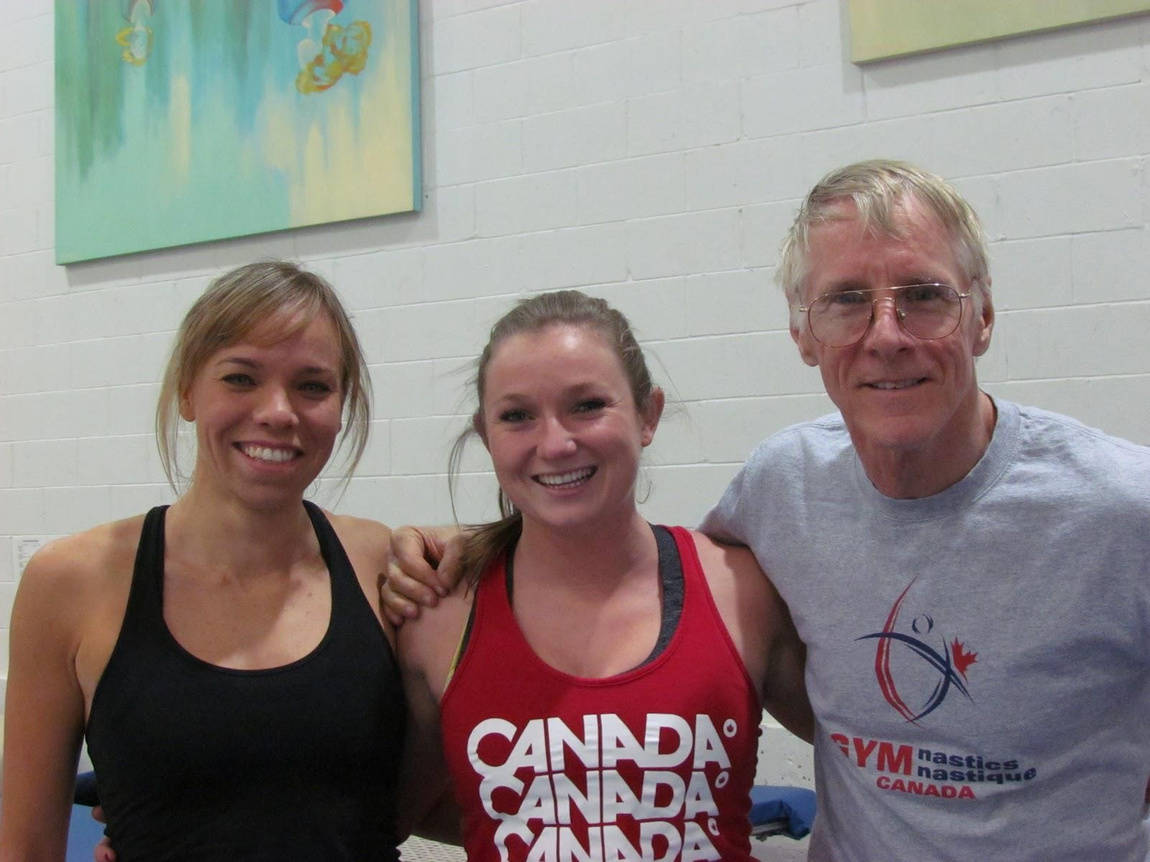

Slide 9
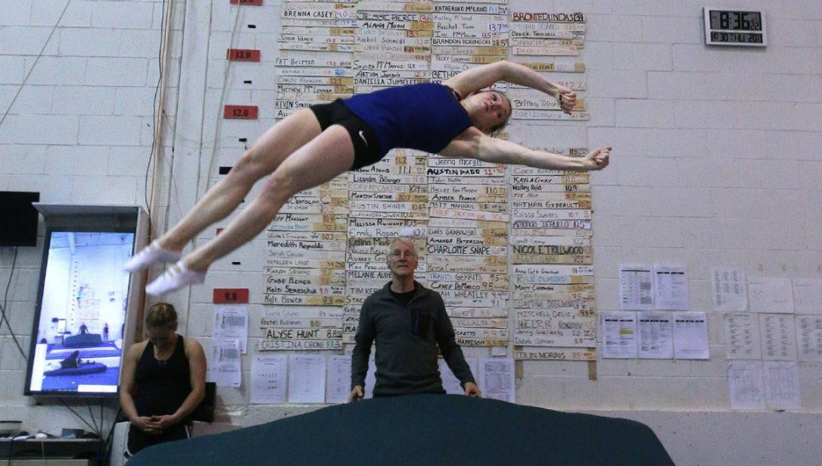

Slide 10


Slide 11

“Inspiration is for amateurs.
The rest of us just show up and get to work.”

Slide 12


Slide 13


Slide 14
The certainty of uncertainty

Slide 15
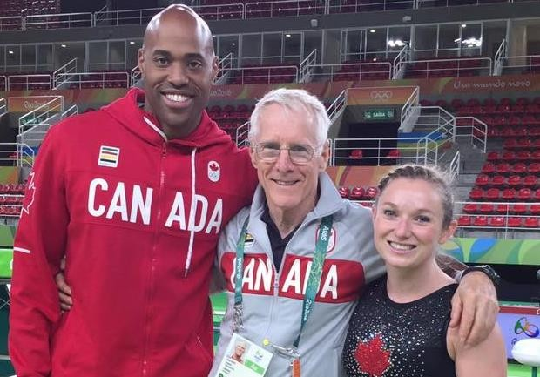
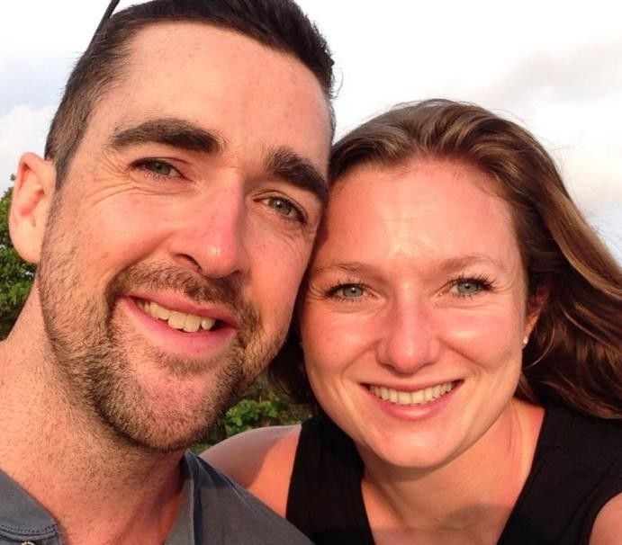

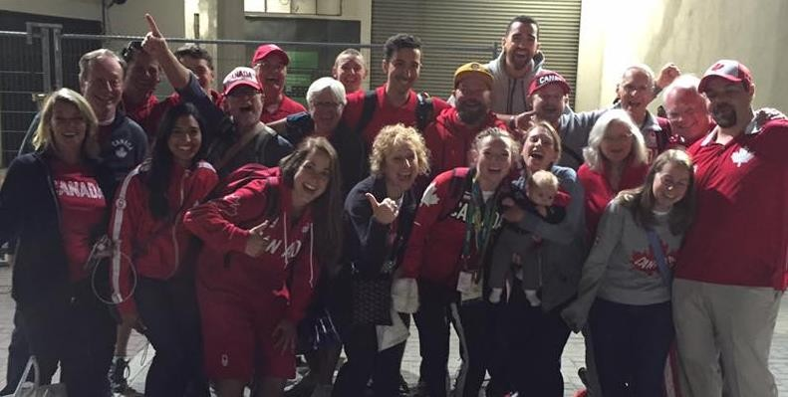


Slide 16
Things you can control:
Attitude
Behaviour
SQUEEZE EVERY DROP OUT OF WHAT YOU CAN CONTROL

Slide 17
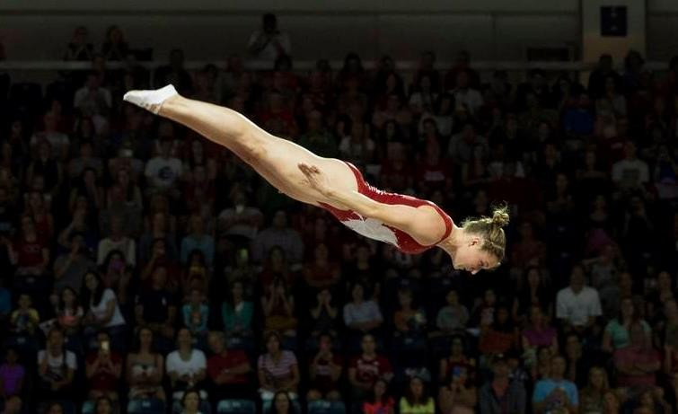

Slide 18
“I’m not afraid of heights, I’m afraid of losing”

Slide 19
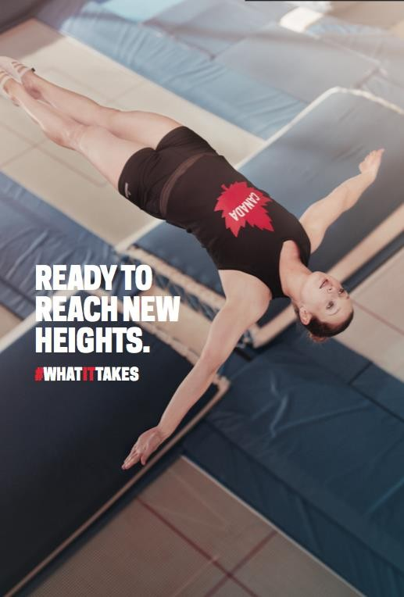

Slide 20
Two ways of living life:
Trying to avoid bad things
Trying to pursue good things

Slide 21


Slide 22
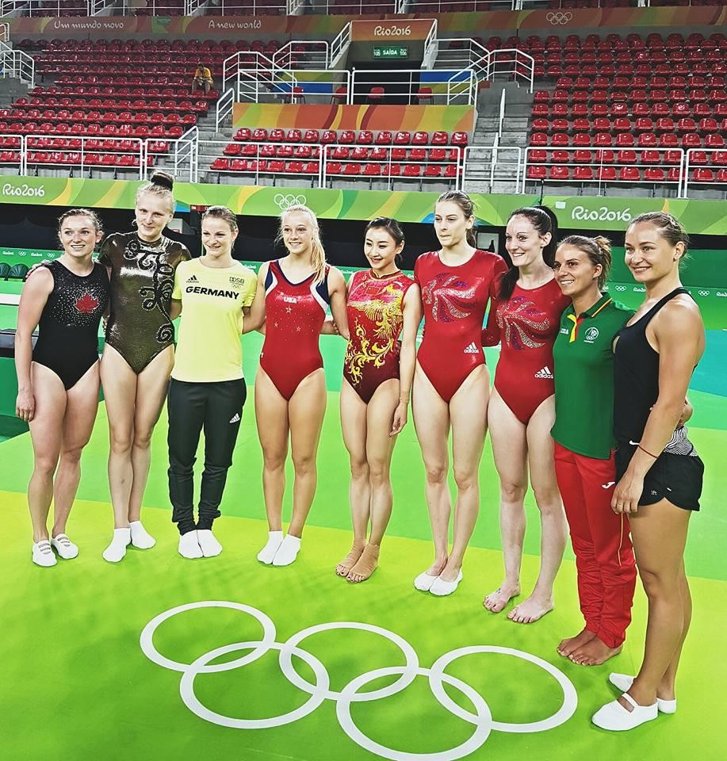

Slide 23


Slide 24


Slide 26


Slide 27

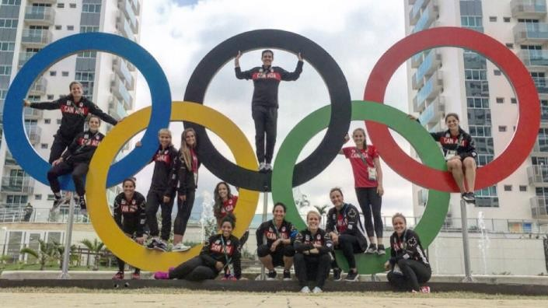



Embracing Disruption

Slide 29
Embracing Disruption

Slide 30

Thank you FEI!
To follow my journey: @rosiemaclennan

