Slide 1

Tail & maverick spend:
What you don’t know can hurt you

Slide 2

What is Tail Spend?
Tail spend is that spend for any firm, which is not actively managed in all the spend categories and may have an impact on the firm's financial performance due to its impact on SG&A and COGS. it contains a small portion of the spend (10–20% under each spend category) but large number of suppliers accounting for it.

Slide 3

“Automating B2B payments…can create an
interconnected, automated world that
provides financial prowess and
deep intelligence, turning B2B payments into
a strategic business process.”
—Andrew Bartolini, Ardent Partners “The State of B2B Payments 2015: Emerging Business Value”
This material contains information that is proprietary and confidential to American Express. It cannot be shared with third parties without
American Express’ written consent. AMERICAN EXPRESS PROPRIETARY & CONFIDENTIAL. DO NOT COPY. DO NOT DISTRIBUTE
3
Notes:
Automation of B2B payments is the key to turning a historically expensive and cumbersome process into a strategic business asset.
Taking it a step further, all B2B workflows present substantial opportunities for automation, including Procurement, Invoicing, and Accounting.
Can anyone tell me what the volume of commerce between companies is world wide?

Slide 4
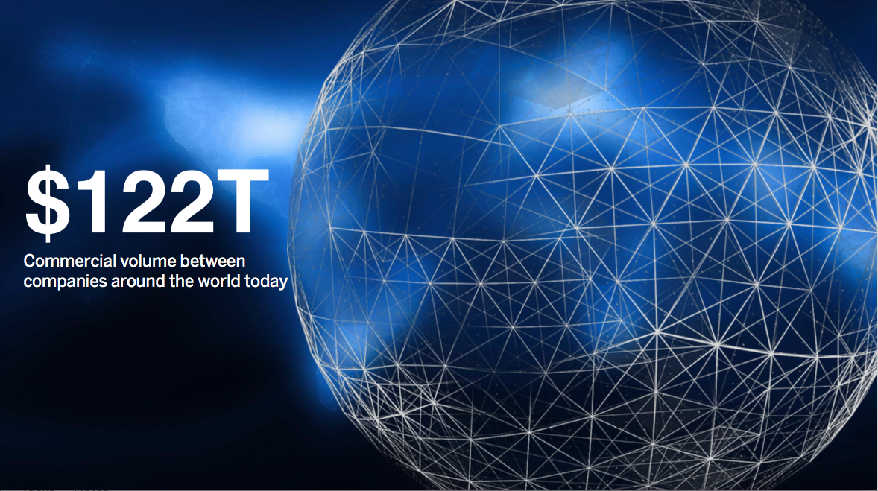
Source: McKinsey Global Payments Map 2014
This material contains information that is proprietary and confidential to American Express. It cannot be shared with third parties without
American Express’ written consent. AMERICAN EXPRESS PROPRIETARY & CONFIDENTIAL. DO NOT COPY. DO NOT DISTRIBUTE
4
Notes:
All transactions flowing between companies around the works – $122% (World’s Biggest Market)
Credit Cards (across all major providers) account for ~$1T of that.

Slide 5
B2b supplier payments
Direct
$
Indirect
~10s
100s
1,000s
Source: CAPS Research 2016
Notes:
The typical view of B2B spend is broken into Direct Spend and Indirect Spend.
Direct Spend
Includes payments made for the goods necessary to produce a company’s product or service (for example, BMW has to buy tires to put on its cars)
Typically tightly managed with few suppliers and a deep Treasury relationship with bank.
Difficult to break into.
Indirect Spend
Everything else a company needs to buy.
100s or 1,000s of suppliers and transactions.
Optimal space to capture spend for American Express.

Slide 6
Multiple sources of truth
SUPPLIER
BUYER
CRM
Procurement
Systems
Order to Cash (O2C)
A
B
C
D
Purchase
Process
Invoicing Systems (EIPP)
E
F
G
H
I
Invoice
Process
Factoring, Discounting
Credit Rating/Scoring
Supplier Directory
Vendor Master
Buyer’s Bank
Credit Line Financing
Buyer’s Bank
PAY
Payment
Process
SWIFT
Collections
Credit Cards
Supply Chain Financing
K
L
K
L
Supplier’s
Bank
PCI Compliance & Tokenization
Escrow Services
Notes:
Although the B2B process itself may seem simple, it’s actually very complex.
Many different systems and sources of truth involved.
Increasingly complex the large the company.

Slide 7

The b2b gap to solve
AP Automation
Procurement
ERP/Accounting
PURCHASE
PROCESS
INVOICE PROCESS
NOT INTEGRATED
Payments
Financing
Currencies
Cash Flow
Management
Notes:
Most companies have put significant investment into integrating the Traditional Supply Chain “Purchase processes & Invoice processes”.
The Financial Supply chain is still not integrated though.
E.g. Although goods can be ordered and invoices can be processed electronically, the AP department is still writing checks or dealing with disconnected bank portals.
This causes the data from the Financial Supply Chain and Traditional Supply chain to be disconnected, leading to challenges getting visibility or control of spend.

Slide 8

THE IMPACT TO BUYERS/SUPPLIERS
visibility
costs
delays
control
CFOs report poor
VISIBILITY into
payments
60%+
30%
78%
payments are
handled manually
due to mismatches
B2B invoices are paid
AFTER the due period
companies cannot
forecast CASH FLOW
accurately
Source: Hackett Group 2015
This material contains information that is proprietary and confidential to American Express. It cannot be shared with third parties without
American Express’ written consent. AMERICAN EXPRESS PROPRIETARY & CONFIDENTIAL. DO NOT COPY. DO NOT DISTRIBUTE
8
Notes:
Speaker Notes:
You may THINK you have the ultimate control with your current process, but you really don’t…
Ever have someone cash a check months after you wrote it? Then you know how painful it can be to manage cash for a complex business that relies on traditional payment methods.
Source:
http://ardentpartners.com/Reports/ArdentPartners-TheStateofB2BPayments2015.pdf
Andrew Bartolini, Ardent Partners “The State of B2B Payments 2015: Emerging Business Value” 2015 Page 5 “While paper checks have a variable “float” from the time it takes for a supplier to receive and deposit a mailed check, ePayments allow for precise scheduling of the payment. This creates financial agility that is difficult to achieve with manual payment methods. When payments can be scheduled so accurately, enterprises can make more subtle choices in deciding which suppliers should be paid when.”

Slide 9
Anatomy of indirect spend
35%
Strategic Sourcing Spend
65%
28%
Spot Buying
37%
Maverick/Rogue
Spend
$
Strategic
Sourcing Spend
Spot Buying
~10s
100s
1,000s
Number of Suppliers
Source: Hackett Group
Notes:
Diving deeper into the “Indirect Spend” that is the biggest area of opportunity for American Express.
About 35% of that spend is “Strategically Sourced”, meaning that the Procurement department and processes have visibility and control of it.
Another 28% is one-time, small dollar purchases that Procurement does not have control of (and does not typically want to given the amount and volume).
Another 37% is accounted for by employees making direct purchases directly with vendors outside of any established system (Maverick/Rogue Spend)

Slide 10
A 65% opportunity
Spot Buy
Unclassified / Misclassified
Off-contract, non-PO
Low Value
Non-Compliant
Fragmented
Notes:
This means that 65% of company’s indirect spend falls into unmanaged or difficult to manage spend.
Beyond the impacts on cost, visibility, and efficiency, this spend opens the risk for non-compliant purchases with legal and regulatory risks.

Slide 11
Lots of ideas
Consolidate
Suppliers
Build a
Buying
Desk
Leverage Your
Purchasing
Card Program
Outsource
Buying
Create Tail
Spend
Analytics
Forced
Employee
Compliance
Notes:
The challenges or Tail Spend and Maverick Spend are not new, and many ideas have been discussed to address this.

Slide 12
It’s Not so simple…
Consolidate
Suppliers
Build a
Buying
Desk
Leverage Your
Purchasing
Card Program
Outsource
Buying
Create Tail
Spend
Analytics
Forced
Employee
Compliance
Too Many Categories
Limited Data
Too Much Effort
Multiple Systems
Disconnected Payments
Notes:
The challenge is that these ideas are Band-Aids - there are still fundamental issues in the process.

Slide 13
connecting the dots
It’s Not so simple…
Spot Buy
Off-Contract, Non-PO
Unclassified / Misclassified
Low Value
Fragmented
Non-Compliant
PURCHASE
PROCESS
INVOICE PROCESS
PAYMENT
PROCESS
Platform
Too Many Categories
Expanded Catalogs
Limited Data
Enhanced Data
Too Much Effort
Minimal Effort
Multiple Systems
Consolidated Systems
Disconnected Payments
Integrated Payments
Notes:
The future opportunity is to truly connect the dots – the platforms that support Purchasing, Invoicing, and Payments.
American Express is uniquely positioned to connect our Payment capabilities with the Purchase and Invoicing processes and products that customers are already using.

Slide 14
From products
Purchasing
Card
Buyer Initiated
Payments
Corporate Account
Reconciliation
vPayment
ACH/EFT
Underwriting
Fraud & Risk Management
Merchant Financing
Checks
AML/KYC
On-Card Lending
Card Processing
Transaction Data
Wires
Servicing
Banking & Compliance
Predictive Analytics
Foreign Exchange
Supply Chain
Solutions
Notes:
Underneath the products that we have in market today are a wealth of underlying payment, data, service, and financing assets.
To connect these capabilities into customers’ B2B workflows, we need to move beyond a “Product” mentality.

Slide 15

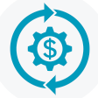
To platform
& ecosystem
AP Automation
Procurement
ERP/Accounting
PAYMENTS
WORKING CAPITAL
INSIGHTS
COMMERCIAL PAYMENTS GATEWAY
ACH/EFT
Underwriting
Fraud & Risk Management
Merchant Financing
Checks
AML/KYC
On-Card Lending
Card Processing
Transaction Data
Wires
Servicing
Banking & Compliance
Predictive Analytics
Foreign Exchange
Supply Chain
Solutions
Notes:
Instead, we need to take those capabilities and expose them through a ”Platform”.
That Platform can then be integrated into the tools and workflows that customers are already using – whether it’s an AP Automation System, Procurement System, or Accounting System.

Slide 16
PROGRESS
Global
Partners
Engaged
Multiple
B2B
Platform
Deployments
Digital
Platform
Tail &
Maverick
Spend Solutions
Notes:
This is not a future vision, we’re already doing this.
We have a fully Digital Platform built that enables partners to connect and integrate our company’s capabilities.
We have some of the largest AP Automation, Procurement, Accounting, and B2B Marketplace partners engaged and excited about integrating our payment capabilities.
We already have our platform deployed in the market with select partners.
Many of the partnerships are specifically focused on addressing Tail & Maverick Spend Solutions (e.g. Ariba Spot Buy).
To learn more about how Procurement organizations are leveraging best practices and American Express’ unique assets to solve Tail Spend and Maverick Spend I’ll turn it over to one of our largest clients – American Express Global Supply Management.

Slide 17






American Express Spend Analytics
Our unique Spend IQ analysis delivers customized, actionable insights for execution of your strategy.
Process method analysis
Understand your current mix of procurement and payment methods to assess progress in electronic payment migration
AP SPEND FILE
Invoice assessment
Identify opportunities to enhance process efficiencies.
Gain insight into your invoice frequency and invoice size to strike a balance between process efficiency and control
SUPPLIER SEGMENTATION
Leverage our proprietary process to target best-fit suppliers that can help you to realize hard dollar savings
Speed-of-Pay analysis
Develop a plan to manage working capital by leveraging our experience in cash management
actionable plan with insights
Notes:
How do we make it all happen?
What have found to be the most effective foundation on which to build this type of program is on a base of solid analytics. As discussed, when we met, this is generally a fee based service, the value or cost is typically $50-$60K. But we have approval to waive it for Graham Const. – so what it is… {talk from slide}

Slide 18
Opportunity Overview
Unlocking Financial Value from your Tail Spend
EFT
Wire
Dynamic
Discounting
Buyer Initiated Payments
Single-use vPayments
Corporate Card / Purchasing Card
#
Strategic Vendor Relationships (Early Pay Discounts)
$$$
Larger Non Strategic Vendor Relationships (Catalogue Spend & Invoices)
Txn Size ($)/ Control
$$
##
Non-Strategic Vendor Relationships (Tail Spend)
$
###
# of Vendor Relationships
Notes:
So how do we do this, well we work with companies to understand their entire payments ecosystem.
Partnering with American Express® will allow Graham Construction to drive incremental financial value from your supply chain while maintaining complete visibility and control over spend.
At the bottom is the opportunity to drive maximum rebate and convenience from traditional credit card spend. It the non strategic spend typically made up of small dollar expense for items like T&E, office supplies, and the like.
As you move up the triangle you move into a different subset or better said subsets of suppliers (the green section). This can be catalogue spend at the lower end and too big for card large invoice spend at the upper limit. Here it’s not one size fits all and Amex is uniquely positioned with our B2B solutions to help Graham develop a winning strategy and approach for every supplier. This is about complimenting existing process and systems, yet still bringing financial value.
Finally, is the top of the pyramid which is the trench of your most strategic vendors. These are suppliers where you likely have highly negotiated contacts with early pay discounts and the like. Ultimately, we have found that there are some suppliers deemed beyod program scope for one reason or another and often they are from this segment.

Slide 19
Impacts
Unsecured Capital
Incremental Revenue
Manage & Improve Working Capital
Process Improvement & Efficiencies
Notes:
Impacts!
In a more macro sense, we find that organizations continue to look for ways to drive incremental financial value and ultimately strengthen their balance sheet.
Through partnerships with Amex Bank of Canada, our large corporate customers are benefiting from:
UNSECURED CAPITAL - We act as an alternative funding source beyond traditional credit lines. We provide an unsecured credit line based on the strength of your financials and are considered a trade payable rather than long term debt on your financial statements
Managing and improving working capital. Cash flow certainty and liquidity to fortify the business for the long term. When done right it helps ensure an organization has the financial flexibility to execute on its growth strategy.
Incremental Revenue: apart from a positive working capital improvement, our customers have the ability to earn an financial incentive or additional early pay discounts on existing spend.
Processes improvements & efficiencies. Canada is 3rd only behind the USA and France as it relates to per capita cheques processed. So there is a real opportunity to reduce costs associated with cheque. Beyond hard dollar costs there is a treasury cost and even a cost to the lack of visibility. We have also found that companies who have begun adopting digitized processes… can face challenges so there are opps to optimize there as well.

Slide 20
Questions?

