Slide 1
Workplace – sneak preview of the future
FEI Canada Annual Conference
Halifax
2018
Controllers' Roundtable
Theme: Oceans of Innovation

Slide 2
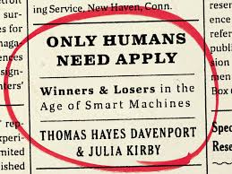
Future of hiring

Slide 3
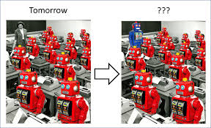
Future of workforce

Slide 4
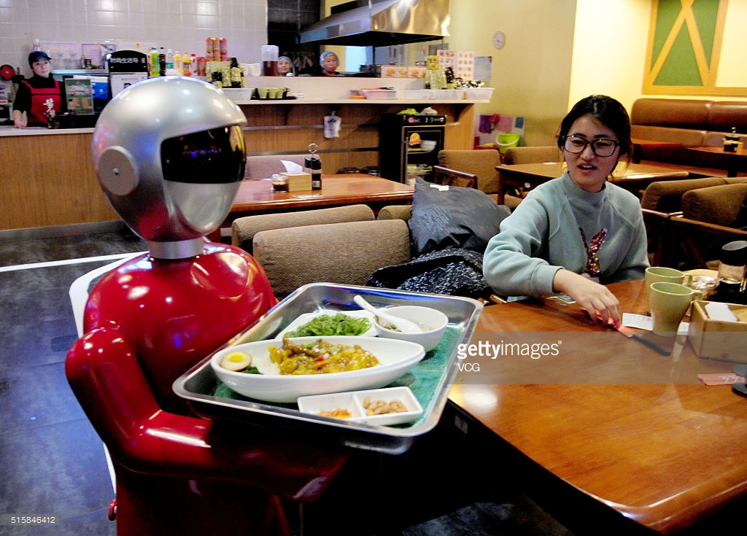
Future of OpenText cafeteria ☺

